Slide 2
Define important words in this chapter
diabetes
a condition in which the pancreas does not produce insulin or does not produce enough insulin; causes problems with circulation and can damage vital organs.
glands
organs that produce and secrete chemicals called hormones.
hormones
chemical substances produced by the body that control numerous body functions.
hyperglycemia
high blood glucose (blood sugar).

Slide 3
Define important words in this chapter
hyperthyroidism
a condition in which the thyroid gland produces too much thyroid hormone, which causes body processes to speed up and metabolism to increase.
hypoglycemia
low blood glucose (blood sugar); also known as insulin reaction or insulin shock.
hypothyroidism
a condition in which the body lacks thyroid hormone, which causes body processes to slow down.

Slide 4
Define important words in this chapter
prediabetes
a condition in which a person’s blood glucose levels are above normal but not high enough for a diagnosis of type 2 diabetes.
thyroid
a butterfly-shaped gland in the neck that is responsible for regulating metabolism and growth.

Slide 5
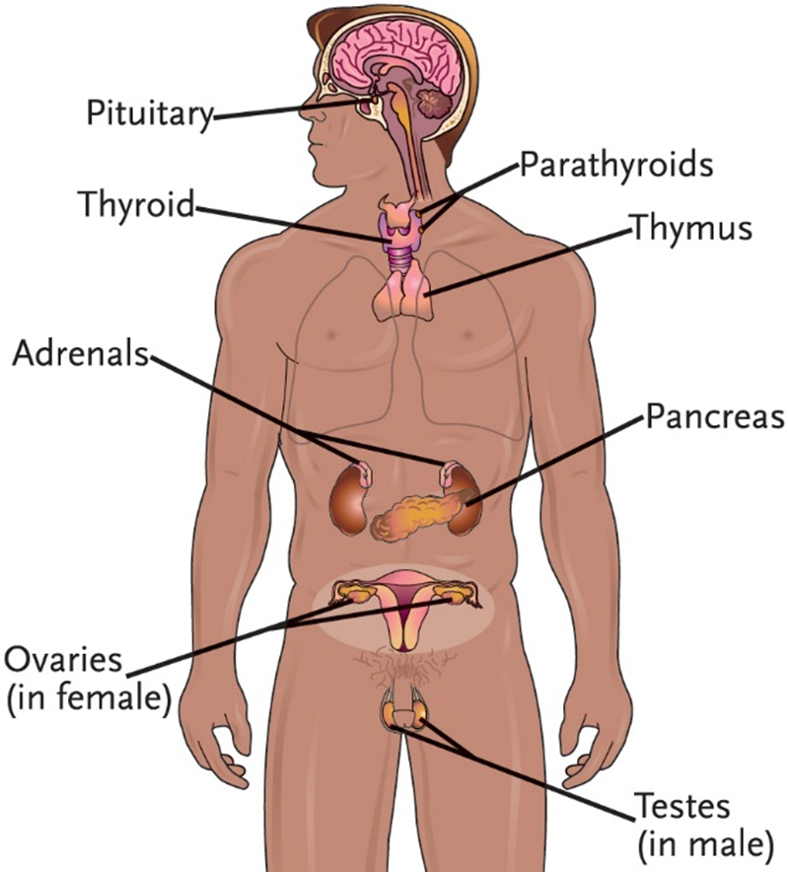
Key Material 23-1: The Endocrine System

Slide 6
Explain the structure and function of the endocrine system
Define the following terms:
glands
organs that produce and secrete chemicals called hormones.
hormones
chemical substances produced by the body that control numerous body functions.
thyroid
a butterfly-shaped gland in the neck that is responsible for regulating metabolism and growth.

Slide 7
Explain the structure and function of the endocrine system
Remember the following points about the endocrine system:
Glands secrete hormones, which are chemical substances that control numerous body functions.
Hormones are carried in the blood for delivery to target tissues or organs.
The pituitary gland controls the hormone production of other glands.
The pancreas produces the hormone insulin, which regulates the amount of glucose available to the cells for metabolism.

Slide 8
Explain the structure and function of the endocrine system
Know the functions of the endocrine system:
Maintains homeostasis through hormone secretion
Influences growth and development
Regulates levels of vitamin D, calcium, and phosphate in the body
Maintains blood sugar levels
Regulates the body’s ability to reproduce
Determines how quickly cells burn food for energy

Slide 9
Discuss changes in the endocrine system due to aging
Normal changes of aging in the endocrine system:
Levels of estrogen and progesterone decrease, which signal the onset of menopause in women.
Testosterone levels in males usually decrease, but production does not stop.
Insulin production decreases.
Body is less able to handle stress.

Slide 10
Discuss common disorders of the endocrine system
Define the following terms:
diabetes
a condition in which the pancreas does not produce insulin or does not produce enough insulin; causes problems with circulation and can damage vital organs.
hyperglycemia
high blood glucose (blood sugar).
hypoglycemia
low blood glucose (blood sugar); also known as insulin reaction or insulin shock.
prediabetes
a condition in which a person’s blood glucose levels are above normal but not high enough for a diagnosis of type 2 diabetes.

Slide 11
Discuss common disorders of the endocrine system
Remember these points about diabetes:
Condition in which the pancreas does not produce insulin or does not produce enough insulin
Risk factors: family history of the disease, advanced age, obesity
Complications caused by diabetes: hypoglycemia; DKA; problems with circulation; increased risk of heart attack; stroke, or impaired circulation of the legs; increased risk of infection and gangrene; diabetic retinopathy, damage to vital organs including the kidneys; diabetic peripheral neuropathy

Slide 12
Discuss common disorders of the endocrine system
Know these points about prediabetes:
Condition in which glucose levels are elevated, but not high enough to establish a diagnosis of diabetes
People with prediabetes may already have damage to the vital organs.
Change in diet can reduce weight and lower the risk of prediabetes or diabetes.

Slide 13
Discuss common disorders of the endocrine system
Remember these points about type 1 diabetes:
Usually diagnosed in children and young adults
Cause: pancreas does not produce any insulin
Condition will continue throughout person’s life
Treatment: daily injections, special diet, monitoring blood glucose level

Slide 14
Discuss common disorders of the endocrine system
Remember these points about type 2 diabetes:
Most common form of diabetes
Cause: body does not produce enough insulin or fails to properly use insulin
Treatment: monitoring blood glucose levels, diet, weight loss, medication, stopping smoking, exercise

Slide 15
Discuss common disorders of the endocrine system
Know the signs and symptoms of diabetes:
Excessive thirst
Excessive hunger
Excessive urination
High blood sugar levels
Glucose in the urine
Very dry skin

Slide 16
Discuss common disorders of the endocrine system
Signs and symptoms of diabetes (cont’d):
Fatigue
Blurred vision or visual changes
Slow-healing sores, cuts, or bruises
Tingling or numbness in the hands or feet
Unexplained weight loss
Increased number of infections

Slide 17
Discuss common disorders of the endocrine system
Define the following term:
hypothyroidism
a condition in which the body lacks thyroid hormone, which causes body processes to slow down.

Slide 18
Discuss common disorders of the endocrine system
Know these points about hypothyroidism:
Condition in which the body lacks thyroid hormone
Autoimmune disorder
Causes: Hashimoto’s thyroiditis, surgical removal of the thyroid gland, radioactive iodine therapy, thyroiditis
Symptoms: fatigue and weakness, weight gain, constipation, intolerance to cold, dry skin, thinning hair or hair loss, brittle hair or fingernails, slow heart rate, low blood pressure, abnormally low temperature, goiter, hoarseness, heavier menstrual periods, absent menses, depression
Treatment: thyroid replacement therapy

Slide 19
Discuss common disorders of the endocrine system
Define the following term:
hyperthyroidism
a condition in which the thyroid gland produces too much thyroid hormone, which causes body processes to speed up and metabolism to increase.

Slide 20
Discuss common disorders of the endocrine system
Know these points about hyperthyroidism:
Condition in which thyroid gland produces too much thyroid hormone
Primary cause: Grave’s disease
Symptoms: nervousness, restlessness, fatigue, visual problems or eye irritation, bulging or protruding eyes (exophthalmos), trembling, intolerance to heat, excessive perspiration, rapid heartbeat, high blood pressure, increase in appetite, weight loss, changes in bowel movements, irregular or absent menses, goiter
Treatment: anti-thyroid drugs, beta-blockers, radioactive iodine, surgery

Slide 21
Discuss common disorders of the endocrine system
REMEMBER:
Obesity increases the risk for certain endocrine system diseases or disorders, including type 2 diabetes and insulin resistance.

Slide 22
Describe care guidelines for diabetes
REMEMBER:
Care of the person with diabetes includes a plan of care associated with every system in the body. Diabetes must be carefully controlled to prevent complications and serious illness. Nursing assistants must follow the care plan closely.

Slide 23
Describe care guidelines for diabetes
Know these care guidelines for diabetes:
Give frequent skin care.
Observe the feet carefully for breaks in the skin.
Encourage residents to follow their exercise plans.
Report complaints of pain, numbness, or tingling in the arms or legs.
Perform foot care carefully.
Encourage proper footwear.

Slide 24
Describe care guidelines for diabetes
Care guidelines for diabetes (cont’d):
Carefully follow diet instructions.
People with diabetes can work with a registered dietitian (RDT) or a certified diabetes educator (CDE).
Keep track of residents’ tests.
Perform blood glucose tests only as directed and if trained.
Report if resident does not follow care plan.

Slide 25
Describe care guidelines for diabetes
Care guidelines for diabetes (cont’d):
Report any of the following: signs of skin breakdown; visual changes; changes in appetite or increased thirst; fruity or sweet-smelling breath; weight change; nausea or vomiting; change in urine output; any signs of urinary tract infection; fruity or sweet-smelling urine; changes in mobility; numbness or tingling in the arms or legs; nervousness or anxiety; dizziness or loss of coordination; or irritability or confusion

Slide 26
Discuss foot care guidelines for diabetes
REMEMBER:
Quality foot care is vital for people with diabetes. Diabetes weakens the immune system, which reduces resistance to infections. Poor circulation due to the narrowing of the blood vessels also increases the risk of infection. When foot infections are not caught early, they can take months to heal. If wounds do not heal, amputation of a toe, an entire foot, or a leg may be necessary.

Slide 27
Discuss foot care guidelines for diabetes
REMEMBER:
Foot care to prevent infection should be a part of daily care of residents. Keeping the feet clean and dry is a way to help prevent complications. It is important to observe the feet carefully during care.

Slide 28
Discuss foot care guidelines for diabetes
Remember these guidelines for safe diabetic foot care:
Inspect and clean the feet each day.
Avoid harsh soaps and hot water.
Always dry feet carefully.
Never cut toenails, corns, or calluses.
Do not use objects to remove dirt from toenails.
Use doctor-recommended cream or lotion on feet, but not between the toes.

Slide 29
Discuss foot care guidelines for diabetes
Guidelines for safe diabetic foot care (cont’d):
Check shoes for rocks or other objects.
Remind resident not to go barefoot.
Report the following: painful, tender, soft, or fragile areas, or burning in the feet; rashes or bruises; change in color of the skin or nails, especially reddening or blackening; change in the temperature of the skin; excessive dryness of the skin of the feet; breaks or tears in the skin; drainage or bleeding on the feet or toes; corns, blisters, calluses, or warts; or ingrown toenails.

Slide 30
Providing foot care for a resident with diabetes
Equipment: basin, disposable absorbent pad, mild soap, lotion, gloves, 2 washcloths, 2 towels, water thermometer, clean socks, shoes or slippers
Identify yourself by name. Identify the resident. Greet the resident by name.
Wash your hands.
Explain procedure to resident. Speak clearly, slowly, and directly. Maintain face-to-face contact whenever possible.
Provide for the resident’s privacy with a curtain, screen, or door.
If the resident is in bed, adjust bed to its lowest position. Lock bed wheels.
Fill the basin halfway with warm water. Test water temperature with a thermometer or against the inside of your wrist. Water temperature should be no higher than 105°F. Have the resident check water temperature. Adjust if necessary.

Slide 31
Providing foot care for a resident with diabetes
Place the basin on a disposable absorbent pad (protective barrier) on the floor, at a comfortable position for the resident. If the resident cannot sit up on the side of the bed to do this, place the basin on the pad at the foot of the bed. Support the foot and ankle throughout the procedure.
Put on gloves.
Remove resident’s socks. Completely submerge resident’s feet in water. Soak the feet for 15 to 20 minutes.

Slide 32
Providing foot care for a resident with diabetes
Put soap on a wet washcloth. Remove one foot from the water. Wash entire foot gently, including between the toes and around the nail beds.
Rinse entire foot, including between the toes.
With a clean, dry towel or washcloth, pat the foot dry gently, including between the toes.
Repeat steps 10 through 12 for the other foot.
Put lotion in one hand. Warm the lotion by rubbing hands together.

Slide 33
Providing foot care for a resident with diabetes
Starting at the toes and working up to the ankles, gently rub lotion into the feet with circular strokes. Do not put lotion between the toes. Remove excess lotion (if any) with a towel or washcloth. Make sure lotion has been absorbed and feet are completely dry.
Observe the feet, ankles, and legs carefully, checking for things like dry skin, skin tears, red areas, corns, blisters, calluses, warts, rashes, or bruises.
Help the resident put on clean socks and shoes or slippers.
Empty, rinse, and dry basin. Place basin in the designated dirty supply area or return to storage, depending on facility policy.
Place soiled linen in the proper container.
Remove and discard gloves properly. Wash your hands.
Make resident comfortable.
Remove privacy measures.

Slide 34
Providing foot care for a resident with diabetes
Leave call light within the resident’s reach.
Wash your hands.
Be courteous and respectful at all times.
Report any changes in the resident to the nurse. Document procedure using facility guidelines.

