Slide 2
Define important words in this chapter
abdominal thrusts
a method of attempting to remove an object from the airway of someone who is choking.
cardiac arrest
sudden stopping/cessation of the heartbeat.
code team
group of people chosen for a particular shift to respond to resident emergencies.
conscious
having awareness of surroundings, sensations, and thoughts.

Slide 3
Define important words in this chapter
CPR
an abbreviation for cardiopulmonary resuscitation; medical procedures used when a person’s heart and lungs have stopped working.
diabetic ketoacidosis (DKA)
a life-threatening complication of diabetes that can result from undiagnosed diabetes, infection, not enough insulin, hyperglycemia (high blood sugar), eating too much, not getting enough exercise, and stress.
emesis
the act of vomiting, or ejecting stomach contents through the mouth and/or nose.
epistaxis
a nosebleed.

Slide 4
Define important words in this chapter
expressive aphasia
difficulty communicating through speech or writing.
first aid
care given to an injured person by the first people to respond to an emergency.
hemiparesis
weakness on one side of the body.
hemiplegia
paralysis of one side of the body.
hemorrhage
bleeding; blood loss
hyperglycemia
high blood glucose (blood sugar).

Slide 5
Define important words in this chapter
hypoglycemia
low blood glucose (blood sugar); also known as insulin reaction or insulin shock.
insulin reaction
a life-threatening complication of diabetes that can result from either too much insulin or too little food; also known as hypoglycemia or insulin shock.
myocardial infarction (MI)
a condition in which blood flow to the heart is blocked and muscle cells die; also called a heart attack.
obstructed airway
a condition in which the tube through which air enters the lungs is blocked.

Slide 6
Define important words in this chapter
receptive aphasia
difficulty understanding spoken or written words.
respiratory arrest
stopping/cessation of breathing.
shock
a condition that occurs when there is decreased blood flow to organs and tissues.
syncope
a temporary loss of consciousness; also called fainting.

Slide 7
Demonstrate how to respond to medical emergencies
Define the following term:
conscious
having awareness of surroundings, sensations, and thoughts.

Slide 8
Demonstrate how to respond to medical emergencies
The most serious medical emergencies involve these situations:
The person is unconscious
The person is not breathing
The person has no pulse
The person is bleeding severely

Slide 9
Demonstrate how to respond to medical emergencies
REMEMBER:
When an emergency happens, a nursing assistant must try to remain calm. She must act quickly and communicate clearly. A nursing assistant should take two pairs of gloves and a face mask or other barrier device with her in the event of an emergency.

Slide 10
Demonstrate how to respond to medical emergencies
Remember these steps to take in an emergency situation:
Make sure the area is safe. Put on gloves.
Assess the situation. Notice the time. Try to find out what happened.
Assess the victim. Ask the injured or ill person what happened. Determine if the person is conscious.
Call for help or send someone to call for help right away.
If the person is conscious, listen to him and reassure him that he is being taken care of.

Slide 11
Demonstrate how to respond to medical emergencies
Nursing assistants must know what to look for when checking for injury:
Severe bleeding
Changes in consciousness
Irregular breathing
Unusual color or feel to skin
Swollen places on the body
Medical alert tags
Pain

Slide 12
Demonstrate how to respond to medical emergencies
REMEMBER:
A nursing assistant must document an emergency and complete an incident report as soon as it is over, remembering as many details as possible and reporting only facts.

Slide 13
Demonstrate how to respond to medical emergencies
Critical Thinking: Conversation Starter
Why is it important to remember as many details as you can and to report only facts when documenting an emergency?

Slide 14
Demonstrate how to respond to medical emergencies
The acronym PPE SCC can help nursing assistants remember how to prepare to perform first aid:
PPE: Grab and apply personal protective equipment.
Safety first! Are you safe?
Call for help or point to a person and say: “You, get help now!”
Care for victims.

Slide 15
Demonstrate knowledge of first aid procedures
Define the following terms:
respiratory arrest
stopping/cessation of breathing.
cardiac arrest
sudden stopping/cessation of the heartbeat.
CPR
an abbreviation for cardiopulmonary resuscitation; medical procedures used when a person’s heart and lungs have stopped working.
first aid
care given to an injured person by the first people to respond to an emergency.

Slide 16
Demonstrate knowledge of first aid procedures
Define the following terms:
obstructed airway
a condition in which the tube through which air enters the lungs is blocked.
abdominal thrusts
a method of attempting to remove an object from the airway of someone who is choking.

Slide 17
Demonstrate knowledge of first aid procedures
Define the following term:
shock
a condition that occurs when there is decreased blood flow to organs and tissues.
hemorrhage
bleeding; blood loss

Slide 18
Demonstrate knowledge of first aid procedures
Define the following terms:
syncope
a temporary loss of consciousness; also called fainting.
hypoglycemia
low blood glucose (blood sugar); also known as insulin reaction or insulin shock.

Slide 19
Demonstrate knowledge of first aid procedures
Define the following term:
epistaxis
a nosebleed.

Slide 20
Demonstrate knowledge of first aid procedures
Define the following term:
emesis
the act of vomiting, or ejecting stomach contents through the mouth and/or nose.

Slide 21
Demonstrate knowledge of first aid procedures
Define the following terms:
myocardial infarction (MI)
a condition in which blood flow to the heart is blocked and muscle cells die; also called a heart attack.
insulin reaction
a life-threatening complication of diabetes that can result from either too much insulin or too little food; also known as hypoglycemia or insulin shock.

Slide 22
Demonstrate knowledge of first aid procedures
Define the following terms:
diabetic ketoacidosis (DKA)
a life-threatening complication of diabetes that can result from undiagnosed diabetes, infection, not enough insulin, hyperglycemia (high blood sugar), eating too much, not getting enough exercise, and stress.
hyperglycemia
high blood glucose (blood sugar).

Slide 23
Demonstrate knowledge of first aid procedures
Define the following terms:
hemiplegia
paralysis of one side of the body.
hemiparesis
weakness on one side of the body.
expressive aphasia
difficulty communicating through speech or writing.
receptive aphasia
difficulty understanding spoken or written words.

Slide 24
Demonstrate knowledge of first aid procedures
REMEMBER:
The first few minutes of any emergency can determine the victim’s ability to survive.

Slide 25
Demonstrate knowledge of first aid procedures
REMEMBER:
Only properly trained people should perform CPR. In an emergency situation, it is important that a nursing assistant never does anything that is beyond his ability or training. He should give basic first aid until the emergency medical team arrives.

Slide 26
Demonstrate knowledge of first aid procedures
REMEMBER:
Residents who have difficulty chewing or swallowing, are confused, or have poor vision may be at risk of choking. When something is blocking the tube through which air enters the lungs, the person has an obstructed airway.

Slide 27
Demonstrate knowledge of first aid procedures
REMEMBER:
Abdominal thrusts should not be performed unless the person shows signs of a severely obstructed airway. These signs include poor air exchange, trouble breathing, silent coughing, cyanosis, and the inability to breathe or speak.

Slide 28
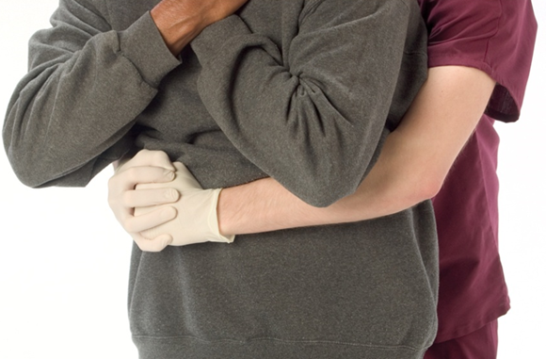
Performing abdominal thrusts for the conscious person
Stand behind the person and bring your arms under her arms. Wrap your arms around the person’s waist.
Make a fist with one hand. Place the flat, thumb side of the fist against the person’s abdomen, above the navel but below the breastbone.
Grasp the fist with your other hand. Pull both hands toward you and up (inward and upward), quickly and forcefully.
Repeat until the object is pushed out or the person loses consciousness.

Slide 29
Demonstrate knowledge of first aid procedures
REMEMBER:
Shock occurs when organs and tissues in the body do not receive an adequate blood supply. Bleeding, heart attack, severe infection, and falling blood pressure can lead to shock.
Shock is a life-threatening situation that may be worsened by fear or pain.

Slide 30
Demonstrate knowledge of first aid procedures
Know the symptoms of shock:
Pale or cyanotic skin
Staring
Increased pulse and respiration rates
Low blood pressure
Extreme thirst

Slide 31
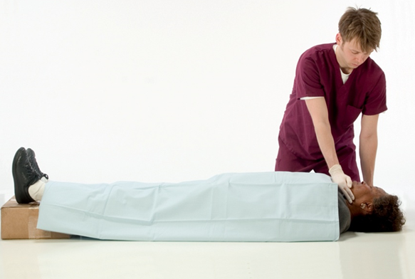
Responding to shock
Notify the nurse immediately. Victims of shock should always receive medical care as soon as possible.
If you need to control bleeding, put on gloves first. The next procedure will explain how to do this.
Have the person lie down on her back. If the person is bleeding from the mouth or vomiting, turn or logroll her on her side (chapter 11). Elevate the legs about 8 to 12 inches unless the person has a head, neck, back, leg, spinal, or abdominal injury; breathing difficulties; or fractures. Elevating the legs allows blood to flow back to the brain (and other vital areas).

Slide 32
Responding to shock
(cont’d) Never elevate a body part if a broken bone exists or if it causes pain.
Check pulse and respirations if possible (Chapter 13). Begin CPR if breathing and pulse are absent and if you are trained to do so.
Keep the person as calm and comfortable as possible. Loosen clothing or ties around the neck and any belts or waist strings.
Maintain normal body temperature. If the weather is cold, place a blanket around the person. If the weather is hot, provide shade.
Do not give the person food or liquids.

Slide 33
Demonstrate knowledge of first aid procedures
REMEMBER:
Severe bleeding can cause death quickly and must be controlled.

Slide 34
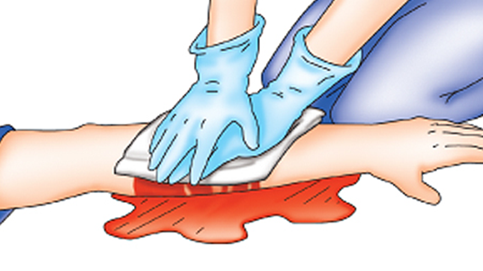
Controlling bleeding
Notify the nurse immediately.
Put on gloves. Always take time to do this. If the person is able, he can hold his bare hand over the wound until you can put on gloves.
Hold a thick sterile pad, clean cloth, handkerchief, or towel against the wound.
Press down hard directly on the bleeding wound until help arrives. Do not decrease pressure. Put additional pads over the first pad if blood seeps through. Do not remove the first pads.

Slide 35
Controlling bleeding
If you can, raise the wound above the level of the heart to slow the bleeding. Prop up the limb if the wound is on an arm, leg, hand, or foot, and there are no head, neck, back, spinal, or abdominal injuries; breathing difficulties; or fractures. Use towels or other absorbent material.
When bleeding is under control, secure the dressing to keep it in place. Check the person for symptoms of shock (pale skin, staring, increased pulse and respiration rates, low blood pressure, and extreme thirst). Stay with the person until help arrives.
Remove gloves and wash hands thoroughly when finished.

Slide 36
Demonstrate knowledge of first aid procedures
REMEMBER:
If a resident is burned, call or have someone call for the nurse immediately.

Slide 37
Demonstrate knowledge of first aid procedures
Care of a burn depends on its depth, size, and location.
There are three types of burns:
First-degree (superficial)
Second-degree (partial-thickness)
Third-degree (full thickness)

Slide 38
Treating burns
To treat a minor burn:
Notify the nurse immediately. Put on gloves.
Use cool, clean water to decrease the skin temperature and prevent further injury. Do not use ice or ice water, as ice may cause further skin damage. Dampen a clean cloth with cool water, and place it over the burn.
Once the pain has eased, you may cover the area with a dry, clean dressing or non-adhesive sterile bandage.
Remove and discard gloves. Wash your hands.
Never use any kind of ointment, salve, or grease on a burn.

Slide 39
Treating burns
For more serious burns:
Remove the person from the source of the burn. If clothing has caught fire, have the person stop, drop, and roll, or smother the fire with a blanket or towel to put out flames. Protect yourself from the source of the burn.
Notify the nurse immediately. Put on gloves.
Check for breathing, pulse, and severe bleeding. If the person is not breathing and has no pulse, begin CPR if trained and allowed to do so. Do not put pillows under the head, as this may obstruct the airway.
Do not use any type of ointment, water, salve, or grease on the burn.
Do not try to pull away any clothing from burned areas. Cover the burn with sterile gauze or a clean sheet. Apply the gauze or sheet lightly. Take care not to rub the burned area.

Slide 40
Treating burns
Take steps to prevent shock.
Do not give the resident food or liquids.
Monitor vital signs and wait for emergency medical help.
Remove and discard gloves. Wash your hands.

Slide 41
Demonstrate knowledge of first aid procedures
Fainting, or syncope, occurs as a result of decreased blood flow to the brain, causing a loss of consciousness.
Know the possible causes of fainting:
Abnormal heart rhythm
Hunger
Hypoglycemia
Fear
Pain
Fatigue
Standing for a long time
Poor ventilation
Pregnancy
Overheating

Slide 42
Demonstrate knowledge of first aid procedures
Remember these signs and symptoms of fainting:
Dizziness
Nausea
Perspiration
Pale skin
Weak pulse
Shallow respirations
Blackness in the visual field

Slide 43
Responding to fainting
Notify the nurse immediately.
Have the person lie down or sit down before fainting occurs.
If the person is in a sitting position, have him bend forward and place his head between his knees if he is able. If the person is lying flat on his back, and there are no head, neck, back, spinal or abdominal injuries; breathing difficulties; or fractures, elevate the legs about 12 inches.

Slide 44
Responding to fainting
Loosen any tight clothing.
Have the person stay in this position for at least five minutes after symptoms disappear.
Help the person get up slowly. Continue to observe him for symptoms of fainting. Help him to sit down if needed. Stay with him until he feels better. If you need help but cannot leave the person, use the call light.
If a person does faint, lower him to the floor or other flat surface. Position him on his back. If he has no head, neck, back, spinal, or abdominal injuries; breathing difficulties; or fractures, elevate his legs about 12 inches. Check to make sure the person is breathing. (If the person is not breathing and has no pulse, begin CPR if trained and allowed to do so.) He should recover quickly, but keep him down for several minutes. Report the incident to the nurse immediately. Fainting may be a sign of a more serious medical condition.

Slide 45
Demonstrate knowledge of first aid procedures
Know the signs and symptoms of poisoning:
Vomiting
Heavy, difficult breathing
Drowsiness
Confusion
Burns or red areas around the mouth

Slide 46
Demonstrate knowledge of first aid procedures
REMEMBER:
If a nursing assistant suspects poisoning, she should notify the nurse immediately. She may be asked to don gloves and look for a container that will help determine what the resident has taken or eaten.

Slide 47
Demonstrate knowledge of first aid procedures
Remember these possible causes of a nosebleed:
Dry air
Injury
Medication

Slide 48
Responding to a nosebleed
Notify the nurse immediately.
Elevate the head of the bed, or tell the resident to remain in a sitting position, leaning forward slightly. Offer tissues, a clean cloth, or an emesis basin to catch the blood. Do not touch blood or bloody clothes, tissues, or cloths without gloves.

Slide 49
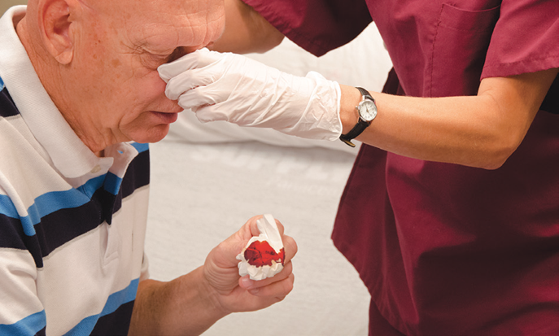
Responding to a nosebleed
Put on gloves. Apply firm pressure on both sides of the nose, on the soft part, up near the bridge. Squeeze the sides with your thumb and forefinger. You can have the resident do this until you are able to put on gloves.
Apply pressure until the bleeding stops.
Use a cool cloth or ice wrapped in a cloth over the bridge of the nose to help slow the flow of blood. Never apply ice directly to skin.

Slide 50
Responding to a nosebleed
Keep person still and calm until help arrives.
Remove and discard gloves and wash your hands.

Slide 51
Demonstrate knowledge of first aid procedures
Critical Thinking: Conversation Starter
Why should you both soothe the resident and report to the nurse when vomiting occurs?

Slide 52
Responding to vomiting
Notify the nurse immediately.
Put on gloves.
If the resident is sitting up, place an emesis basin under the chin. If the resident is lying on his back, turn his head to the side to help prevent choking, and place the basin under the chin. If an emesis basin is not nearby, use the wash basin. Remove it when vomiting has stopped.
Remove soiled linens or clothes and set aside. Replace with fresh linens or clothes.
Note amount, color, and consistency of vomitus. Look for blood in vomitus, blood-tinged vomitus, or medication (pills) in vomitus. Find out if a specimen should be sent to the laboratory. Show the nurse the vomitus before discarding if blood or pills are noted.

Slide 53
Responding to vomiting
Flush vomitus down the toilet and wash and store the basin.
Remove and discard gloves properly.
Wash your hands.
Put on fresh gloves.
Provide comfort to the resident. Wipe his face and mouth. Position him comfortably, and offer a drink of water or a sip to swish in the mouth and spit. Provide oral care (see Chapter 12). It helps get rid of the vomit taste in the mouth.

Slide 54
Responding to vomiting
Put the soiled linen in proper containers.
Remove and discard gloves properly.
Wash your hands again.
Document time, amount, color, odor and consistency of vomitus.

Slide 55
Demonstrate knowledge of first aid procedures
Know the signs and symptoms of a heart attack:
Sudden, severe pain in the chest
Pain or discomfort in other areas of the body
Indigestion or heartburn
Nausea and vomiting
Difficulty breathing
Dizziness

Slide 56
Demonstrate knowledge of first aid procedures
Signs and symptoms of a heart attack (cont’d):
Pale, gray, or cyanotic skin color or mucous membranes
Perspiration
Cold and clammy skin
Weak and irregular pulse rate
Low blood pressure
Anxiety and a sense of doom
Denial of a heart problem

Slide 57
Demonstrate knowledge of first aid procedures
Women may experience different symptoms than men, and are somewhat more likely to experience the following:
Shortness of breath
Pressure or pain in the lower chest or upper abdomen
Dizziness
Lightheadedness
Fainting
Pressure in the upper back, or extreme fatigue
Flu-like symptoms

Slide 58
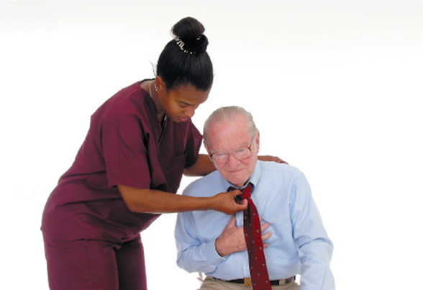
Responding to a myocardial infarction
Notify the nurse immediately.
Place the resident in a comfortable position. Encourage him to rest. Reassure him that you will not leave him alone.
Loosen clothing around the resident’s neck.
Do not give the resident food or liquids.

Slide 59
Responding to a myocardial infarction
Monitor the person’s breathing and pulse. If the person stops breathing and has no pulse, begin CPR if trained and allowed to do so.
Stay with the resident until help has arrived.

Slide 60
Demonstrate knowledge of first aid procedures
Know the causes of insulin reaction:
Too much insulin
Too little food
Additional activity that causes the body to rapidly absorb food
Vomiting
Diarrhea

Slide 61
Demonstrate knowledge of first aid procedures
Remember these signs and symptoms of insulin reaction:
Feeling weak or different
Nervousness
Dizziness
Perspiration
Headache
Blurred vision
Numbness of the lips and tongue
Cold, clammy skin

Slide 62
Demonstrate knowledge of first aid procedures
Signs and symptoms of insulin reaction (cont’d):
Trembling
Hunger
Rapid pulse
Low blood pressure
Confusion
Unconsciousness

Slide 63
Demonstrate knowledge of first aid procedures
REMEMBER:
These signs and symptoms mean that the resident needs food; a diabetic resident should always have a quick source of sugar handy.

Slide 64
Demonstrate knowledge of first aid procedures
Know the causes of diabetic ketoacidosis (DKA):
Undiagnosed diabetes
Infection
Not enough insulin
Eating too much
Not getting enough exercise
Physical and emotional stress

Slide 65
Demonstrate knowledge of first aid procedures
Remember these signs and symptoms of DKA:
Increased hunger, thirst, or urination
Abdominal pain
Deep or difficult breathing
Breath that smells sweet or fruity
Headache
Blurred vision
Dry skin, dry mouth
Flushed cheeks
Nausea and vomiting

Slide 66
Demonstrate knowledge of first aid procedures
Signs and symptoms of DKA (cont’d):
Loss of appetite
Rapid, weak pulse
Low blood pressure
Shortness of breath or air hunger
Weakness
Drowsiness
Confusion
Unconsciousness

Slide 67
Demonstrate knowledge of first aid procedures
REMEMBER:
DKA can lead to diabetic coma and death, if left untreated.

Slide 68
Demonstrate knowledge of first aid procedures
Seizures are involuntary, often violent, contractions of muscles. They can involve a small area or the entire body.
Know the causes of seizures:
Abnormality in the brain
High fever
Serious illness
Head injury
Seizure disorder

Slide 69
Demonstrate knowledge of first aid procedures
REMEMBER:
Your main goal during a seizure is to make sure the resident is safe.

Slide 70
Demonstrate knowledge of first aid procedures
Remember these signs of seizure:
Severe shaking
Uncontrolled thrusting of arms and legs
Clenching jaw
Drooling
Inability to swallow

Slide 71
Demonstrate knowledge of first aid procedures
Types of seizures:
Absence or Petit Mal
Myoclonic
Atonic
Tonic
Clonic
Tonic-clonic

Slide 72
Responding to seizures
Note the time. Put on gloves. If the person is wearing eyeglasses, remove them.
Lower the resident to the floor. Cradle and protect his head. If a pillow is nearby, place it under his head. Loosen clothing to help with breathing. Attempt to turn him to one side to lower the risk of choking. This may not be possible during a violent seizure.
Have someone call the nurse immediately or use the call light. Do not leave the person unless you must do so to get medical help.
Move furniture away to prevent injury.
Do not try to stop the seizure or restrain the person.
Do not force anything between the resident’s teeth. Do not place your hands in his mouth for any reason. You could be bitten.

Slide 73
Responding to seizures
Do not give the resident food or liquids.
When the seizure is over, note the time. Gently turn the person to his left side if you do not suspect head, neck, back, spinal, or abdominal injuries, or fractures, or if the resident has difficulty breathing. This reduces the risk of choking on vomit or saliva. If the resident begins to choke, get help immediately. Check for adequate breathing and pulse. If the resident is not breathing and has no pulse, begin CPR if trained and allowed to do so. Do not begin CPR during a seizure.
Remove and discard gloves and wash your hands.
Report the length of the seizure and your observations to the nurse.

Slide 74
Demonstrate knowledge of first aid procedures
REMEMBER:
A cerebrovascular accident (CVA) or stroke occurs when the blood supply to a portion of the brain is cut off.
TIA is a warning sign of a CVA. Symptoms should be reported to the nurse immediately.

Slide 75
Demonstrate knowledge of first aid procedures
Know the signs that a TIA or stroke is occurring:
Difficulty speaking
Weakness on one side of the body
Temporary loss of vision
Numbness or tingling
Facial numbness, weakness, or drooping, especially on one side
Paralysis on one side of the body
Arm or leg numbness or weakness, especially on one side
Trouble walking, loss of balance

Slide 76
Demonstrate knowledge of first aid procedures
Signs that a TIA or stroke is occurring (cont’d):
Slurred speech or inability to speak
Inability to understand spoken or written words
Use of inappropriate words
Severe headache
Blurred vision or trouble seeing in one or both eyes
Ringing in the ears
Redness in the face

Slide 77
Demonstrate knowledge of first aid procedures
Signs that a TIA or stroke is occurring (cont’d):
Noisy breathing
Slow pulse rate
Elevated blood pressure
Nausea or vomiting
Loss of bowel and bladder control
Seizures
Dizziness
Loss of consciousness

Slide 78
Demonstrate knowledge of first aid procedures
Women may have the following symptoms in the case of TIA or stroke:
Pain in the face, arms, and legs
Hiccups
Shortness of breath
Palpitations
Chest pain
Agitation
Hallucinations
Disorientation

Slide 79
Demonstrate knowledge of first aid procedures
It is helpful to remember the acronym F.A.S.T.:
(F)ace: Is one side of the face drooping? Is it numb? Ask the person to smile. Is the smile uneven?
(A)rms: Is one arm numb or weak? Ask the person to raise both arms. Check to see if one arm shifts downward.
(S)peech: Is the person’s speech slurred? Is the person unable to speak? Can the person be understood? Ask the person to repeat a simple sentence and see if the sentence is repeated correctly.
(T)ime: Time is of the utmost importance when responding to a stroke. If the person shows any of the symptoms listed above, report to the nurse immediately.

Slide 80
Demonstrate knowledge of first aid procedures
REMEMBER:
Important information on stroke can be found online:
American Stroke Association – strokeassociation.org
National Stroke Association – stroke.org

Slide 81
Explain the nursing assistant’s role on a code team
Define the following term:
code team
group of people chosen for a particular shift to respond to resident emergencies.

Slide 82
Explain the nursing assistant’s role on a code team
As a member of the code team a nursing assistant
May be asked to get special equipment.
May do chest compressions during CPR.
Must respond to codes from wherever he is in the facility.
Should not panic.
Should get another staff member to take over any care he is performing.

Slide 83
Describe guidelines for responding to disasters
REMEMBER:
A disaster can occur during a nursing assistant’s shift at a facility. Disasters can include fire, flood, earthquake, hurricane, tornado, or severe weather. Acts of terrorism are also considered disasters.
NAs are expected to respond calmly and skillfully to disasters. They need to be responsible and efficient.

Slide 84
Describe guidelines for responding to disasters
In the event of a disaster an NA should follow these guidelines:
Know the facility’s disaster plan.
Pay close attention during classes on disasters and disaster drills.
Listen carefully and follow instructions.
Remain calm.
Know location of all exits and stairwells.
Know where fire alarms and fire extinguishers are located.
Know the appropriate action to take.

Slide 85
Describe guidelines for responding to disasters
Critical Thinking: Conversation Starter
Have you had any experiences with disasters?
If yes, what actions did you (or those around you) take that were helpful?
What actions did you (or others) take that were not helpful?

