Slide 2
Define important words in this chapter
bariatrics
branch of medicine that deals with the causes, prevention, and treatment of obesity.
biorhythms
natural rhythms or cycles related to bodily functions.
circadian rhythm
the 24-hour day-night cycle.
closed bed
bed completely made with the bedspread and blankets in place.
depressant
a substance that causes calmness and drowsiness.

Slide 3
Define important words in this chapter
disposable
only to be used once and then discarded.
draw sheet
an extra sheet placed on top of the bottom sheet; used for moving residents.
incontinence
the inability to control the bladder or bowels, which leads to an involuntary loss of urine or feces.
insomnia
the inability to fall asleep or remain asleep.

Slide 4
Define important words in this chapter
occupied bed
a bed made while a person is in the bed.
open bed
bed made with linen folded down to the foot of the bed.
parasomnias
sleep disorders.
sleep
natural period of rest for the mind and body during which energy is restored.

Slide 5
Define important words in this chapter
stimulant
a drug that increases or quickens actions of the body.
surgical bed
bed made so that a person can easily move onto it from a stretcher.
unoccupied bed
a bed made while no person is in the bed.

Slide 6
Discuss the importance of sleep
Define the following terms:
sleep
natural period of rest for the mind and body during which energy is restored.
biorhythms
natural rhythms or cycles related to bodily functions.
circadian rhythm
the 24-hour day-night cycle.

Slide 7
Discuss the importance of sleep
Remember these important points about sleep:
The human body cannot survive for long without sleep.
Sleep is needed to replace old cells with new ones and provide energy to organs.
Sleep promotes healing and healthy body functioning.
Getting enough sleep helps decrease the risk of certain illnesses and disease.
Sleep helps improve cognitive function and promotes emotional health.

Slide 8
Describe types of sleep disorders
Define the following terms:
insomnia
the inability to fall asleep or remain asleep.
parasomnias
sleep disorders.

Slide 9
Describe types of sleep disorders
People may develop sleep disorders for the following reasons:
Illness
Anxiety
Fear
Stress
Medications
Trouble breathing
Noise
Hunger
Thirst

Slide 10
Describe types of sleep disorders
Types of sleep disorders, or parasomnias, include the following:
Somnambulism, or sleepwalking
Sleeptalking
Bruxism, or grinding and clenching the teeth during sleep
REM sleep behavior disorder, which involves talking, often along with violent movements, during REM (dreaming) sleep
Sleep apnea, or the disruption of breathing while a person is sleeping

Slide 11
Identify factors affecting sleep
Define the following terms:
depressant
a substance that causes calmness and drowsiness.
stimulant
a drug that increases or quickens actions of the body.

Slide 12
Identify factors affecting sleep
Remember these factors that may affect residents’ sleep:
Environment
Noise level and lighting
Problems with odors and inadequate ventilation
Temperature problems
Anxiety
Illness
Aging changes
Dietary habits
Medications, alcohol, and cigarettes

Slide 13
Identify factors affecting sleep
A number of problems can be caused by not sleeping well, including the following:
Decreased mental function
Reduced reaction time
Decreased immune system function
Irritability

Slide 14
Identify factors affecting sleep
Critical Thinking: Conversation Starter
Think about a time when you could not sleep well. Did you use any special methods to help you sleep?

Slide 15
Describe a standard resident unit and equipment
REMEMBER:
Residents’ units are their homes and residents have a right to privacy. Nursing assistants must always knock and wait for permission before entering a resident’s room.

Slide 16
Describe a standard resident unit and equipment
Critical Thinking: Conversation Starter
Why should residents’ personal items always be respected and handled carefully?
How would it feel to have someone handling your personal belongings?

Slide 17
Describe a standard resident unit and equipment
Standard equipment in residents’ rooms may include
Bed
Bedside stand and dresser
Overbed table
Chair
Bath basin
Emesis basin
Bedpan
Urinal for males
Water pitcher and cup
Privacy screen or curtain
Call light

Slide 18
Describe a standard resident unit and equipment
The following items are usually stored in the bedside stand:
Emesis basin
Bath basin
Urinal
Bedpan
Soap
Toothbrush and toothpaste
Comb and brush

Slide 19
Describe a standard resident unit and equipment
Critical Thinking: Conversation Starter
Personal articles are usually kept in the top drawer. Why must they must be kept separate from basins, urinals, and bedpans?

Slide 20
Describe a standard resident unit and equipment
REMEMBER:
The overbed table is used for meals and personal care, and it must be kept clean. Bedpans, urinals, and soiled linen should never be placed on it. It should be kept free of clutter.

Slide 21
Explain how to clean a resident unit and equipment
Define the following term:
disposable
only to be used once and then discarded.

Slide 22
Discuss types of beds and demonstrate proper bedmaking
Define the following term:
bariatrics
branch of medicine that deals with the causes, prevention , and treatment of obesity.
incontinence
the inability to control the bladder or bowels, which leads to an involuntary loss of urine or feces.

Slide 23
Discuss types of beds and demonstrate proper bedmaking
Define the following terms:
closed bed
a bed completely made with the bedspread and blankets in place.
open bed
a bed made with linen folded down to the foot of the bed.
draw sheet
an extra sheet placed on top of the bottom sheet; used for moving residents.
occupied bed
a bed made while a person is in the bed.

Slide 24
Discuss types of beds and demonstrate proper bedmaking
Define the following terms:
unoccupied bed
a bed made while no person is in the bed.
surgical bed
bed made so that a person can easily move onto it from a stretcher.

Slide 25
Explain how to clean a resident unit and equipment
Disposable equipment is used to prevent the spread of microorganisms. The following types of disposable equipment may be found in facilities:
Cups
Tissues
Gloves
Paper gowns
Masks
Disposable razors
Pads

Slide 26
Explain how to clean a resident unit and equipment
Remember these guidelines for residents’ units:
Keep residents’ units neat and clean.
Keep call lights within resident’s reach.
Straighten bed linens and remove crumbs before leaving the room.
Re-stock resident supplies daily.
Notify housekeeping department if bathroom needs cleaning.

Slide 27
Explain how to clean a resident unit and equipment
Guidelines for residents’ units (cont’d):
Check equipment to make sure it is working and not damaged.
Refill water pitchers regularly.
Remove anything that might cause odor or safety hazards.
Report signs of insects or pests immediately.
Leave residents’ personal items where you found them.
After providing care, leave the unit neat and tidy.

Slide 28
Explain how to clean a resident unit and equipment
Remember these guidelines for cleaning a unit after a transfer, discharge, or death:
Wash hands.
Wear proper PPE.
Make sure area is well-ventilated when using strong cleaning solutions.
Remove and dispose of equipment and supplies carefully.
Raise bed to safe working level and remove soiled linen. Make the bed.

Slide 29
Explain how to clean a resident unit and equipment
Guidelines for cleaning a unit after a transfer, discharge, or death (cont’d):
Clean all other unit items and equipment as instructed.
Report any damaged or broken furniture to the proper department.
Remove PPE and wash hands.
Place new equipment and supplies in room for new resident.

Slide 30
Discuss types of beds and demonstrate proper bedmaking
Proper bedmaking is important for a number of reasons:
The resident will spend a great deal of time in bed.
Neat, well-made beds help the resident sleep better.
Careful bedmaking prevents infection.
A clean, neat, and dry bed helps prevent skin breakdown and odors and promotes health.

Slide 31
Discuss types of beds and demonstrate proper bedmaking
The following beds and features may be found in a facility:
Electric beds
Beds with built-in weight scales
Alternating pressure mattresses
Bariatric beds

Slide 32
Discuss types of beds and demonstrate proper bedmaking
REMEMBER:
Beds should remain locked in their lowest positions whenever residents are in the beds.

Slide 33
Discuss types of beds and demonstrate proper bedmaking
Remember these guidelines for bedmaking:
Change bed linens when they are wet, soiled, or wrinkled.
Wash hands and use proper infection prevention methods. Wear gloves when removing soiled linens.
Gather linen in order of placement on the bed.
Carry clean linen away from uniform.
Bring linen into one resident’s room at a time.
Never transfer linen from one room to another.
Place clean linen on a clean surface within reach.

Slide 34
Discuss types of beds and demonstrate proper bedmaking
Guidelines for bedmaking (cont’d):
Use proper body mechanics.
Look for personal items.
Roll dirty linen away from you.
Do not shake linen.
Place used linen in proper container.
Make one side of bed first to save energy.
Keep beds free of wrinkles and crumbs.
Wash hands after handling linens.

Slide 35
Making a closed bed
Equipment: clean linen—mattress pad, fitted or flat bottom sheet, disposable absorbent pad (if needed), cotton draw sheet, flat top sheet, blanket(s), bedspread (if used), pillowcase(s), gloves
Wash your hands.
If resident is in the room, identify yourself by name. Identify the resident. Greet the resident by name.
Explain procedure to the resident. Speak clearly, slowly, and directly. Maintain face-to-face contact whenever possible.
Place clean linen on clean surface within reach (e.g., bedside stand, overbed table, or chair).
Adjust bed to safe working level, usually waist high. Put bed in flattest position. Lock bed wheels.
Put on gloves.

Slide 36
Making a closed bed
Loosen soiled linen and roll soiled linen (soiled side inside) from head to foot of bed. Avoid contact with your skin or clothes. Place it in a hamper or linen bag. Do not place on overbed table, chair, or floor. Remove pillows and pillowcases and place pillowcases in hamper or bag.
Remove and discard gloves. Wash your hands.
Remake the bed. Place the mattress pad (if used) on the bed, attaching elastic at corners as necessary.
Place bottom sheet on bed without shaking linen. If using a flat sheet with seams, this sheet must be placed with the crease in the center of the mattress. The seams on both ends must be placed down. If using a fitted bottom sheet, place right-side up and tightly pull over all four corners of the bed.

Slide 37
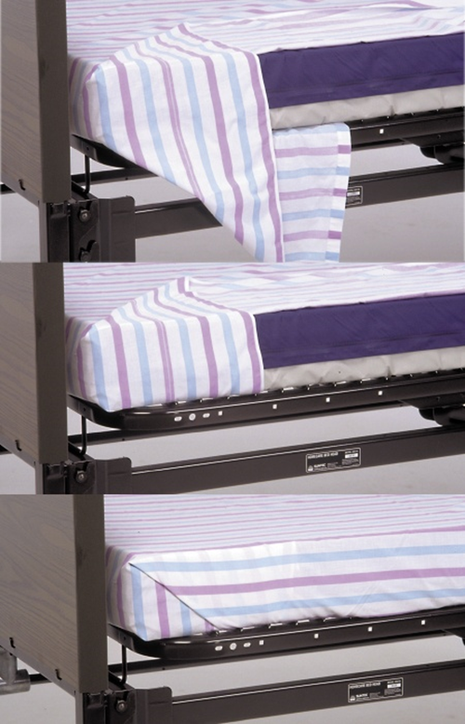
Making a closed bed
Make hospital corners to keep bottom sheet wrinkle-free.
Put on disposable absorbent pad and then the draw sheet if used. Place them in the center of the bed on the bottom sheet. Smooth and tightly tuck the bottom sheet and draw sheet together under the sides of bed. Move from the head of the bed to the foot of the bed.
Place the top sheet over the bed and center it. The seam must be up.

Slide 38
Making a closed bed
Place blanket over the bed and center it.
Place the bedspread over the bed and center it.
Tuck top sheet and blanket under the foot of the bed and make hospital corners.
Fold down the top sheet to make a cuff of about six inches over the blanket.

Slide 39
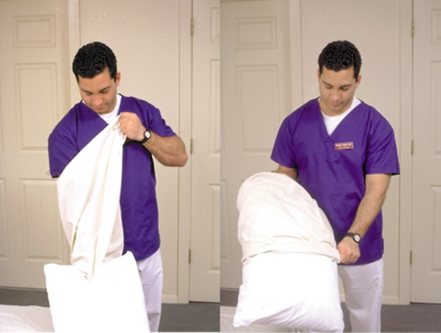
Making a closed bed
Take a pillow, and with one hand, grasp the clean pillowcase at the closed end. Turn it inside out over your arm. Next, using the hand that has the pillowcase over it, grasp the one narrow edge of the pillow. Pull the pillowcase over it with your free hand. Do the same for any other pillows. Place them at the head of the bed with open end away from the door. Make sure zippers or tags are on the inside.

Slide 40
Making a closed bed
Return bed to lowest position.
Leave call light within the resident’s reach.
Wash your hands.
Take laundry bag or to the proper area.
Document procedure using facility guidelines.

Slide 41
Making an open bed
Equipment: clean linen—mattress pad, fitted or flat bottom sheet, disposable absorbent pad (if needed), cotton draw sheet, flat top sheet, blanket(s), bedspread (if used), pillowcase(s), gloves
Wash your hands.
Make a closed bed, as described in previous procedure.
Stand at the head of the bed. Grasp the top sheet and blanket, and bedspread, and fold them down to the foot of the bed. Then bring them back up the bed to form a large cuff.
Bring the cuff on the top linens to a point where it is one hand-width above the linen underneath. This way, when the resident gets into bed, he will not pull all the linen out at the foot of the bed.
Make sure all linen is wrinkle-free.
Wash your hands.
Document procedure using facility guidelines.

Slide 42
Making an occupied bed
Equipment: clean linen—mattress pad, fitted or flat bottom sheet, disposable absorbent pad (if needed), cotton draw sheet, flat top sheet, blanket(s), bedspread (if used), bath blanket, pillowcase(s), gloves
Wash your hands.
Identify yourself by name. Identify the resident. Greet the resident by name.
Explain procedure to the resident. Speak clearly, slowly, and directly. Maintain face-to-face contact whenever possible.
Provide for the resident’s privacy with a curtain, screen, or door.
Place clean linen on clean surface within reach (e.g., bedside stand, overbed table, or chair).
Adjust bed to safe working level, usually waist high. Lower head of bed. Lock bed wheels.
Put on gloves.

Slide 43
Making an occupied bed
Loosen top linen from the end of the bed on the working side.
Unfold the bath blanket over the top sheet and remove the top sheet. Keep resident covered at all times with the bath blanket.

Slide 44
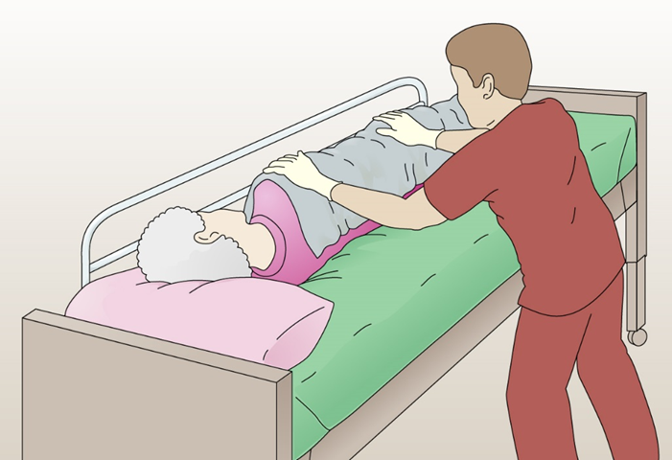
Making an occupied bed
You will make the bed one side at a time. Raise the bed rail (if bed has them) on far side of bed. After raising the bed rail, go to the other side of the bed. Gently help resident to turn onto her side slowly, moving away from you, toward raised bed rail (see Procedure: Turning a Resident in Chapter 11).

Slide 45
Making an occupied bed
Loosen bottom used linen, mattress pad, and absorbent pad, if present, on the working side.
Roll bottom used linen toward resident and center of bed, soiled side inside. Tuck it snugly against resident’s back.
Place the mattress pad (if used) on the bed, attaching elastic at corners on working side.
Place clean bottom linen or fitted bottom sheet with the center crease in the center. If flat sheet is used, tuck in at top and on working side. Make hospital corners to keep bottom sheet wrinkle-free. If fitted sheet is used, tightly pull two fitted corners on working side.

Slide 46
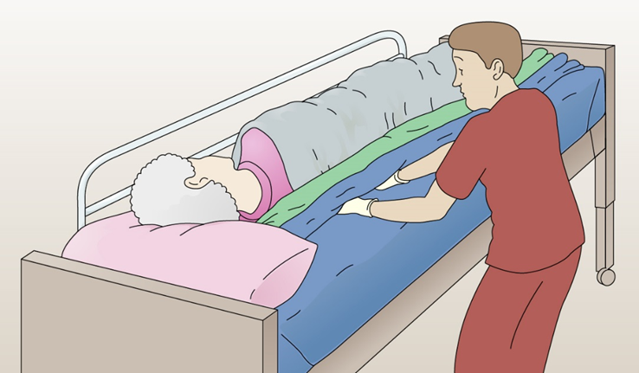
Making an occupied bed
Smooth the bottom sheet out toward the resident. Be sure there are no wrinkles in the mattress pad. Roll the extra material toward the resident. Tuck it under the resident’s body.

Slide 47
Making an occupied bed
If using a disposable absorbent pad, unfold it and center it on the bed. Smooth it out toward the resident. Tuck the side near you under the mattress. Smooth it out toward the resident. Tuck as you did with the sheet.
If using a draw sheet, place it on the bed. Tuck in on your side, smooth, and tuck as you did with the other bedding.

Slide 48
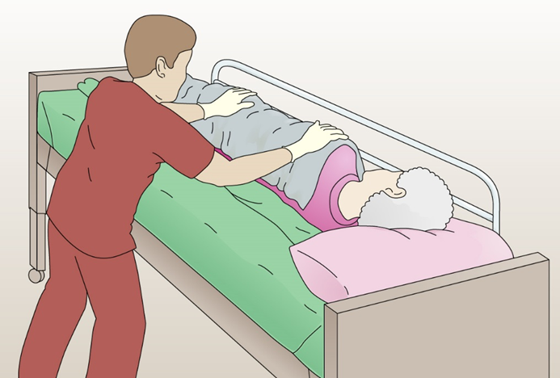
Making an occupied bed
Raise bed rail nearest you. Go to the other side of the bed and lower that bed rail. Help resident roll or turn onto clean bottom sheet. Explain that he will be moving over a roll of linen. Protect the resident from any soiled matter on the old linens.

Slide 49
Making an occupied bed
Loosen the used linen. check for personal items. Roll linen from head to foot of bed, avoiding contact with your skin or clothes. Do not shake the used linen. Place it in a hamper or linen bag. Do not place on overbed table, chair, or floor.
Pull the clean linen through as quickly as possible. Start with the mattress pad and wrap around corners. Pull and tuck in clean bottom linen, just like the other side. Pull and tuck in disposable absorbent pad and draw sheet if used. Make hospital corners with bottom sheet. Finish with bottom sheet free of wrinkles.
Ask resident to turn onto her back, helping as needed. Keep resident covered and comfortable, with a pillow under his head. Raise the bed rail nearest you.

Slide 50
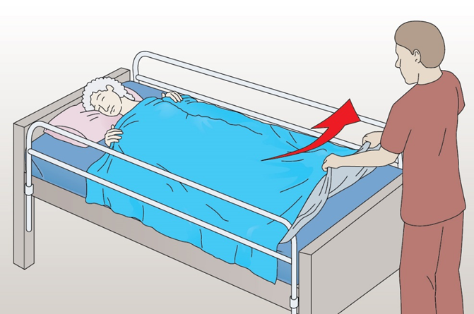
Making an occupied bed
Unfold the top sheet. Place it over the resident and center it. Ask the resident to hold the top sheet and pull the bath blanket out from underneath. Put it in the hamper/bag.

Slide 51
Making an occupied bed
Place the blanket over the top sheet and center it. Match the top edges. Place the bedspread over the blanket and center it. Match the top edges. Tuck the top sheet, blanket and bedspread under the foot of the bed and make hospital corners on each side. Loosen the top linens over the resident’s feet.
At the top of the bed, fold down the top sheet over the blanket about six inches to make a cuff.
Gently hold and lift resident’s head and remove pillow. Do not hold it near your face. Remove the soiled pillowcase by turning it inside out. Place it in the hamper or bag.
Remove and discard gloves. Wash your hands.

Slide 52
Making an occupied bed
With one hand, grasp the clean pillowcase at the closed end. Turn it inside out over your arm. Next, using the hand that has the pillowcase over it, grasp the center of the end of the pillow. Pull the pillowcase over it with your free hand. Do the same for any other pillows. Place them gently under resident’s head with open end away from the door. Make sure zippers or tags are on the inside.
Make sure bed is wrinkle-free. Make resident comfortable.
Return bed to lowest position. Leave bed rails in the ordered position. Remove privacy measures.
Leave call light within the resident’s reach.
Be courteous and respectful at all times.
Wash your hands.
Take laundry bag or hamper to proper area.
Report any changes in the resident to the nurse. Document procedure using facility guidelines.

Slide 53
Making a surgical bed
Equipment: clean linen (see Procedure: Making a closed bed), gloves
Wash your hands.
Place clean linen on clean surface within reach (e.g., bedside stand, overbed table, or chair).
Adjust bed to safe working level, usually waist high. Lock bed wheels.
Put on gloves.
Remove all used linen, rolling it (soiled side inside) from head to foot of bed. Avoid contact with your skin or clothes. Place it in a hamper or linen bag.
Remove and discard gloves.
Wash your hands.

Slide 54
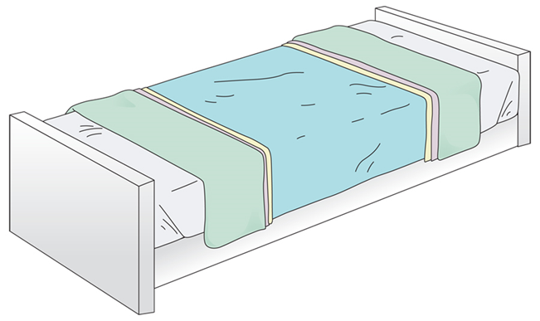
Making a surgical bed
Make a closed bed. Do not tuck top linens under the mattress.
Fold top linens down from the head of the bed and up from the foot of the bed.

Slide 55
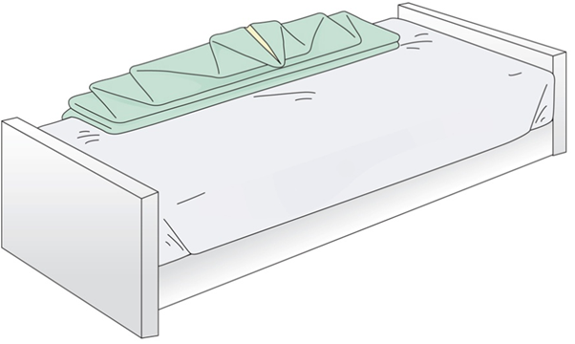
Making a surgical bed
Form a triangle with the linen. Fanfold the linen triangle into pleated layers and position opposite the stretcher side of the bed. Fanfolding means folding several times into pleats. After fanfolding, form a tiny tip with the end of the linen triangle. The tip can be grasped quickly and pulled over the returning resident. This step quickly provides much-needed warmth to the resident.

Slide 56
Making a surgical bed
Put on clean pillowcases. Place the clean pillows on a clean surface off the bed, such as on the bedside stand or chair.
Leave bed in its locked position. Leave both bed rails down.
Move all furniture to make room for the stretcher.
Do not place call light on bed. That is placed after the resident returns to bed.
Wash your hands.
Take laundry bag or hamper to proper area.
Document procedure using facility guidelines.

