Slide 2
Define important words in this chapter
apical pulse
the pulse on the left side of the chest, just below the nipple.
apnea
the absence of breathing.
BPM
the medical abbreviation for beats per minute.
brachial pulse
the pulse located inside the elbow; about 1 to 1½ inches above the elbow.

Slide 3
Define important words in this chapter
bradycardia
slow heart rate, under 60 beats per minute.
Celsius
the centigrade temperature scale in which the boiling point of water is 100 degrees and the freezing point of water is 0 degrees.
Cheyne-Stokes respiration
alternating periods of slow, irregular respirations and rapid, shallow respirations, possibly along with periods of apnea.

Slide 4
Define important words in this chapter
diastolic
the second measurement of blood pressure; phase when the heart relaxes or rests.
dilate
to widen.
dyspnea
difficulty breathing.
eupnea
normal respirations.

Slide 5
Define important words in this chapter
expiration
the process of exhaling air out of the lungs.
Fahrenheit
a temperature scale in which the boiling point of water is 212 degrees and the freezing point of water is 32 degrees.
hypertension
high blood pressure, regularly measuring 130/80 mm Hg or higher.
hypotension
low blood pressure, below 90/60 mm HG.

Slide 6
Define important words in this chapter
hypothermia
severe subnormal body temperature; body temperature drops below the level required for normal functioning.
inspiration
the process of inhaling air into the lungs.
Kussmaul breathing:
very deep, rapid breathing that is associated with diabetic ketoacidosis and kidney failure; also known as air hunger.
orthopnea
shortness of breath when lying down that is relieved by sitting up.

Slide 7
Define important words in this chapter
orthostatic hypotension
a sudden drop in blood pressure that occurs when a person stands or sits up; also called postural hypotension.
radial pulse
the pulse located on the inside of the wrist, where the radial artery runs just beneath the skin.
respiration
the process of inhaling air into the lungs (inspiration) and exhaling air out of the lungs (expiration).

Slide 8
Define important words in this chapter
sphygmomanometer
a device that measures blood pressure.
stethoscope
an instrument used to hear sounds in the human body, such as the heartbeat or pulse, breathing sounds, or bowel sounds.
systolic
first measurement of blood pressure; phase when the heart is at work, contracting and pushing blood out of the left ventricle.
tachycardia
rapid heart rate, over 100 beats per minute.

Slide 9
Define important words in this chapter
tachypnea
rapid respirations, over 20 breaths per minute.
thermometer
a device used for measuring the degree of heat or cold.
vital signs
measurements – body temperature, pulse, respirations, and blood pressure – that monitor the functioning of the vital organs of the body.

Slide 10
Discuss the relationship of vital signs to health and well-being
Define the following term:
vital signs
measurements – body temperature, pulse, respirations, and blood pressure – that monitor the functioning of the vital organs of the body.

Slide 11
Discuss the relationship of vital signs to health and well-being
Vital signs consist of the following:
Measuring temperature
Counting pulse
Counting rate of respirations
Measuring blood pressure
Observing and reporting pain level

Slide 12
Discuss the relationship of vital signs to health and well-being
REMEMBER:
A change in vital signs is often the first indication that someone is ill.

Slide 13
Key Material 13-1: Ranges for Adult Vital Signs
Temp. Site Fahrenheit Celsius
Mouth (oral) 97.6° - 99.6° 36.5° - 37.5°
Rectum (rectal) 98.6° - 100.6° 37.0° - 38.1°
Armpit (axillary) 96.6°- 98.6° 36.0° - 37.0°
Ear (tympanic) 96.6° - 99.7° 35.8° - 37.6°
Temporal artery 97.2°- 100.1° 36.2° - 37.8°
Normal Pulse Rate: 60-100 beats per minute
Normal Respiratory Rate: 12-20 respirations per minute
Blood Pressure
Normal
Systolic: 129 or lower
Diastolic: 80 or lower
Low
Below 90/60
High
130/80 or above

Slide 14
Identify factors that affect body temperature
Define the following term:
hypothermia
severe subnormal body temperature; body temperature drops below the level required for normal functioning.

Slide 15
Identify factors that affect body temperature
These factors can affect body temperature:
Age
Amount of exercise
Circadian rhythm
Stress
Illness
Environment

Slide 16
Identify factors that affect body temperature
The following are signs of hypothermia:
Temperature below 97°F
Shivering
Numbness
Quick and shallow breathing
Slow movements
Mild confusion
Changes in mental status
Pale and cyanotic skin

Slide 17
List guidelines for measuring body temperature
Define the following terms:
thermometer
a device used for measuring the degree of heat or cold.
Fahrenheit
a temperature scale in which the boiling point of water is 212 degrees and the freezing point of water is 32 degrees.
Celsius
the centigrade temperature scale in which the boiling point of water is 100 degrees and the freezing point of water is 0 degrees.

Slide 18
List guidelines for measuring body temperature
There are five common sites for measuring temperature:
Mouth
Rectum
Armpit
Ear
Temporal artery

Slide 19
List guidelines for measuring body temperature
Remember these points about different types of thermometers:
Mercury-free thermometers can be used to take an oral, rectal, or axillary temperature.
Mercury-free thermometers are usually green for oral thermometers and red for rectal.
Digital thermometers are commonly used for oral, rectal, and axillary temps. They register temperature within two to 60 seconds.
Digital thermometers require a sheath to cover the probe.
Electronic thermometers are commonly used for oral, rectal, and axillary temps. They register temperature within two to 60 seconds.

Slide 20
List guidelines for measuring body temperature
Different types of thermometers (cont’d):
Electronic thermometers require a probe cover that must be discarded after a single use.
Disposable thermometers can be used to take oral or axillary temps.
Disposable thermometers are used once and discarded. They do not require a disposable sheath.
Tympanic thermometers are fast and accurate.
Temporal artery thermometers are moved across the forehead and are non-invasive.

Slide 21
List guidelines for measuring body temperature
Do not take an oral temperature on a person who
Is unconscious
Is using oxygen
Is confused or disoriented
Is paralyzed
Has facial trauma
Is likely to have a seizure
Has a nasogastric or orogastric tube
Is younger than five years old
Has sores, redness, swelling, or pain in the mouth
Has an injury to the face or neck

Slide 22
Measuring and recording oral temperature
Equipment: clean digital, electronic, or mercury-free thermometer, gloves, disposable sheath/cover for thermometer, tissues, pen and paper
Do not take an oral temperature if the resident has smoked, eaten or drunk fluids, chewed gum, or exercised within the last 10 to 20 minutes.
Identify yourself by name. Identify the resident. Greet the resident by name.
Wash your hands.
Explain procedure to the resident. Speak clearly, slowly, and directly. Maintain face-to-face contact whenever possible.
Provide for the resident’s privacy with a curtain, screen, or door.
Put on gloves.

Slide 23
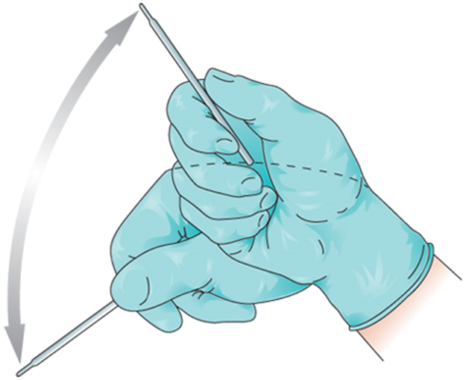
Measuring and recording oral temperature
​Digital thermometer: Put on the disposable sheath. Turn on the thermometer. Wait until the ready sign appears.
Electronic thermometer: Remove probe from the base unit. Put on the probe cover.
Mercury-free thermometer: Hold the thermometer by the stem. Before inserting it in the resident’s mouth, shake the thermometer down to below the lowest number (at least below 96°F or 35°C). To shake thermometer down, hold it at the end opposite the bulb with the thumb and two fingers. With a snapping motion of the wrist, shake the thermometer. Stand away from furniture and walls while doing so.

Slide 24
Measuring and recording oral temperature
​Digital thermometer: Insert the end of digital thermometer into resident’s mouth, under the tongue and to one side.
Electronic thermometer: Insert the end of electronic thermometer into resident’s mouth, under tongue and to one side.
Mercury-free thermometer: Put on the disposable sheath if available. Gently insert the bulb end of thermometer into the resident’s mouth, under the tongue and to one side.

Slide 25
Measuring and recording oral temperature
​For all thermometers: Tell resident to hold the thermometer in his mouth with his lips closed. Assist as necessary. The resident should breathe through his nose. Ask the resident not to bite down or talk.
Digital thermometer: Leave in place until thermometer blinks or beeps.
Electronic thermometer: Leave in place until you hear a tone or see a flashing or steady light.
Mercury-free thermometer: Leave in place for at least three minutes.
​Digital thermometer: Remove the thermometer. Read the temperature on the display screen. Remember the temperature reading.
Electronic thermometer: Read the temperature on the display screen. Remember the temperature reading. Remove the probe.
Mercury-free thermometer: Remove the thermometer. Wipe with a tissue from stem to bulb or remove the sheath. Dispose of the tissue or sheath. Hold the thermometer at eye level. Rotate until the line appears, rolling the thermometer between your thumb and forefinger. Read the temperature. Remember the temperature reading.

Slide 26
Measuring and recording oral temperature
​Digital thermometer: Using a tissue, remove and discard sheath. Clean the thermometer according to facility policy. Replace the thermometer in the case.
Electronic thermometer: Press the eject button to discard the cover. Return the probe to the holder.
Mercury-free thermometer: Clean thermometer according to facility policy. Rinse with clean water and dry. Return it to the case or container.
Remove and discard gloves properly.
Wash your hands.

Slide 27
Measuring and recording oral temperature
Immediately record the temperature, date, time, and method used (oral).
Make resident comfortable. Remove privacy measures.
Leave call light within the resident’s reach.
Wash your hands.
Be courteous and respectful at all times.
Report any changes in the resident to the nurse.

Slide 28
List guidelines for measuring body temperature
Remember these points about taking rectal temperature:
Rectal temperatures are most accurate.
The NA must explain what he will do before starting.
The NA should be reassuring.
The NA must hold onto the thermometer at all times.
Gloves must be worn.
Thermometer must be lubricated for this procedure.
The privacy of the resident is important.
Thermometer must be held the entire time it is in the rectum.

Slide 29
List guidelines for measuring body temperature
Remember this point about tympanic temperatures:
The tip will only go into the ear 1/4 to 1/2 inch.
Remember these points about axillary temperatures:
Axillary temperatures are not as accurate as other sites.
Axillary area must be clean and dry when temperature is measured.

Slide 30
Measuring and recording rectal temperature
Equipment: clean rectal digital, electronic, or mercury-free thermometer, lubricant, gloves, tissue, disposable sheath/cover, pen and paper
Identify yourself by name. Identify the resident. Greet the resident by name.
Wash your hands.
Explain procedure to the resident. Speak clearly, slowly, and directly. Maintain face-to-face contact whenever possible. Remind resident that the procedure will take only a few minutes.

Slide 31
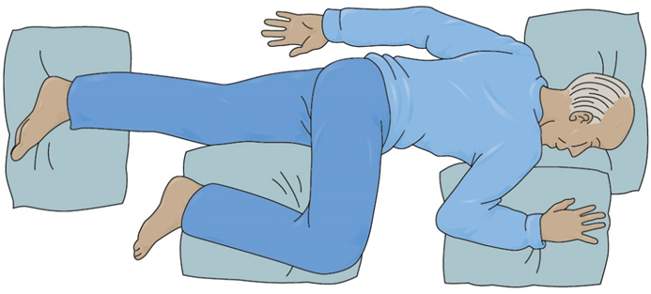
Measuring and recording rectal temperature
Provide for the resident’s privacy with a curtain, screen, or door.
Adjust the bed to safe level, usually waist high. Lock bed wheels.
Help the resident to left-lying (Sims’) position.
Fold back linens to expose only the rectal area.
Put on gloves.

Slide 32
Measuring and recording rectal temperature
​Digital thermometer: Put on the disposable sheath. Turn on thermometer and wait until the ready sign appears.
Electronic thermometer: Remove the probe from the base unit. Put on the probe cover.
Mercury-free thermometer: Hold the thermometer by the stem. Shake thermometer down to below the lowest number. Put on disposable sheath.
Apply a small amount of lubricant to tip of bulb or probe cover (or apply pre-lubricated cover).

Slide 33
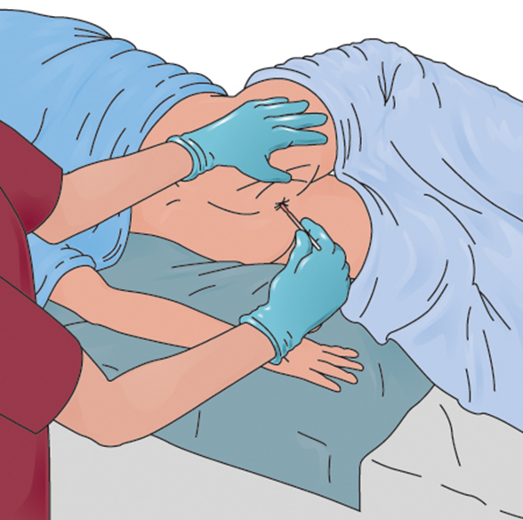
Measuring and recording rectal temperature
Separate the buttocks. Gently insert thermometer into rectum ½ to 1 inch. Stop if you meet resistance. Do not force the thermometer into the rectum.
Replace sheet over buttocks while holding on to the thermometer at all times.

Slide 34
Measuring and recording rectal temperature
​Digital thermometer: Hold thermometer in place until it blinks or beeps.
Electronic thermometer: Leave in place until you hear a tone or see a flashing or steady light.
Mercury-free thermometer: Hold the thermometer in place for at least three minutes.
Gently remove the thermometer. Wipe with tissue from stem to bulb or remove sheath. Discard the tissue or sheath.
Read thermometer at eye level as you would for an oral temperature. Remember the temperature reading.
​Digital thermometer: Clean the thermometer according to facility policy. Replace the thermometer in case.
Electronic thermometer: Press the eject button to discard the cover. Return the probe to the holder.
Mercury-free thermometer: Clean the thermometer according to facility policy. Rinse with clean water and dry. Return it to the case or container.

Slide 35
Measuring and recording rectal temperature
Remove and discard gloves properly.
Wash your hands.
Make resident comfortable.
Immediately record the temperature, date, time, and method used (rectal).
Return bed to its lowest position. Remove privacy measures.
Leave call light within the resident’s reach.
Wash your hands.
Be courteous and respectful at all times.
Report any changes in the resident to the nurse.

Slide 36
Measuring and recording tympanic temperature
Equipment: tympanic thermometer, gloves, disposable sheath/cover, pen and paper
Identify yourself by name. Identify the resident. Greet the resident by name.
Wash your hands.
Explain procedure to the resident. Speak clearly, slowly, and directly. Maintain face-to-face contact whenever possible.

Slide 37
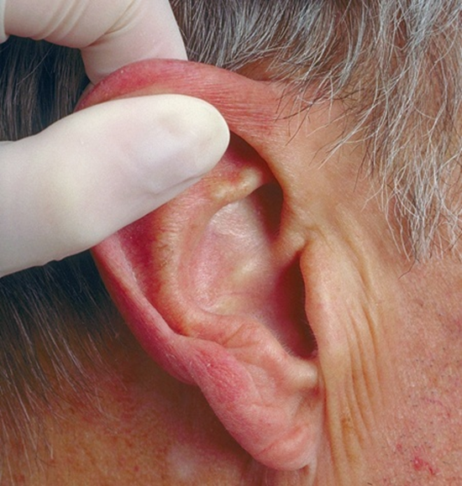
Measuring and recording tympanic temperature
Provide for the resident’s privacy with a curtain, screen, or door.
Put on gloves.
Put a disposable sheath over the earpiece of the thermometer.
Position the resident’s head so that the ear is in front of you. Straighten the ear canal by gently pulling up and back on the outside edge of the ear. Insert the covered probe into the ear canal. Press the button.

Slide 38
Measuring and recording tympanic temperature
Hold thermometer in place until it blinks or beeps.
Read the temperature. Remember the temperature reading.
Dispose of sheath. Return the thermometer to storage or to the battery charger if thermometer is rechargeable.
Remove and discard gloves properly.
Wash your hands.
Immediately record the temperature, date, time, and method used (tympanic).
Make the resident comfortable. Remove privacy measures.
Leave call light within the resident’s reach.
Wash your hands.
Be courteous and respectful at all times.
Report any changes in the resident to the nurse.

Slide 39
Measuring and recording axillary temperature
Equipment: clean digital, electronic or mercury-free thermometer, gloves, tissues, disposable sheath/cover, pen and paper
Identify yourself by name. Identify the resident. Greet the resident by name.
Wash your hands.
Explain procedure to the resident. Speak clearly, slowly, and directly. Maintain face-to-face contact whenever possible.
Provide for the resident’s privacy with a curtain, screen, or door.
Adjust bed to safe level, usually waist high. Lock bed wheels.
Put on gloves.
Remove the resident’s arm from the sleeve of the gown or shirt to allow skin contact with the end of the thermometer. Wipe the axillary area with tissues before placing the thermometer.

Slide 40
Measuring and recording axillary temperature
​Digital thermometer: Put on the disposable sheath. Turn on the thermometer and wait until the ready sign appears.
Electronic thermometer: Remove the probe from the base unit. Put on probe cover.
Mercury-free thermometer: Hold thermometer by stem. Shake thermometer down to below the lowest number. Put on disposable sheath.
Position thermometer (bulb end for mercury-free) in center of the armpit. Fold the resident’s arm over his chest.

Slide 41
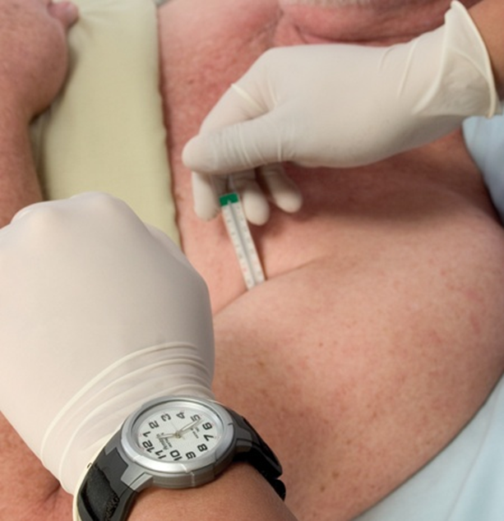
Measuring and recording axillary temperature
​Digital thermometer: Hold thermometer in place until it blinks or beeps.
Electronic thermometer: Leave in place until you hear a tone or see a flashing or steady light.
Mercury-free thermometer: Hold thermometer in place, with the arm close against the side, for 8 to 10 minutes

Slide 42
Measuring and recording axillary temperature
​Digital thermometer: Remove the thermometer. Read the temperature on the display screen. Remember the temperature reading.
Electronic thermometer: Read the temperature on the display screen. Remember the temperature reading. Remove the probe.
Mercury-free thermometer: Gently remove the thermometer. Wipe with a tissue from stem to bulb or remove the sheath. Discard the tissue or sheath. Read the thermometer at eye level as you would for an oral temperature. Remember the temperature reading
​Digital thermometer: Using a tissue, remove and discard the sheath. Clean the thermometer according to facility policy. Replace the thermometer in the case.
Electronic thermometer: Press the eject button to discard the cover. Return the probe to the holder.
Mercury-free thermometer: Clean the thermometer according to facility policy. Return it to the case or container.

Slide 43
Measuring and recording axillary temperature
Remove and discard gloves properly.
Wash your hands.
Put resident’s arm back into the sleeve of the gown. Make the resident comfortable.
Immediately record the temperature, date, time, and method used (axillary).
Return bed to its lowest position. Remove privacy measures.
Leave call light within the resident’s reach.
Wash your hands.
Be courteous and respectful at all times.
Report any changes in the resident to the nurse.

Slide 44
Explain pulse and respirations
Define the following terms:
BPM
the medical abbreviation for beats per minute.
tachycardia
rapid heart rate, over 100 beats per minute.
bradycardia
slow heart rate, under 60 beats per minute.
dilate
to widen.

Slide 45
Explain pulse and respirations
Define the following terms:
respiration
the process of inhaling air into the lungs (inspiration) and exhaling air out of the lungs (expiration).
inspiration
the process of inhaling air into the lungs.
expiration
the process of exhaling air out of the lungs.

Slide 46
Explain pulse and respirations
Define the following terms:
apnea
the absence of breathing.
dyspnea
difficulty breathing.
eupnea
normal respirations.
orthopnea
shortness of breath when lying down that is relieved by sitting up.

Slide 47
Explain pulse and respirations
Define the following terms:
tachypnea
rapid respirations, over 20 breaths per minute.
Cheyne-Stokes respiration
alternating periods of slow, irregular respirations and rapid, shallow respirations, possibly along with periods of apnea.
Kussmaul breathing:
very deep, rapid breathing that is associated with diabetic ketoacidosis and kidney failure; also known as air hunger.

Slide 48
Explain pulse and respirations
Age
Gender
Exercise
Stress
Hemorrhage
Medications
Fever and illness

Slide 49
List guidelines for counting pulse and respirations
Define the following terms:
radial pulse
the pulse located on the inside of the wrist, where the radial artery runs just beneath the skin.
stethoscope
an instrument used to hear sounds in the human body, such as the heartbeat or pulse, breathing sounds, or bowel sounds.
apical pulse
the pulse on the left side of the chest, just below the nipple.

Slide 50
List guidelines for counting pulse and respirations
Remember these points about pulse rate:
Pulse is the number of heartbeats per minute. Normal rate is 60-100 beats per minute for adults.
NA should observe for the overall pattern of the pulse and the quality or type of the pulse.

Slide 51
List guidelines for counting pulse and respirations
Remember these points about respirations:
NA should do the counting immediately after taking the pulse.
It is important not to let the resident know the NA is counting breaths.
Normal rate is 12-20 breaths per minute.
NA should observe for the overall pattern of the respirations and the quality or type of breathing.

Slide 52
Counting and recording radial pulse and counting and recording respirations
Equipment: watch with second hand, pen and paper
Identify yourself by name. Identify the resident. Greet the resident by name.
Wash your hands.
Explain procedure to the resident. Speak clearly, slowly, and directly. Maintain face-to-face contact whenever possible.
Provide for the resident’s privacy with a curtain, screen, or door.

Slide 53
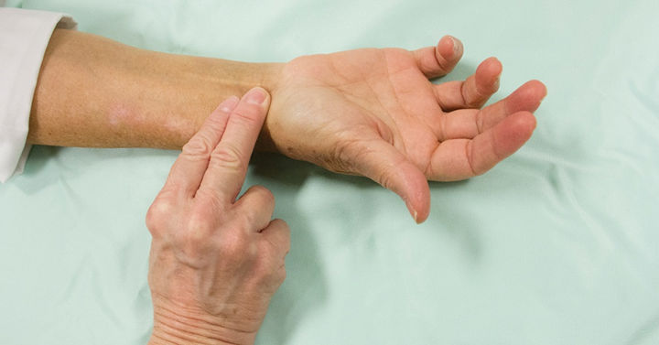
Counting and recording radial pulse and counting and recording respirations
Place the tips of your index finger and middle finger on the thumb side of the resident’s wrist to locate the radial pulse. Do not use your thumb.
Count beats for one full minute.
Keep your fingertips on the resident’s wrist. Count respirations for one full minute. Remember that one respiration consists of an inspiration and an expiration.

Slide 54
Counting and recording radial pulse and counting and recording respirations
(cont’d) Observe for the pattern and character of the resident’s breathing. Normal breathing is smooth and quiet. If you see signs of troubled, shallow, or noisy breathing, such as wheezing, report it to the nurse.
Wash your hands.
Immediately record pulse rate, date, time, and method used (radial). Record the respiratory rate and the pattern or character of breathing.
Remove privacy measures. Make the resident comfortable.
Leave call light within the resident’s reach.
Wash your hands.
Be courteous and respectful at all times.
Report any changes in the resident to the nurse. Report to the nurse if the pulse is less than 60 beats per minute, over 100 beats per minute, if the pulse rhythm is irregular, or if breathing is irregular.

Slide 55
List guidelines for counting pulse and respirations
REMEMBER:
The apical pulse is normally about the same as the radial pulse.

Slide 56
Counting and recording apical pulse
Equipment: stethoscope, watch with second hand, alcohol wipes, pen and paper
Identify yourself by name. Identify the resident. Greet the resident by name.
Wash your hands.
Explain procedure to the resident. Speak clearly, slowly, and directly. Maintain face-to-face contact whenever possible.
Provide for the resident’s privacy with a curtain, screen, or door.
Before using stethoscope, wipe diaphragm and earpieces with alcohol wipes.
Fit the earpieces of the stethoscope snugly in your ears. Place the flat metal diaphragm on the left side of the chest, just below the nipple. Listen for the heartbeat.

Slide 57
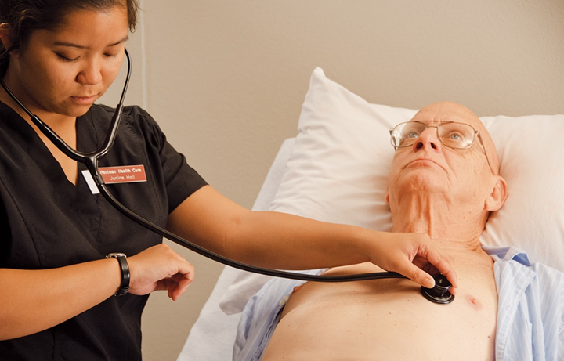
Counting and recording apical pulse
Use the second hand of your watch. Count beats for one full minute. Each “lubdub” you hear is counted as one beat. A normal heartbeat is rhythmical. Leave the stethoscope in place to count respirations.
Immediately record pulse rate, date, time, and method used (apical). Note any irregularities in the rhythm.
Clean the earpieces and diaphragm of the stethoscope with alcohol wipes.

Slide 58
Counting and recording apical pulse
Make the resident comfortable. Remove privacy measures.
Leave call light within the resident’s reach.
Wash your hands.
Be courteous and respectful at all times.
Report any changes in the resident to the nurse.

Slide 59
List guidelines for counting pulse and respirations
REMEMBER:
The pulse deficit is the difference between an apical pulse and another pulse.
For example, if the apical pulse is 80 beats per minute, and the radial pulse is 68 beats per minute, the pulse deficit is 12 (80 - 68 = 12).

Slide 60
Counting and recording apical-radial pulse
Equipment: stethoscope, watch with second hand, alcohol wipes, pen and paper
Find a coworker to assist you.
Identify yourself by name. Identify the resident. Greet the resident by name.
Wash your hands.
Explain procedure to the resident. Speak clearly, slowly, and directly. Maintain face-to-face contact whenever possible.
Provide for the resident’s privacy with a curtain, screen, or door.
Before using the stethoscope, wipe the diaphragm and earpieces with alcohol wipes.
Fit the earpieces of the stethoscope snugly in your ears. Place the flat metal diaphragm on the left side of the chest, just below the nipple. Listen for the heartbeat.

Slide 61
Counting and recording apical-radial pulse
Your coworker should place her fingertips on the thumb side of resident’s wrist to locate the radial pulse.
After both pulses have been located, look at the second hand of your watch. When the second hand reaches the 12 or 6, say, “Start,” and both people will count beats for one full minute. Say, “Stop” after one minute.
Record both pulse rates, date, time, and method used (apical-radial). Record pulse deficit if the pulse rates are not the same (subtract radial pulse measurement from apical pulse to get pulse deficit). Note any irregularities in the pulse rhythm.
Clean the earpieces and diaphragm of stethoscope with alcohol wipes.

Slide 62
Counting and recording apical-radial pulse
Make the resident comfortable. Remove privacy measures.
Leave call light within resident’s reach.
Wash your hands.
Be courteous and respectful at all times.
Report any changes in the resident to the nurse.

Slide 63
Identify factors that affect blood pressure
Define the following terms:
systolic
first measurement of blood pressure; phase when the heart is at work, contracting and pushing blood out of the left ventricle.
diastolic
the second measurement of blood pressure; phase when the heart relaxes or rests.
hypertension
high blood pressure, regularly measuring 130/80 mm Hg or higher.

Slide 64
Identify factors that affect blood pressure
Define the following terms:
hypotension
low blood pressure, below 90/60 mm Hg.
orthostatic hypotension
a sudden drop in blood pressure that occurs when a person stands or sits up; also called postural hypotension.

Slide 65
Identify factors that affect blood pressure
All of these factors can affect blood pressure:
Age
Exercise
Stress
Race
Heredity
Obesity/unhealthy diet
Alcohol
Tobacco products
Time of day
Illness

Slide 66
List guidelines for measuring blood pressure
Define the following terms:
sphygmomanometer
a device that measures blood pressure.
brachial pulse
the pulse located inside the elbow; about 1 to 1½ inches above the elbow.

Slide 67
List guidelines for measuring blood pressure
There are different types of sphygmomanometers:
An aneroid sphygmomanometer has a round gauge that is portable or is attached to the wall. It may also hook onto clothing.
A digital sphygmomanometer automatically inflates and deflates to measure blood pressure. In addition to blood pressure, it may also measure other vital signs. The use of a stethoscope is not required with digital sphygmomanometers.

Slide 68
List guidelines for measuring blood pressure
Remember these points about blood pressure:
Brachial pulse is used to measure blood pressure.
The cuff must first be completely deflated before measuring blood pressure.

Slide 69
List guidelines for measuring blood pressure
An NA should not to take blood pressure when these situations exist:
An intravenous line (IV) is present.
The cuff does not fit the arm properly.
The arm has a cast.
Burns or injuries are present.
The arm is being used for dialysis.
The arm or side has had recent trauma.
The arm or side is paralyzed due to stroke.
An amputation has been performed.
The side has had a mastectomy (or any other surgery or incision).

Slide 70
List guidelines for measuring blood pressure
Remember these additional points about blood pressure:
Cuff must be correct size.
Observe for normal readings and the quality or type of sounds.
Other sites for measuring blood pressure are forearm, thigh, and calf. Other sites may be required due to the size of the upper arm or blood pressure cuff or due to recent surgeries or conditions.

Slide 71
List guidelines for measuring blood pressure
REMEMBER:
Taking accurate blood pressure takes practice. It is not always easy to perfect the skill of hearing the first and last sounds of the blood pressure. You may have to do the procedure over and over again and have others check your results for correctness.

Slide 72
Measuring and recording blood pressure manually
Equipment: sphygmomanometer, stethoscope, alcohol wipes, pen and paper
Do not take blood pressure if the resident has had tobacco, alcohol, caffeine, or food, or has exercised within the last 30 minutes.
Identify yourself by name. Identify the resident. Greet the resident by name.
Wash your hands.
Explain procedure to the resident. Speak clearly, slowly, and directly. Maintain face-to-face contact whenever possible.
Provide for the resident’s privacy with a curtain, screen, or door.
Before using the stethoscope, wipe the diaphragm and earpieces with alcohol wipes.

Slide 73
Measuring and recording blood pressure manually
Make sure the resident is positioned comfortably. Ask the resident to roll up his sleeve so that his upper arm is exposed (approximately five inches above the elbow). Do not measure blood pressure over clothing.
Position resident’s arm with his palm up. The arm should be level with the heart.
With the valve open, squeeze the cuff. Make sure it is completely deflated.

Slide 74
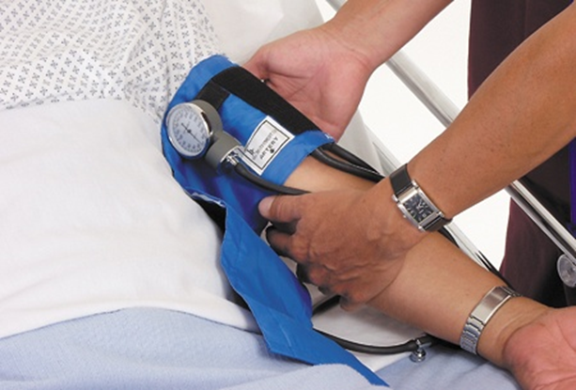
Measuring and recording blood pressure manually
Place the proper sized cuff snugly on resident’s upper arm. The center of the cuff with sensor/arrow is placed over the brachial artery (1-1½ inches above the elbow toward inside of elbow).
Ask the resident to remain still and quiet during the measurement
Locate the brachial artery pulse with your fingertips.
Place the earpieces of the stetho-scope in your ears.
Place the diaphragm of the stetho-scope over the brachial artery.

Slide 75
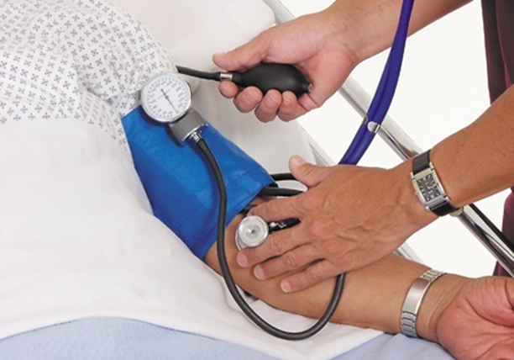
Measuring and recording blood pressure manually
Close the valve (clockwise) until it stops. Do not over-tighten it.
Inflate cuff to between 160 mm Hg to 180 mm Hg. If a beat is heard immediately upon cuff deflation, completely deflate the cuff. Reinflate the cuff to no more than 200 mm Hg.
Open the valve slightly with thumb and index finger. Deflate the cuff slowly.

Slide 76
Measuring and recording blood pressure manually
Watch the gauge. Listen for sound of the pulse.
Remember the reading at which the first clear pulse sound is heard. This is the systolic blood pressure.
Continue listening for a change or muffling of the pulse sound. The moment you hear a change or the point at which the sound disappears is the diastolic pressure. Remember this reading.
Open the valve. Deflate the cuff completely. Remove the cuff.
Wash your hands.
Immediately record both the systolic and diastolic pressures. Record the numbers like a fraction, with the systolic reading on top and the diastolic reading on the bottom (for example: 110/70). Note which arm was used. Use RA for right arm and LA for left arm.

Slide 77
Measuring and recording blood pressure manually
Wipe the diaphragm and earpieces of the stethoscope with alcohol wipes. Store equipment.
Make the resident comfortable. Remove privacy measures.
Leave the call light within the resident’s reach.
Wash your hands.
Be courteous and respectful at all times.
Report the blood pressure to a nurse if the reading is abnormal or significantly different from a previous reading.

Slide 78
Measuring and recording blood pressure electronically
Equipment: Electronic blood pressure machine, pen and paper
Identify yourself by name. Identify the resident. Greet the resident by name.
Wash your hands.
Explain procedure to the resident. Speak clearly, slowly, and directly. Maintain face-to-face contact whenever possible.
Provide for the resident’s privacy with a curtain, screen, or door.
Make sure the resident is positioned comfortably. Ask the resident to roll up his sleeve so that his upper arm is exposed (approximately five inches above the elbow). Do not measure blood pressure over clothing.
Position resident’s arm with his palm up. The arm should be level with the heart.

Slide 79
Measuring and recording blood pressure electronically
Ask the resident to remain still and quiet during the measurement.
Turn on the blood pressure machine. If needed, choose the proper setting for an adult. Press the start button.
When the measurement is complete, the reading will be displayed on the screen and the machine may beep. The cuff should deflate.
Remove the cuff.
Wash your hands.
Immediately record both the systolic and diastolic pressures that are displayed on the screen. Note which arm was used.

Slide 80
Measuring and recording blood pressure electronically
Make the resident comfortable. Remove privacy measures.
Leave the call light within the resident’s reach.
Wash your hands.
Be courteous and respectful at all times.
Report the blood pressure to a nurse if the reading is abnormal or significantly different from a previous reading.

Slide 81
Describe guidelines for pain management
Remember these points about pain:
It is as important to monitor as vital signs.
It is uncomfortable and an individual experience.
NAs must take complaints of pain seriously.
NAs should ask questions to get accurate information.

Slide 82
Describe guidelines for pain management
Know the signs and symptoms of pain to observe and report:
Increased pulse, respirations, and blood pressure
Sweating
Nausea and vomiting
Tightening the jaw
Squeezing eyes shut
Holding or guarding a body part
Frowning
Grinding teeth
Increased restlessness

Slide 83
Describe guidelines for pain management
Signs and symptoms of pain (cont’d):
Agitation or tension
Change in behavior
Crying
Sighing
Groaning
Breathing heavily
Difficulty moving or walking

Slide 84
Describe guidelines for pain management
Nursing assistants should take these measures to reduce pain:
Report complaints of pain or unrelieved pain promptly to the nurse.
Check on the resident often and ask if the pain has been relieved.
Give back rubs frequently if allowed.
Assist in frequent changes of position. Use pillows to properly support the body. Be careful when moving, lifting, or transferring the resident in pain

Slide 85
Describe guidelines for pain management
Measures to reduce pain (cont’d):
Offer warm baths or showers.
Assist the resident to the bathroom or commode or offer the bedpan or urinal.
Encourage slow, deep breathing.
Be patient, caring, gentle, empathetic, and responsive to residents who are in pain.

