Slide 2
Define important words in this chapter
apathy
a lack of interest.
diet cards
cards that list residents’ names and information about special diets, allergies, likes and dislikes, and any other dietary instructions.
diuretics
substances that increase urine formation and cause the body to excrete sodium, potassium, and water through the kidneys.
fasting
a period of time during which food is given up voluntarily.

Slide 3
Define important words in this chapter
fluid balance
maintaining equal input and output.
fluid overload
a condition in which the body cannot eliminate the fluid consumed.
glucose
natural sugar.
graduate
container for measuring fluid volume.

Slide 4
Define important words in this chapter
input
the fluid a person consumes; also called intake.
intake
the fluid a person consumes; also called input.
lactose intolerance
inability of the body to digest lactose, a type of sugar found in milk and other dairy products.
malnutrition
the lack of proper nutrition that results from insufficient food intake or an improper diet.

Slide 5
Define important words in this chapter
metabolism
the process of breaking down and transforming all nutrients that enter the body to provide energy and growth.
nutrient
a necessary substance that provides energy, promotes growth and health, and helps regulate metabolism.
nutrition
the process by which the body uses food to maintain health.
output
fluid that is eliminated each day through urine, feces, and vomitus, and perspiration; also includes suctioned material and wound drainage.

Slide 6
Define important words in this chapter
puree
to blend or grind food into a thick paste.
restrict fluids (RF)
a medical order to limit the amount of fluids a person drinks to the level set by a doctor.
special diet
a diet for people who have certain illnesses or conditions; also called therapeutic or modified diet.

Slide 7
Define important words in this chapter
vegans
people who do not eat meat, fish, or poultry and may or may not eat eggs and dairy products.
vegetarians
people who do not eat meat, fish, or poultry and may or may not eat eggs and dairy products.

Slide 8
Describe common nutritional problems of the elderly and the chronically ill
Define the following terms:
nutrition
the process by which the body uses food to maintain health.
malnutrition
the lack of proper nutrition that results from insufficient food intake or an improper diet.

Slide 9
Describe common nutritional problems of the elderly and the chronically ill
REMEMBER:
Aging and illness affect nutrition. Malnutrition, unhealthy weight loss, and dehydration are serious problems among the elderly. Malnutrition is the lack of proper nutrition that results from insufficient food intake or an improper diet.

Slide 10
Describe common nutritional problems of the elderly and the chronically ill
The following problems can affect nutrition:
Less saliva
Side effects from medication
Decrease in activity and mobility
Weakened sense of smell and taste
Loss of vision
Dentures, tooth loss, or poor dental health
Depression and lack of interaction
Special diets that restrict foods

Slide 11
Describe common nutritional problems of the elderly and the chronically ill
Here are some conditions that make it more difficult to eat or swallow:
Stroke
Cancer
Parkinson’s disease
Multiple sclerosis
Alzheimer’s disease

Slide 12
Describe cultural factors that influence food preferences
Define the following terms:
fasting
a period of time during which food is given up voluntarily.
vegetarians
people who do not eat meat, fish, or poultry and may or may not eat eggs and dairy products.
vegans
people who do not eat meat, fish, or poultry and may or may not eat eggs and dairy products.

Slide 13
Describe cultural factors that influence food preferences
Critical Thinking: Conversation Starter
Why is it important to know and honor residents’ food preferences?

Slide 14
Describe cultural factors that influence food preferences
REMEMBER:
Report requests for diet substitutions immediately. This is part of knowing and honoring residents’ food preferences.

Slide 15
Describe cultural factors that influence food preferences
Critical Thinking: Conversation Starter
Reflect on your own regional, cultural, or religious food preferences. How would these preferences affect you if you had to move into a long-term care facility?

Slide 16
Identify six basic nutrients
Define the following terms:
nutrient
a necessary substance that provides energy, promotes growth and health, and helps regulate metabolism.
metabolism
the process of breaking down and transforming all nutrients that enter the body to provide energy and growth.

Slide 17
Identify six basic nutrients
REMEMBER:
Good health requires a daily amount of each of the main nutrients for cells, tissues, organs, and systems to continue to function properly.

Slide 18
Identify six basic nutrients
Water
Water is the most essential nutrient for life.
Water helps with digestion and absorption of food.
It helps to maintain normal body temperature.

Slide 19
Identify six basic nutrients
Fats
Good source of energy
Add flavor to food
Fall into four categories: saturated, trans fat, monounsaturated, and polyunsaturated
Saturated and trans fats can increase cholesterol levels and the risk of some diseases, like cardiovascular disease.
Monounsaturated and polyunsaturated fats can be helpful in the diet, and can decrease the risk of cardiovascular disease and type 2 diabetes.

Slide 20
Identify six basic nutrients
Carbohydrates
Provide fuel for energy
Provide fiber
Protein
Essential for tissue growth and repair
Provides a supply of energy

Slide 21
Identify six basic nutrients
Vitamins
Vitamins are essential to body functions.
Fat-soluble vitamins are A, D, E, and K.
Water-soluble vitamins are B and C.
Minerals
Minerals form and maintain body functions
Examples of minerals include zinc, iron, calcium, and magnesium

Slide 22
Explain the USDA’s MyPlate
REMEMBER:
In 2011, in response to increasing rates of obesity, the United States Department of Agriculture (USDA) developed MyPlate to help people build a healthy plate at meal times.
The MyPlate icon emphasizes vegetables, fruits, grains, protein, and low-fat dairy products.

Slide 23
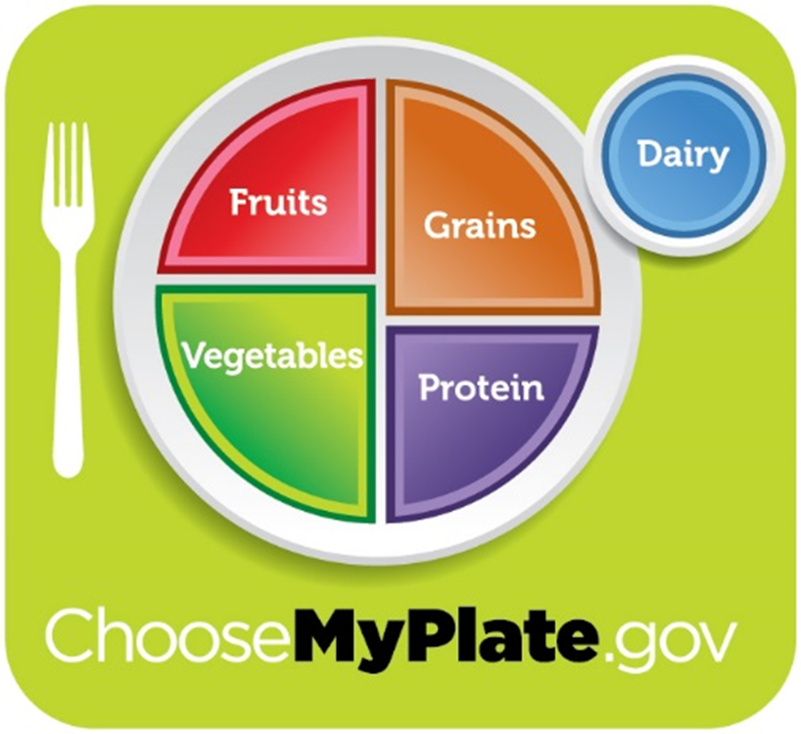
Key Material 14-1: MyPlate

Slide 24
Explain the USDA’s MyPlate
Vegetables and fruits
Make half your plate fruits and vegetables.
Dark green, red, and orange vegetables have the best nutritional content.
Vegetables are low in fat, calories, and have no cholesterol.
Vegetables provide fiber and vitamins.
Fruits are low in fat, sodium, calories, and have no cholesterol.
Fruits provide vitamins and fiber.

Slide 25
Explain the USDA’s MyPlate
Grains
At least half of all grains consumed should be whole grains.
Whole grains contain bran and germ, as well as the endosperm. Refined grains retain only the endosperm.
Grains are found in cereal, bread, rice, and pasta.

Slide 26
Explain the USDA’s MyPlate
Proteins
Meat, poultry, seafood, and eggs are animal sources of proteins. Beans, peas, soy products, nuts, and seeds are plant sources of proteins.
Eat seafood twice a week in place of meat or poultry.
Choose lean meat and poultry. Include eggs and egg whites on a regular basis.
Eat plant-based protein foods more often.
Some nuts and seeds (flax, walnuts) are excellent sources of essential fatty acids.

Slide 27
Explain the USDA’s MyPlate
Dairy
Provide protein, vitamins, and minerals
Includes all of the foods made from milk that retain their calcium content, such as yogurt and cheese
Most dairy group choices should be fat-free or low-fat (1%).
Choose fat-free or low-fat milk or yogurt more often than cheese.
Soy products enriched with calcium are an alternative to dairy foods.

Slide 28
Explain the USDA’s MyPlate
Remember these additional tips for making healthy food choices:
Balance calories.
Enjoy your food, but eat less.
Avoid oversized portions.
Foods to eat more often are vegetables, fruits, whole grains, and fat-free or 1% milk and low-fat dairy products.
Foods to eat less often are foods high in solid fats, added sugars, and salt. These foods include fatty meats, like bacon and hot dogs, cheese, fried foods, ice cream, and cookies.
Compare sodium in foods. Select canned foods that are labeled sodium free, very low sodium, low sodium, or reduced sodium.
Drink water instead of sugary drinks.

Slide 29
Explain the role of the dietary department
Define the following term:
diet cards
cards that list residents’ names and information about special diets, allergies, likes and dislikes, and any other dietary instructions.

Slide 30
Explain the role of the dietary department
REMEMBER:
The dietary department is responsible for providing nutritious meals and snacks to all residents. Each resident is evaluated upon admission in order to create his or her diet plan.

Slide 31
Explain the role of the dietary department
The dietary department
Plans and makes meals
Prepares food so that residents are able to manage it
Prepares food in a way that looks appetizing
Prepares diet cards
Follows infection prevention measures carefully

Slide 32
Explain the importance of following diet orders and identify special diets
Define the following terms:
special diet
a diet for people who have certain illnesses or conditions; also called therapeutic or modified diet.
puree
to blend or grind food into a thick paste.
lactose intolerance
inability of the body to digest lactose, a type of sugar found in milk and other dairy products.
diuretics
substances that increase urine formation and cause the body to excrete sodium, potassium, and water through the kidneys.

Slide 33
Explain the importance of following diet orders and identify special diets
Define the following term:
glucose
natural sugar.

Slide 34
Explain the importance of following diet orders and identify special diets
REMEMBER:
Special diets are often ordered for residents who have certain illnesses or conditions. Sometimes they are ordered to help a resident gain or lose weight. Some diets are ordered for a short time before a medical test or surgery.

Slide 35
Explain the importance of following diet orders and identify special diets
REMEMBER:
Residents who have orders for specific diets require additional care and supervision. Serving a resident the wrong food can cause serious problems, such as allergic reactions and possibly death. It is very important to check resident identification against the diet card before serving meal trays. Also check the food on the tray to see if it matches the diet ordered.

Slide 36
Explain the importance of following diet orders and identify special diets
Residents may be on any of the following special diets:
Liquid diets
Soft diet or mechanical soft diet
Pureed diet
Bland diet
Lactose-free diet
High-residue or high-fiber diet
Low-residue or low-fiber diet
Modified calorie diets
Low-sodium diet

Slide 37
Explain the importance of following diet orders and identify special diets
Special diets (cont'd):
High-protein diet
Low-protein diet
Low-fat/low-cholesterol diet
High-potassium diet
Fluid-restricted diets
Diabetic diet
Gluten-free diet
Vegetarian diets (lacto-ovo, lacto, ovo, vegan)

Slide 38
Explain the importance of following diet orders and identify special diets
REMEMBER:
Residents who are NPO (nothing by mouth) should not be offered drinks (even water) or snacks.

Slide 39
Explain the importance of following diet orders and identify special diets
Critical Thinking: Conversation Starter
What special diets do you or members of your family follow (based on culture, religion, medical conditions, etc.)?

Slide 40
Explain thickened liquids and identify three basic thickening consistencies
Remember these points about thickened liquids:
Thickening improves the ability to control fluid in the mouth and throat.
A doctor orders the necessary thickness.
Some beverages arrive already thickened.
NAs cannot offer regular liquids, including water, to residents who must have thickened liquids.

Slide 41
Explain thickened liquids and identify three basic thickening consistencies
There are three basic thickened consistencies:
Nectar Thick
This consistency is similar to a fruit nectar or other thicker juices, such as tomato juice. A resident can drink this from a cup with or without a straw.
Honey Thick
This consistency is similar to that of honey. It will pour very slowly, and spoons are usually used to consume these types of liquids.
Pudding Thick
This consistency is semi-solid, much like the consistency of pudding. A spoon will stand up straight when put into this thickened liquid. Spoons are used to consume these liquids.

Slide 42
List ways to identify and prevent unintended weight loss
Define the following term:
apathy
a lack of interest.

Slide 43
List ways to identify and prevent unintended weight loss
Critical Thinking: Conversation Starter
Why must an NA report any weight loss in a resident, no matter how small?

Slide 44
List ways to identify and prevent unintended weight loss
REMEMBER:
Unintended weight loss is a serious problem for the elderly.

Slide 45
List ways to identify and prevent unintended weight loss
Report any of these signs and symptoms of unintended weight loss:
Needing help eating or drinking
Eating less than 70% of meals/snacks
Having mouth pain
Having dentures that do not fit properly
Having difficulty chewing or swallowing
Coughing or choking while eating
Being sad or withdrawing from others
Being confused, wandering, or pacing

Slide 46
List ways to identify and prevent unintended weight loss
Know the signs of malnourishment:
Feeling of coldness throughout body
Weight loss
Abdominal distention
Abdominal pain
Constipation
Edema
Cracks or splits at the corners of the mouth
Inflammation of the mucous membranes of the mouth

Slide 47
List ways to identify and prevent unintended weight loss
Signs of malnourishment (cont’d):
Dry or peeling skin
Brittle, easily-cracked nails
Rapidly thinning hair that breaks off easily; hair that changes or loses color
Frequent infections
Muscle weakness
Fainting

Slide 48
List ways to identify and prevent unintended weight loss
Signs of malnourishment (cont’d):
Fatigue
Withdrawal or apathy
Anxiety and irritability
Problems with sleeping
Low body temperature
Slow pulse
Low blood pressure

Slide 49
List ways to identify and prevent unintended weight loss
Remember the following guidelines for preventing unintended weight loss:
Report warning signs immediately.
Report any decrease in appetite.
Talk about eating and food being served in a positive way.
Check to make sure proper diet is being served.
Respond promptly to complaints about food.
Season foods to residents’ preferences.
Use adaptive equipment as needed.
Record meal/snack intake.
Ask for dietician, OT, or SLP consultation, if necessary.

Slide 50
List ways to identify and prevent unintended weight loss
REMEMBER:
Residents may be served snacks or nourishments in addition to their three main meals. Sometimes these snacks or nourishments are required for special diets. Nursing assistants should encourage residents to eat all of their snacks and supplements. If a resident does not finish a snack, a family member eats it, or the NA finds it in the trash, the NA should notify the nurse.

Slide 51
List ways to identify and prevent unintended weight loss
Critical Thinking: Conversation Starter
Can you describe some of the ways that meals are not only a time for getting nutritional needs met, but are also a time for getting social needs met?

Slide 52
Describe how to make dining enjoyable for residents
REMEMBER:
Nursing assistants play a critical role in assisting residents to get proper nutrition.

Slide 53
Describe how to make dining enjoyable for residents
Remember these guidelines for dining:
Follow a routine.
Assist with grooming.
Encourage use of dentures, glasses, and hearing aids.
Give oral care before eating.
Assist with handwashing.
Offer a trip to the bathroom before eating.
Seat residents next to friends.
Properly position residents for eating, normally in the upright position.

Slide 54
Describe how to make dining enjoyable for residents
Guidelines for dining (cont’d):
Place residents in appropriate chairs.
Serve food at correct temperature.
Provide proper eating tools.
Cut food when necessary before bringing it to the table.
Allow enough time for eating.
Keep noise level low. Do not shout or bang plates or cups.
Be cheerful, positive, and helpful.
Honor requests regarding food. Give additional food when requested.

Slide 55
Describe how to make dining enjoyable for residents
REMEMBER
Meals are usually served on trays or are brought from the kitchen. Nursing assistants must work quickly to make sure food is served at the proper temperature and that residents do not have to wait long for their meals.

Slide 56
Describe how to serve meal trays and assist with eating
Remember these guidelines for serving trays:
Wash hands first.
Check the diet card for special diet orders, and identify each resident before serving a meal tray.
Serve all residents at one table before serving another table.
Maintain proper temperature of food.
Wearing gloves, prepare food, only doing what residents cannot do for themselves.
Open milk or juice cartons. Put in straw if resident uses one.
Butter roll, bread, and vegetables as resident likes.
Offer to season all food as resident likes, including pureed food.

Slide 57
Describe how to serve meal trays and assist with eating
Remember the following when serving meal trays to residents in isolation:
Follow Isolation Precautions, along with Standard Precautions.
Apply PPE as needed.
Do not share food with anyone.

Slide 58
Describe how to serve meal trays and assist with eating
Remember the following points about assisting residents with eating:
Residents will need different levels of help.
Prepare residents who require the least assistance first.
Some residents will need to be fed. Be sensitive and give privacy.
Do not judge food choices.
Follow infection prevention precautions.
Offer a clothing protector but respect the resident’s right to refuse to wear it.
Sit at resident’s eye level and give him full attention.
Identify food and fluids in front of resident, including pureed foods.

Slide 59
Describe how to serve meal trays and assist with eating
Assisting residents with eating (cont’d):
Ask resident which food he wants first.
Do not mix foods.
Put hand over food to test temperature. Do not blow on it or touch it.
Make appropriate conversation. Say positive things about the food.
Pay attention to person you are helping. Do not talk to other staff.
Alternate between food and drink.
Honor requests for different food.
Respect a resident’s right to refuse to eat.

Slide 60
Describe how to serve meal trays and assist with eating
REMEMBER:
Do not insist a resident use a clothing protector if he or she does not wish to do so, and always use the term clothing protector rather than bib.

Slide 61
Feeding a resident
Equipment: meal; beverage; eating utensils; clothing protector; washcloths, wipes, towel, or paper towels
Identify yourself by name. Identify the resident. Greet the resident by name.
Wash your hands.
Explain procedure to resident. Speak clearly, slowly, and directly. Maintain face-to-face contact whenever possible.
Provide for the resident’s privacy with a curtain, screen, or door.
Look at diet card or menu. Ask resident to state her name. If the resident is unable to state her name, check identification another way, such as looking at a photo ID or armband. Verify that resident has received the right tray.

Slide 62
Feeding a resident
Raise the head of the bed. Make sure resident is in an upright sitting position (at a 90-degree angle).
Adjust bed height to where you will be able to sit at resident’s eye level. Lock bed wheels.
Place the tray where it can be easily seen by the resident, such as on the overbed table.
Help the resident clean hands with a wet washcloth, hand wipe, towel, or paper towel if the resident cannot do herself.
Help resident to put on clothing protector if desired.

Slide 63
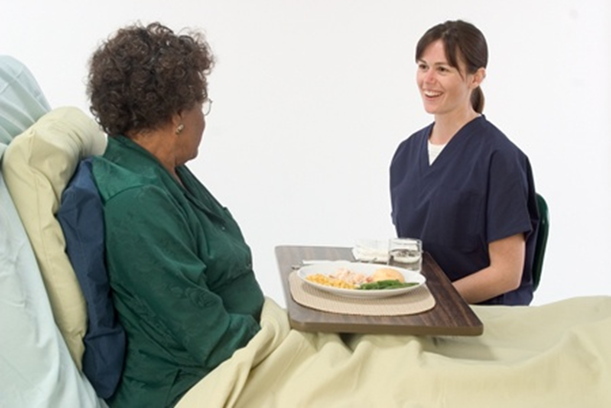
Feeding a resident
Sit facing the resident at the resident’s eye level. Sit on the stronger side if the resident has one-sided weakness. Do not sit on the resident’s bed.
Tell the resident what foods and beverages are on the tray. Offer a drink of beverage and ask what the resident would like to eat first.

Slide 64
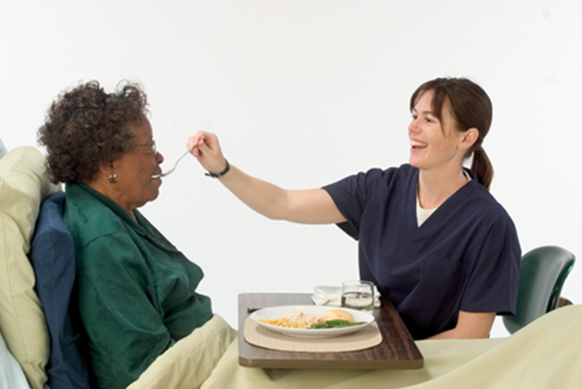
Feeding a resident
Check the temperature of the food (see previous guidelines). Using utensils, offer the food in bite-sized pieces, telling the resident the content of each bite of food offered. Alternate types of food, allowing for resident’s preferences. Do not feed all of one type before offering another type. Make sure resident’s mouth is empty before the next bite or sip is offered. Report any swallowing problems to the nurse immediately. If resident has one-sided weakness, direct food to the unaffected, or stronger, side.

Slide 65
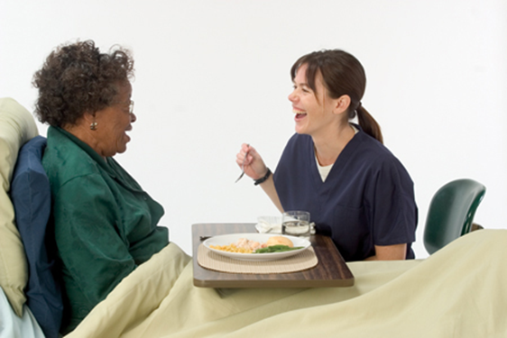
Feeding a resident
Ask the resident if she is ready for the next sip of the beverage. Offer sips of beverage to the resident throughout the meal. If you are holding the cup, touch it to the resident’s lips before you tip it. Give small, frequent sips.
Talk with the resident during the meal.

Slide 66
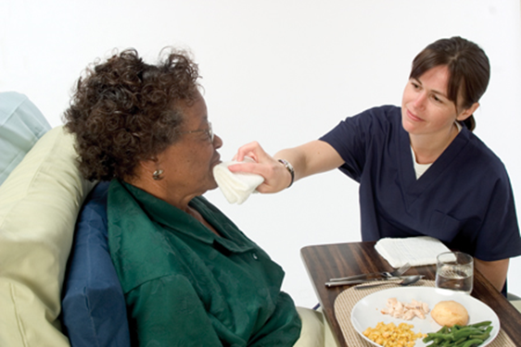
Feeding a resident
Use a washcloth, wipe, towel or paper towel to wipe food from the resident’s mouth and hands as needed during the meal. Wipe again at the end of the meal.
Remove the clothing protector if used. Place it and used washcloths or wipes in the proper containers.
Remove the food tray. Check for eyeglasses, dentures, hearing aids, or any personal items before removing the tray. Place the tray in proper area to be picked up.

Slide 67
Feeding a resident
Make the resident comfortable. Keep the resident in the upright position for at least 30 minutes after eating and drinking. Make sure the bed is free from crumbs.
Return bed to lowest position. Remove privacy measures.
Leave call light within the resident’s reach.
Wash your hands.
Be courteous and respectful at all times.
Report any changes in the resident to the nurse. Document procedure using facility guidelines. Record intake of solid food and fluids properly (see Learning Objective 14 for more information).

Slide 68
Describe how to assist residents with special needs
REMEMBER:
Residents with certain diseases or conditions, such as Parkinson’s disease, stroke, dementia, head trauma, blindness, or confusion may need additional help with eating.

Slide 69
Describe how to assist residents with special needs
Follow these guidelines for special dining techniques:
Use assistive devices when necessary.
Use physical and verbal cues.
Always put food into the stronger side of the mouth.
Read menus to visually-impaired residents. Allow time with eating and use the face of an imaginary clock to explain the position of food.

Slide 70
Describe how to assist residents with special needs
These tips can be useful for nursing assistants dealing with specific special needs:
Resident eats too quickly:
Remind him to chew, and set the utensils down between bites. Use smaller cups and plates and put less food on plates.
Resident bites down on utensils:
Ask the resident to open his mouth. Wait until the jaw relaxes to pull the utensil out of the mouth. Offer finger foods instead.
Resident cannot or will not chew:
Lightly press on the edge of the lips or on the chin to stimulate chewing.

Slide 71
Describe how to assist residents with special needs
Dealing with specific special needs (cont’d):
Resident will not stop chewing:
Ask him to stop chewing. Offer smaller bites of food and feed softer foods that do not need as much chewing.
Resident holds food in his mouth:
Remind him to swallow after every bite. After feeding a bite of food, lightly press an empty teaspoon against the lips to encourage the person to swallow the food.
Resident pockets food in his cheek:
Ask him to chew and swallow the food. Touch the outside of the cheek and ask him to use his tongue to get the food.

Slide 72
Describe how to assist residents with special needs
Dealing with specific special needs (cont’d):
Resident has poor lip closure:
Remind him to close his lips. Show him how to close his lips if necessary.
Resident has no teeth or missing teeth:
Thickened liquids or soft or pureed diets may be ordered.
Resident has dentures that do not fit properly:
Report it to the nurse immediately for evaluation by a dentist. Thickened liquids or soft or pureed diets may be ordered.

Slide 73
Describe how to assist residents with special needs
Dealing with specific special needs (cont’d):
Resident has change in vision that causes problems seeing food clearly:
Make sure resident wears eyeglasses and that they are clean. Report to the nurse if eyeglasses are damaged or broken. Read menus out loud and describe food.
Resident has protruding tongue or tongue thrust:
Use special straws and cups to help.
Resident will not open his mouth:
Touch his lower lip to encourage him to open the mouth.

Slide 74
Describe how to assist residents with special needs
Dealing with specific special needs (cont’d):
Resident falls asleep while eating:
Seat him with residents who talk a lot and are very social. Make appropriate conversation while he is eating.
Resident chokes when drinking:
Remind him to lift his chin before taking a sip of fluid. Offer fluids when he has no food in his mouth. Resident should be seated, not standing, while drinking.
Resident is susceptible to choking:
Avoid foods like cake, hot dogs, peanut butter, nuts, popcorn, raw vegetables and certain fruits, like grapes.

Slide 75
Describe how to assist residents with special needs
Dealing with specific special needs (cont’d):
Resident forgets to eat:
Remind him to take another bite. Offer praise and encouragement. Do not rush the resident.
Resident drools excessively:
Make sure he is in an upright eating position, using good posture.
Resident has poor sitting balance:
Seat him in a regular dining room chair with armrests, rather than a wheelchair. Position him upright at a 90-degree angle.

Slide 76
Describe how to assist residents with special needs
Dealing with specific special needs (cont’d):
Resident tends to lean on one side:
Ask him to keep his elbows on the table. Using a wheelchair wedge cushion may help.
Resident tends to fall forward:
Using a geriatric chair may help. A wheelchair wedge cushion may also help.
Resident has poor neck control:
A soft neck brace may stabilize the head. A wedge cushion behind the head and shoulders can help a resident in a geriatric chair.

Slide 77
Describe how to assist residents with special needs
Critical Thinking: Conversation Starter
How would it feel to have one of the problems described? If you were in this situation, what attitudes could a nursing assistant have that would make things easier for you?

Slide 78
Discuss dysphagia and list guidelines for preventing aspiration
Know these signs and symptoms of dysphagia that must be reported to the nurse:
Slow eating
Avoidance of eating
Spitting out pieces of food
Difficulty chewing food
Difficulty swallowing small bites of food or pills
Several swallows needed per mouthful
Dribbling saliva, food, or fluid from the mouth
Food residue inside the mouth or cheeks during and after meals

Slide 79
Discuss dysphagia and list guidelines for preventing aspiration
Signs and symptoms of dysphagia (cont’d):
Vomiting while eating or drinking
Frequent throat clearing
Food or fluid coming up into the nose
Coughing during or after meals
Choking during meals
Gurgling sound in voice during or after meals, or loss of voice
Problems breathing while eating or drinking
Visible effort to swallow
Watering eyes when eating or drinking

Slide 80
Key Material 14-2: Preventing Aspiration
• Position in a straight, upright position at a 90-degree angle.
• Feed residents slowly.
• Avoid distractions.
• Offer small pieces of food or small spoons of pureed food.
• Offer food and then a liquid.
• Place food in the non-paralyzed side of the mouth.
• Make sure food is actually swallowed before next bite of food or sip of drink.
• Have residents stay in upright position for at least 30 minutes after eating and drinking.
• Provide mouth care after eating.
• Observe residents closely. Report signs of aspiration immediately.

Slide 81
Describe intake and output (I&O)
Define the following terms:
intake
the fluid a person consumes; also called input.
input
the fluid a person consumes; also called intake.
output
fluid that is eliminated each day through urine, feces, and vomitus, and perspiration; also includes suctioned material and wound drainage.
fluid balance
maintaining equal input and output.
graduate
a container for measuring fluid volume.

Slide 82
Describe intake and output (I&O)
REMEMBER:
Most people maintain fluid balance naturally. However, residents on special diets or who have certain illnesses may need to have their intake and output (I&O) measured. Measuring I&O means that staff record and add together all of the amounts of food and fluids the resident takes in and eliminates within 24 hours.

Slide 83
Key Material 14-3: Conversion Table
One ounce equals 30 milliliters. To convert ounces to milliliters, the number of ounces must be multiplied by 30.
1 oz. = 30 mL
2 oz. = 60 mL
3 oz. = 90 mL
4 oz. = 120 mL
5 oz. = 150 mL
6 oz. = 180 mL
7 oz. = 210 mL
8 oz. = 240 mL
¼ cup = 2 oz. = 60 mL
½ cup = 4 oz. = 120 mL
¾ cup = 6 oz. = 180 mL
1 cup = 8 oz. = 240 mL
2 cups = 16 oz. = 480 mL
4 cups = 32 oz. = 960 mL

Slide 84
Handout 14-1: Basic Math
Nursing assistants need math skills when doing certain tasks, such as calculating intake and output. A basic math review is listed below:
Addition
Subtraction
2,905 | 53,138
+174 | +3008
3,049 | 56,146
32,542 | 549,233
-8,710 | -26,903
23,832 | 522,330

Slide 85
Handout 14-1: Basic Math (cont’d)
Nursing assistants need math skills when doing certain tasks, such as calculating intake and output. A basic math review is listed below:
Multiplication:
4,962 | 79
x 13 | x 41
14,886 | 79
+49,620 | +3,160
64,506 | 3,239

Slide 86
Handout 14-1: Basic Math (cont’d)
Nursing assistants need math skills when doing certain tasks, such as calculating intake and output. A basic math review is listed below:
Division:
 | 34 |  | 39
22 | 748 | 14 | 546
 | -66 |  | -42
 | 88 |  | 126
 | -88 |  | -126
 | 0 |  | 0

Slide 87
Handout 14-2: Basic Math (cont’d)
Converting Decimals, Fractions, and Percentages
Decimals, fractions, and percentages are different ways of showing the same value. For example, one-half can be written in the following ways:
As a decimal: 0.5
As a fraction: ½
As a percentage: 50%
Here are common values shown in decimal, fraction, and percentage forms:
Decimal | Fraction | Percentage
0.01 | 1/100 | 1%
0.1 | 1/10 | 10%
0.2 | 1/5 | 20%
0.25 | 1/4 | 25%
0.333 | 1/3 | 33 1/3%
0.5 | 1/2 | 50%
0.75 | 3/4 | 75%
1 | 1/1 | 100%

Slide 88
Handout 14-1: Basic Math (cont’d)
Problem : 1/4 = 0.25 = 25%
 | .25
4 | 1.0
 | - .08 20
 | -20
 | 0
To change 0.25 into a percent, move the decimal sign two places to the right and add the percent sign. Drop the decimal sign if there are no numbers to the right of the decimal sign.
0.25 = 25%

Slide 89
Handout 14-1: Basic Math (cont’d)
Problem : 3/4 = 0.75 = 75%
 | .75
4 | 3.0
 | -28 20
 | -20
 | 0
To change 0.75 into a percent, move the decimal sign two places to the right and add the percent sign. Drop the decimal sign if there are no numbers to the right of the decimal sign.
0.75 = 75%

Slide 90
Measuring and recording intake and output
Equipment: I&O sheet, pen and paper
Measure intake first.
Identify yourself by name. Identify the resident. Greet the resident by name.
Wash your hands.
Explain procedure to resident. Speak clearly, slowly, and directly. Maintain face-to-face contact whenever possible.
Provide for the resident’s privacy with a curtain, screen, or door.
A list of container sizes should be available to help with measuring. For example, a water cup equals 240 mL, a cereal bowl equals 150 mL, and a milk carton equals 240 mL. Note the amount of fluid the resident is served on paper.
When the resident has finished a meal or snack, measure any leftover fluids. Note this amount on paper. (If the amount is between measurement lines, you may need to round up to the nearest 25 mL. Follow policy.)

Slide 91
Measuring and recording intake and output
Subtract the leftover amount from the amount served. If you have measured in ounces, convert to milliliters (mL) by multiplying by 30.
Record amount of fluid consumed (in mL) in input column on I&O sheet. Record the time and type of fluid consumed.
Wash your hands.
Measuring output is the other half of monitoring fluid balance.
Chapter 16 contains information about emptying and measuring urine from a catheter drainage bag.
Equipment: I&O sheet, graduate, gloves, additional PPE if required
Wash your hands.

Slide 92
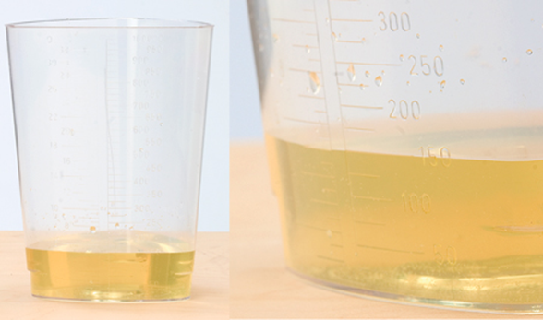
Measuring and recording intake and output
Put on gloves before handling bedpan/urinal.
Pour the contents of the bedpan or urinal into graduate. Do not spill or splash any of the urine.
Place the graduate on flat surface. Measure the amount of urine at eye level. Keep the container level. (f the amount is between measurement lines, you may need to round up to the nearest 25 mL. Follow policy.)
After measuring urine, empty the contents of the graduate into the toilet without splashing.
Rinse the graduate and pour the rinse water into the toilet.

Slide 93
Measuring and recording intake and output
Rinse bedpan/urinal and pour the rinse water into the toilet. Flush the toilet.
Place the graduate and bedpan in area for cleaning or clean and store according to policy.
Remove and discard gloves properly.
Wash hands before recording output.
Immediately document the time and amount of urine in the output column on sheet. Report any changes to the nurse.

Slide 94
List ways to identify and prevent dehydration
REMEMBER:
Drinking at least 64 ounces (eight 8-ounce glasses) of water or other fluids per day can help prevent constipation, urinary incontinence, and dehydration.

Slide 95
List ways to identify and prevent dehydration
Report any of these signs and symptoms of dehydration:
Drinking less than six 8-ounce glasses of liquid per day
Drinking little or no fluids at meals
Needing help drinking from cup
Having trouble swallowing liquids
Having frequent vomiting, diarrhea, or fever
Being easily confused or tired
Severe thirst
Dry mouth
Decrease in urinary output

Slide 96
List ways to identify and prevent dehydration
These additional signs and symptoms of dehydration are also important to report:
Severe thirst
Dry mouth and mucous membranes
Cracked lips
Dry, warm, wrinkled, or clammy skin
Sunken eyes
Flushed face
Decrease in urinary output
Dark urine

Slide 97
List ways to identify and prevent dehydration
Additional signs and symptoms of dehydration that are important to report (cont’d):
Strong-smelling urine
Constipation or weight loss
Weakness, dizziness, lightheadedness, or confusion
Headache
Irritability
Rapid or weakened pulse
Irregular heartbeat
Low blood pressure

Slide 98
List ways to identify and prevent dehydration
Remember these guidelines for preventing dehydration:
Report warning signs immediately.
Encourage residents to drink every time you see them.
Offer fluids that residents prefer.
Make sure pitcher and cup are close by and are light enough for resident to lift.
Offer assistance.
Offer other forms of liquids.
Record fluid I&O.
Follow posted schedules for fluids.

Slide 99
List ways to identify and prevent dehydration
Critical Thinking: Conversation Starter
Why is asking a resident, “Would you like water or juice?” far more effective at encouraging her to drink than asking, “Do you want anything to drink?”

Slide 100
List ways to identify and prevent dehydration
REMEMBER:
Nursing assistants should make an effort to find out what residents’ favorite beverages are and offer these at least three times a day, in addition to meals.

Slide 101
List ways to identify and prevent dehydration
REMEMBER:
Preventing dehydration is an ongoing job. Nursing assistants need to be continuously aware of dehydration and must encourage residents to drink fluids often.

Slide 102
List ways to identify and prevent dehydration
Memorize the POURR acronym as a way of encouraging fluids:
POURR:
Post a regular schedule for offering fluids to residents.
Observe residents carefully for signs and symptoms of dehydration.
Use other kinds of fluids, such as flavored frozen ice sticks, to improve fluid balance and increase fluid intake.
Remind all staff, visitors, and volunteers as necessary of the importance of following the schedule.
Report changes in fluid balance or any signs and symptoms of dehydration promptly.

Slide 103
Serving fresh water
Equipment: water pitcher, ice scoop, cup, straw, gloves
Identify yourself by name. Identify the resident. Greet the resident by name.
Wash your hands.
Put on gloves.
Scoop ice into the water pitcher, without touching ice scoop to pitcher. Add fresh water, without allowing pitcher to touch the faucet.
Use and store ice scoop properly. Do not allow the ice to touch your gloved hand and fall back into the container. Place the scoop into the proper receptacle after each use.
Take the pitcher to the resident.
Pour water into the cup for the resident. Offer the resident a drink of water. Leave the pitcher and cup at the bedside.

Slide 104
Serving fresh water
Make sure the pitcher and cup are light enough for the resident to lift. Leave a straw if the resident desires it and is allowed to use one (if he does not have swallowing problems).
Make resident comfortable.
Leave call light within resident’s reach.
Remove and discard gloves.
Wash your hands.
Be courteous and respectful at all times.

Slide 105
List signs and symptoms of fluid overload and describe conditions that may require fluid restrictions
Define the following terms:
fluid overload
a condition in which the body cannot eliminate the fluid consumed.
restrict fluids (RF)
a medical order to limit the amount of fluids a person drinks to the level set by a doctor.

Slide 106
List signs and symptoms of fluid overload and describe conditions that may require fluid restrictions
Know these signs and symptoms of fluid overload:
Weight gain
Fatigue
Difficulty breathing or shortness of breath
Swelling of extremities
Coughing
Decreased urine
Increased heart rate
Tight, smooth, or shiny skin
Swollen abdomen

