Slide 1
Chapter 6: Challenges to Effective Drug Therapy

Slide 2
Changes in Health Care in the 21st Century
Access to medical and pharmacological information is available from many sources
Consumers are taking steps to demand specific treatments and considerations
Alternative therapies are being offered and advertised
Financial pressures are leading to early discharge
Patient teaching and home care provisions are vital

Slide 3
Media Influence
1990s: legal to advertise prescription drugs directly to the public
Federal guidelines: When the advertisement states the indication, it must also include:
Contraindications
Adverse effects
Precautions

Slide 4
Internet Site Evaluation
Address Identification
.com, edu, gov, net, org
Navigation
Is the site easy to access and navigate or confusing?
Contributor
Who prepared the site and what are his or her qualifications? Is it reviewed, or is it purely commercial?
Dates -Is the site updated frequently?
Accuracy/Reliability Is the information supported by other sites, accurate, and in agreement with other sources you have reviewed? Are other links listed?

Slide 5
OTC Drugs
Those “grandfathered in” not tested to the extent that new drugs are today
Can mask the signs and symptoms of disease
Can interact with prescription drugs
Can be taken in greater than the recommended dose, leading to toxicity

Slide 6
Alternative Therapies & Herbal Medicine #1
Herbal medications of alternative therapies are not controlled or tested by the FDA.
Advertisement for these drugs is not restricted because they are considered dietary supplements.
No regulation by any industry.

Slide 7
Alternative Therapies & Herbal Medicine #2
The active ingredient has not been tested by the FDA
Incidental ingredients are unknown
Patients do not always mention these therapies to their health care providers
Drug–alternative therapy interactions may occur

Slide 8
Off–Label Uses
Definition
The use of a drug for an indication not approved by the FDA
Occurrence
Commonly done for groups of patients for which there is little premarketing testing
Used with pediatric and geriatric population
May lead to discovery of new use for a drug
Liability issues are fuzzy

Slide 9
Costs of Healthcare & Importance of Patient Teaching
Skyrocketing cost of medical care and drugs
Huge research and equipment requirements to meet consumer demands
Rising cost of health insurance
Earlier discharge from hospitals

Slide 10
HMOs and Regulations
Less expensive than traditional insurance, but the tradeoff is loss of choice

Slide 11
Home Care
Aging population
Increase in teaching needs
Role of the nurse crucial as teacher, assessor, diagnostician, and patient advocate

Slide 12
Cost Considerations
Finishing antibiotics
Not splitting pills unless advised to do so
Generic drugs
Ordering drugs from the internet, often from other countries

Slide 13
Emergency Preparedness
Risk of exposure to biological and chemical weapons
CDC guidelines for treating exposure to biological weapons are available online.

Slide 14
Drug Abuse & the Opioid Crisis
Anabolic steroids
Street drugs
Alcohol
Nicotine
Opioid crisis

Slide 15
Protecting the Environment #1
Medications in drinking water
Patients flushing meds, throwing them in garbage
What does it mean for us, animals, crops

Slide 16
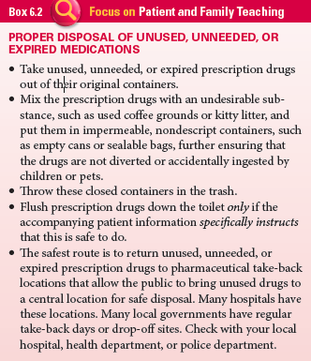
Protecting the Environment #2

Slide 17
Question #1
Please answer the following statement as true or false.
Earlier discharge of patients from the inpatient setting is occurring much more than in the past?

Slide 18
Answer to Question #1
True
Rationale: Financial pressures have led to the early discharge of patients from health care facilities.

