Slide 1
Chapter 10:
Antiviral Agents

Slide 2
Viruses That Respond to Antiviral Therapy
Influenza A and some respiratory viruses
Herpes viruses
Cytomegalovirus (CMV)
Human immunodeficiency virus (HIV) that causes acquired-immune deficiency syndrome (AIDS)
Hepatitis B and C
Some viruses that cause warts and certain eye infections

Slide 3
Characteristics of Common Viruses
A virus cannot replicate on its own.
It must attach to and enter a host cell.
It then uses the host cell’s energy to synthesize protein, DNA, and RNA.
Viruses are difficult to kill because they live inside our cells.
Any drug that kills a virus may also kill our cells.

Slide 4
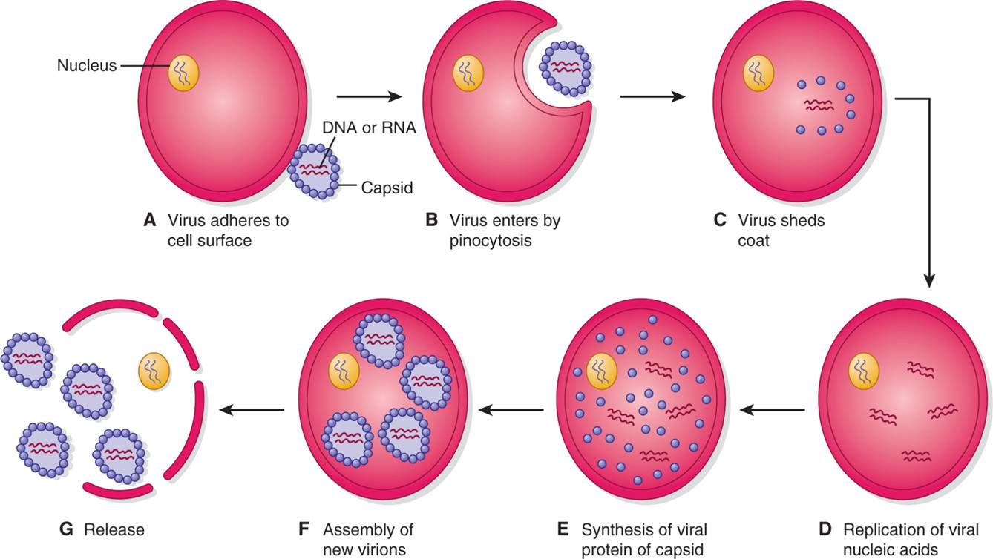
Stages of Virus Replication

Slide 5
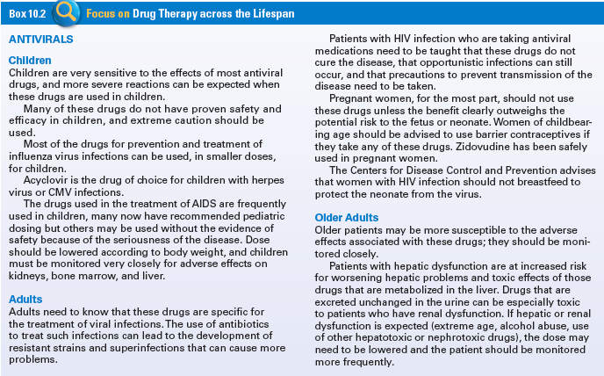
Antivirals Across the Lifespan

Slide 6
Common Respiratory Viruses
Influenza A
Influenza B
Respiratory Syncytial Virus

Slide 7
Agents for Influenza A and Respiratory Viruses
Indications – Prevent shedding of the viral protein coat
Pharmacokinetics – Absorbed readily, excreted unchanged in the urine, metabolized in the urine and liver, feces and cellular level. Excreted primarily via urine but also feces.
Contraindications – Allergy, renal impairment, pregnancy, or lactating
Adverse Effects– Dizziness, insomnia, nausea, orthostatic hypotension and urinary retention
Drug-Drug Interactions – Primarily Anticholinergic agents

Slide 8
Question #1
Tell whether the following statement is true or false.
Treatment of a viral infection is difficult without serious toxic effects for the host.

Slide 9
Answer to Question #1
True
Rationale: A virus must enter a human cell to survive, making it difficult to treat without serious toxic effects for the host.

Slide 10
Agents for Herpes and Cytomegalovirus
Indications – Inhibit viral DNA replication by competing with viral substrates to form shorter, non-effective DNA chains
Pharmacokinetics – Readily absorbed in the kidney and GI tract, metabolized in the liver and excreted primarily in the urine and feces
Contraindications – Known allergies to antiviral agents, highly toxic in pregnancy and lactation and renal disease
Adverse Effects– Nausea, vomiting, headache, rash, and hair loss, paresthesias, neuropathy and renal dysfunction
Drug-Drug Interactions – Nephrotoxic drugs, zidovudine

Slide 11
Agents for HIV and AIDS
Nonnucleoside reverse transcriptase inhibitors
Nucleoside reverse transcriptase inhibitors (NRTIs)
Protease inhibitors
Fusion inhibitors
CCR5 coreceptor antagonists
Integrase inhibitors

Slide 12
Nonnucleoside Reverse Transcriptase Inhibitors
Indications – Bind directly to HIV reverse transcriptase, blocking both RNA- and DNA-dependent DNA polymerase activities
Pharmacokinetics – Rapidly absorbed from the GI tract, metabolized in the liver, excreted in the urine and feces
Contraindications – Pregnancy and lactation
Adverse Effects – GI-related, dizziness, blurred vision, headache
Drug-Drug Interactions –
  Delavirdine: antiarrhythmics, clarithromycin, dapsone, anti-TB drugs, Ca channel blockers, warfarin, quinidine, indinavir, saquinavir, dapsone
  Efavirenz: midazolam, rifabutin, triazolam, ergot derivatives

Slide 13
Nucleoside Reverse Transcriptase Inhibitors
Indications – Compete with naturally occurring nucleosides within the cell that the virus would use to build the DNA chain
Pharmacokinetics – Rapidly absorbed in the GI tract, metabolized by liver, excreted in urine and feces; except Didanosine requires buffered form
Contraindications – pregnancy (except zidovudine), hepatic dysfunction, renal impairment, bone marrow suppression
Adverse Effects – Signs of hypersensitivity, pancreatitis, hepatomegaly, neurological problems, bone marrow suppression
Drug-Drug Interactions – Tenofovir, lamivudine/salcitabine, antibiotics, antifungals

Slide 14
Protease Inhibitors
Indications – Block protease activity within the HIV virus
Pharmacokinetics – Rapidly absorbed in the GI tract, metabolized in the liver and excreted in urine and feces
Contraindications – Pregnancy and lactation and mild to moderate hepatic dysfunction
Adverse Effects- GI effects, changes in liver function, elevated cholesterol and triglyceride levels may occur as well as Stevens-Johnson syndrome risk
Drug-Drug Interactions- Nonsedating antihistamines, sedatives/hypnotics, antiarrhythmics

Slide 15
Fusion Inhibitors
Indications – Prevents the fusion of the virus with the human cellular membrane
Pharmacokinetics – Given sub-q; metabolized in the liver it is recycled in tissues, not excreted
Contraindications – Use cautiously with lung disease and pregnancy
Adverse Effects– Insomnia, depression, peripheral neuropathy, nausea, diarrhea, pneumonia, injection site reactions
Drug-Drug Interactions – No reported drug interactions

Slide 16
CCR5 Coreceptor Antagonist
Indications – Blocks the receptor site on the cell membrane to which the HIV virus needs to interact to enter the cell
Pharmacokinetics –Rapidly absorbed from the GI tract, metabolized in the liver, and excreted primarily through the feces
Contraindications –Hypersensitivity to any component of the drug, nursing mothers and liver disease
Adverse Effects– Dizziness and changes in consciousness
Drug-Drug Interactions – Increased serum levels and toxicity when combined with cytochrome P450 CYP3A inhibitors and inducers

Slide 17
Integrase Inhibitors
Indications –inhibit the activity of the virus-specific enzyme integrase, an encoded enzyme needed for viral replication.
Pharmacokinetics –Rapidly absorbed from the GI tract, metabolized in the liver, and excreted primarily through the feces
Contraindications –Hypersensitivity to any component of the drug and nursing mothers
Adverse Effects– Headache, dizziness, and an increased risk for the development of rhabdomyolysis and myopathy
Drug-Drug Interactions – decreased serum levels of either drug if combined with rifampin

Slide 18
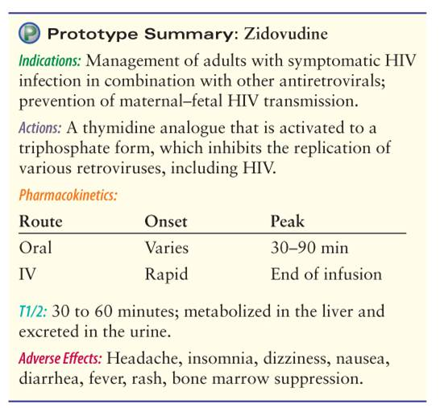
Prototype of HIV/AIDS Antiviral Agents: NRTI

Slide 19
Question #2
You are caring for a patient that has been diagnosed with herpes simplex and are given a prescription. What should you teach this patient about taking their medication?
A. When applying the drug topically be sure to use absorbent pads to decrease risk of exposure to the drug.
B. Warn the patient that GI upset, nausea, and vomiting are to be expected.
C. Start taking the medicine as soon as possible to improve effectiveness of antiviral activity.
D. Be sure to take most of the medication prescribed to improve effectiveness of antiviral activity.

Slide 20
Answer to Question #2
C. Start taking the medicine as soon as possible to improve effectiveness of antiviral activity.
Rationale: Administer the drug as soon as possible after the diagnosis has been made to improve effectiveness of the antiviral activity.

Slide 21
Question #3
You are caring for a patient with HIV. A nursing diagnosis for this patient is acute pain related to related to site reaction of the drugs. What type of drug is this patient taking?
A. Integrase Inhibitor
B. Fusion Inhibitor
C. Reverse Transcriptase Inhibitor
D. Protease inhibitor

Slide 22
Answer to Question #3
A. Fusion Inhibitor
Rationale: Nursing diagnoses related to drug therapy might include: Acute Pain related to site reactions of the drugs

Slide 23
Anti-Hepatitis B Agents
Indications- Inhibits reverse transcriptase in the hepatitis B virus and causes DNA chain termination
Pharmacokinetics- Rapidly absorbed from the GI tract, metabolized in the liver and excreted in the urine
Contraindications- Known allergy, pregnancy, lactation and known renal and liver dysfunction
Adverse Effects- Most significant are headache, dizziness, nausea, diarrhea, and elevated liver enzymes
Drug-Drug Interactions-increased risk of renal toxicity if these drugs are taken with other nephrotoxic drugs

Slide 24
Anti-Hepatitis C Agents
See Protease Inhibitors
Can be used in combination with ribavirin or ribavirin and peginterferon to treat chronic hepatitis C

Slide 25
Locally Active Antiviral Agents
Indications – Act on viruses by interfering with normal viral replication and metabolic processes
Pharmacokinetics – Not absorbed systemically
Contraindications – Allergy to the drug
Adverse Effects – Local burning, stinging, and discomfort

Slide 26
Question #4
Which antiviral drugs are not absorbed systemically?
A. Anti-hepatitis B agents
B. Locally Active Antiviral Agents
C. Nucleoside Agents
D. Fusion Inhibitors

Slide 27
Answer to Question #4
B. Locally Active Antiviral Agents
Rationale: Locally active antiviral drugs are not absorbed systemically, but caution must be used in patients with known allergic reactions to any topical drugs.

