Slide 1
Chapter 12: Antiprotozoal Agents

Slide 2
Causes of Protozoal Infections
Insect Bites
Malaria
Trypanosomiasis
Leishmaniasis
Ingestion or Contact with the Causal Organism
Amebiasis
Giardiasis
Trichomoniasis

Slide 3
Protozoal Parasites Identified as Causes of Malaria
Plasmodium falciparum
Considered the most dangerous type of protozoan
Plasmodium vivax
Milder form of the disease; seldom results in death
Plasmodium malariae
Endemic in tropical countries; mild symptoms
Plasmodium ovale
Rarely seen; in the process of being eradicated

Slide 4
Malaria
Signs and Symptoms
Related to the destruction of red blood cells and toxicity to the liver
Treatment
Aims at attacking the parasite at the various stages of its development inside and outside the human body

Slide 5
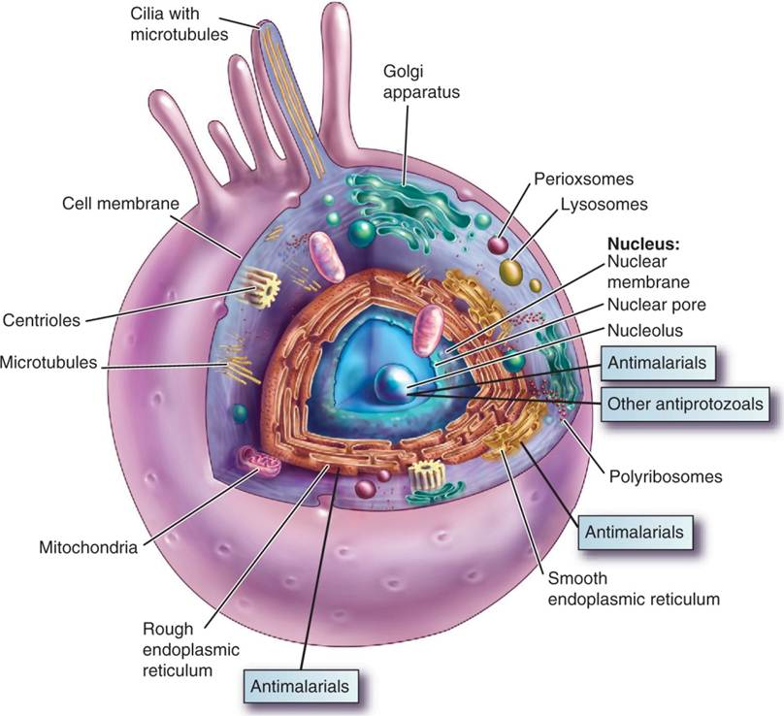
Life Cycle of Plasmodium

Slide 6
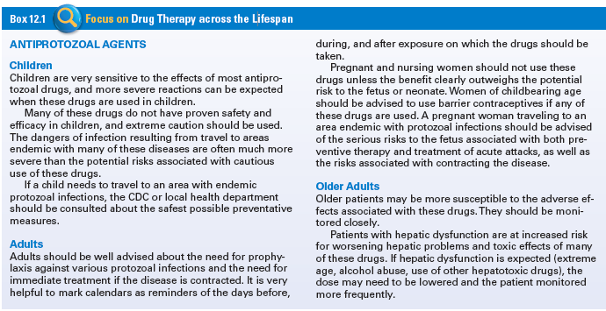
Use of Antiprotozoal Therapy Across the Life Span

Slide 7
Antimalarials #1
Quinine (Qualaquin)
First drug found effective in treatment of malaria
Absent from the market for a while but now available for treating uncomplicated malaria.
Chloroquine (Aralen)
Mefloquine (generic)
Primaquine (generic)
Pyrimethamine (Daraprim)

Slide 8
Antimalarials #4
Indications- Prevent the acute malarial reaction in individuals who have been infected by the parasite, or work against tissue schizonts as prophylactic or antirelapse agents
Actions- Enters human red blood cells and changes the metabolic pathways necessary for the reproduction of the Plasmodium
Pharmacokinetics- Readily absorbed from the GI tract, concentrated in the liver, spleen, kidney, and brain and is excreted very slowly in the urine
Contraindications- Known allergy, liver disease, alcoholism, pregnancy and lactation

Slide 9
Antimalarials #5
Adverse Effects- CNS, GI, hepatic dysfunction and dermatological
Drug-Drug interactions- Patient who is receiving combinations of quinine derivative and quinine is at increased risk for cardiac toxicity and convulsions; anti-folate drugs

Slide 10
Question #1
Please answer the following statements as true or false.
Chlorquine (Aralen) is an antimalarial drug used in the treatment of plasmodial malaria. It is typically used in combination with other drugs.

Slide 11
Answer to Question #1
True
Rationale: Chlorquine (Aralen): Treatment of plasmodial malaria; used in combination with other drugs

Slide 12
Risk Factors for Protozoal Infections
Unsanitary, crowded conditions
Poor hygienic practices

Slide 13
Other Protozoal Infections
Amebiasis
Leishmaniasis
Trypanosomiasis
Trichomoniasis
Giardiasis
Pneumocystic jiroveci pneumonia

Slide 14
Other Antiprotozoal Agents
Atovaquone (Mepron)
Especially active against PCP
Metronidazole (Flagyl)
Treats amebiasis, trichomoniasis, and giardiasis
Pentamidine (Pentam 300, NebuPent)
Treats PCP, trypanosomiasis, and leishmaniasis
Tinidazole (Tindamax)
Treats trichomoniasis, giardiasis, and amebiasis
Benznidazole 9
Pediatric patiens with Chagas

Slide 15
Other Antiprotozoal Drugs
Actions- Inhibit DNA synthesis in susceptible protozoa
Pharmacokinetics- Readily absorbed and highly protein bound in circulation or metabolized in the liver and excreted in the urine and feces
Contraindications- Known allergy, pregnancy, CNS disease, hepatic disease
Adverse Effects- Headache, dizziness, ataxia, nausea, vomiting, and diarrhea
Drug-Drug interaction- Alcohol, anticoagulants, disulfiram

Slide 16
Question #2
When are antiprotozoal medications contraindicated?
A. Renal disease
B. Anemia
C. CNS disease
D. Cardiovascular disease

Slide 17
Answer to Question #2
C. CNS disease
Rationale: Contraindications are known allergy, pregnancy, CNS disease, hepatic disease.

Slide 18
Question #3
When are antimalarial medications contraindicated ?
A. Renal disease
B. Anemia
C. Alcoholism
D. Cardiovascular disease

Slide 19
Answer to Question #3
C. Alcoholism
Rationale: Because of the need for hepatic metabolism to prevent toxicity

