Slide 1
Chapter 15: Introduction to the Immune Response and Inflammation

Slide 2
Body’s Defenses
Barrier Defenses
Cellular Defenses
Inflammatory Response
Immune Response

Slide 3
Barrier Defenses
Skin
Protects the internal tissues and organs of the body
Mucous Membranes
Line the areas of the body that are exposed to external influences, but do not have skin protection
Gastric Acid
Secreted by the stomach in response to many stimuli
Major Histocompatibility Complex
Distinguishes between self-cells and foreign cells

Slide 4
Cellular Defenses
Mononuclear Phagocyte System (MPS)
Composed of:
Thymus gland
Lymphatic tissue
Leukocytes
Lymphocytes- T and B cells and Myelocytes
Numerous chemical mediators

Slide 5
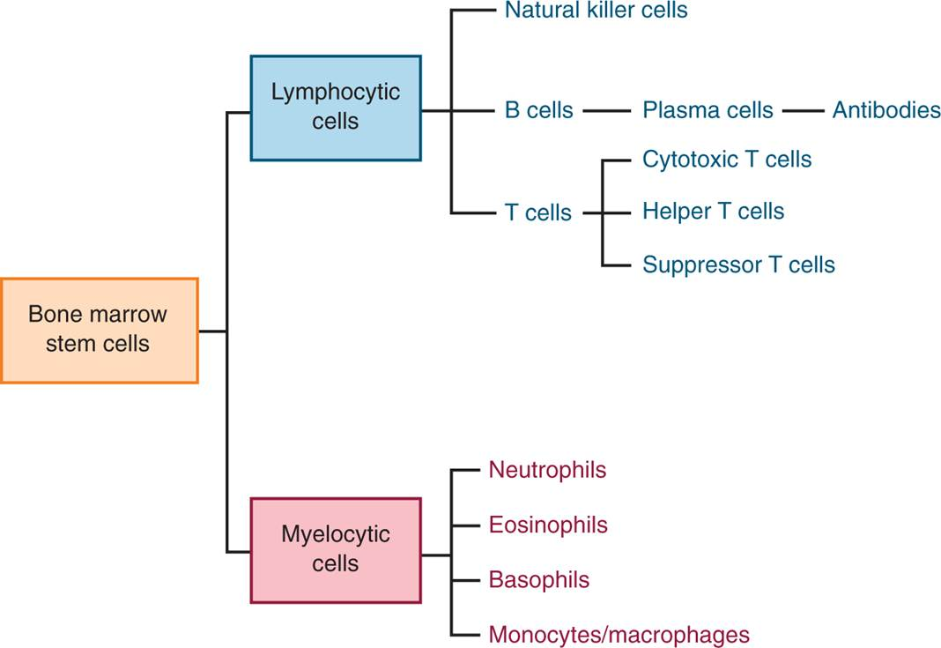
Types of White Blood Cells, or Leukocytes, Produced by the Body

Slide 6
Lymphoid Tissues
Lymph Nodes
Spleen
Thymus gland (a bipolar gland located in the middle of the chest, which becomes smaller with age)
Bone Marrow
Lymphoid tissue throughout the respiratory and GI tracts

Slide 7
The Inflammatory Response #1
Hageman Factor
Kinin System
Bradykinin
Arachidonic acid
Leukotrienes
Thromboxanes

Slide 8
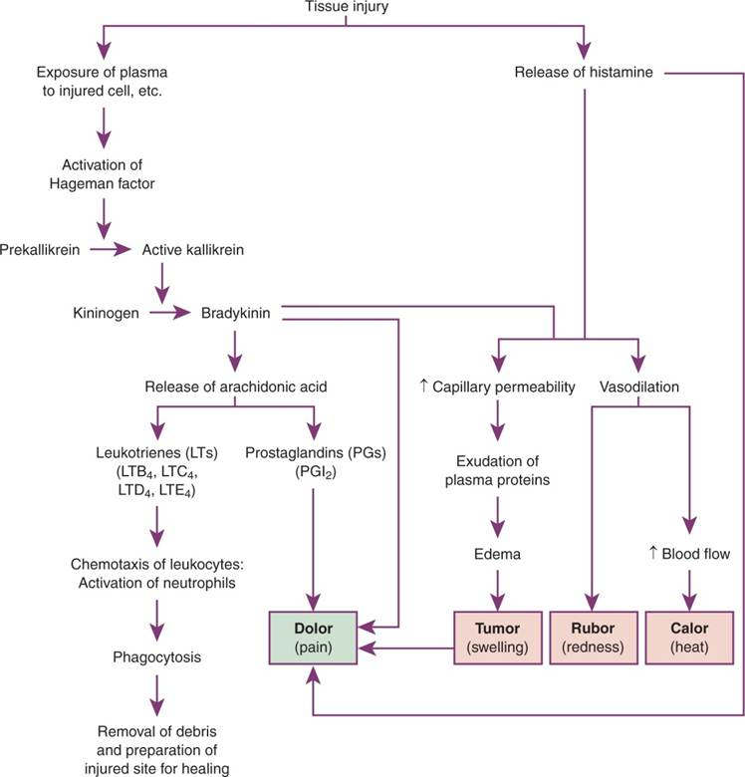
The Inflammatory Response #2

Slide 9
Question #1
Tell whether the following statement is true or false.
A barrier defense that the body has is gastric acid.

Slide 10
Answer to Question #1
True
Rationale: Certain anatomical barriers exist to prevent the entry of foreign pathogens and to serve as important lines of defense in protecting the body. These barriers include the skin and mucous membranes, gastric acid, and the major histocompatibility complex.

Slide 11
Histamine Release
A Locally Mediated Response
Causes vasodilation
Brings neutrophils to the injured area

Slide 12
Chemotaxis
Activated by arachidonic acid
Attract neutrophils and macrophages to become very aggressive
Cause local cellular breakdown and further inflammation

Slide 13
Inflammatory Response Clinical Presentation
Calor (Heat)
Caused by increased blood flow
Tumor (Swelling)
Caused by fluid that leaks into the tissues
Rubor (Redness)
Caused by the increase in blood flow due to vasodilation
Dolor (Pain)
Caused by the activation of pain fibers

Slide 14
Question #2
What factor assists in making macrophages and neutrophils very aggressive?
A. Cellular Defenses
B. Histocompatibility
C. Barrier Defenses
D. Chemotaxis

Slide 15
Answer to Question #2
D. Chemotaxis
Rationale: Some leukotrienes activated by arachidonic acid have a property called chemotaxis, which is the ability to attract neutrophils and to stimulate them and other macrophages in the area to be very aggressive.

Slide 16
Immune Response
More specific invasion can stimulate a more specific response through the immune system
Lymphocytes produced in the bone marrow can develop into T lymphocytes or B lymphocytes
Other identified lymphocytes include natural killer cells and lymphokine-activated killer cells
These cells are aggressive against neoplastic or cancer cells and promote rapid cellular death

Slide 17
Types of T Cells
Effector or Cytotoxic T Cells
Helper T Cells
Suppressor T Cells

Slide 18
Function of T-Cells
Effector or Cytotoxic T Cells
Found throughout the body
Aggressive against non-self cells
Can directly destroy foreign cells or mark cell so other cells can destroy these cells
Helper T Cells
Stimulate the activity of B cells and effector T cells to become more aggressive
Suppressor T Cells
Monitor the chemical activity in the body
Act to suppress B-cell and T-cell activity when the foreign antigen is under control

Slide 19
The Role of the B Cell
Programmed to identify specific proteins or antigens
Involved in humoral immunity
Produce antibodies or immunoglobulins

Slide 20
Complement Proteins
Antibody Formation –
React in a cascade fashion to form a ring around the antigen–antibody complex. The complement can destroy the antigen by altering the membrane, allowing an osmotic in flow of fluid that causes the cell to burst.

Slide 21
Antibody Formation
Takes several days
Once activated the B cells form memory cells that will produce antibodies for immediate release in the future if the antigen is encountered.
The antibodies are released in the form of immunoglobulins- five different forms of (IG’s)

Slide 22
Other Mediators in the Immune Response
Interferons
Prevent viral replication and suppress malignant cell replication and tumor growth
Interleukins
Chemicals secreted by active leukocytes to influence other leukocytes
Tumor Necrosis Factor (TNF)
Chemical released by macrophages; inhibits tumor growth and can cause tumor regression

Slide 23
Interrelationship of the Immune and Inflammatory Responses
Immune and inflammatory responses work together
Effector T cells
Both B cells and T cells depend on an effective inflammatory reaction

Slide 24
Pathophysiology Involving the Immune System
Neoplasms
Viral Invasion of Cells
Autoimmune Disease
Transplant Rejection

Slide 25
Question #3
Interleukin 1 (IL-1) stimulates T and B cells to initiate an immune response. What is another function of interleukin?
A. Arterial vascular spasms
B. Venous stasis
C. Slow-wave sleep induction
D. REM sleep

Slide 26
Answer to Question #3
C. Slow-wave sleep induction
Rationale: Interleukins also cause fever, arthralgia, myalgia, and slow-wave sleep induction—all things that help the body to conserve energy for use in fighting off the invader.

