Slide 1
Chapter 20:
Anxiolytic and Hypnotic Agents

Slide 2
Psychological States Affected by Anxiolytic and Hypnotic Drugs
Anxiety
  Feeling of tension, nervousness, apprehension, or fear involving unpleasant reactions to a stimulus
Sedation
  Loss of awareness and reaction to environmental stimuli
Hypnosis
  Extreme sedation resulting in further CNS depression and sleep

Slide 3
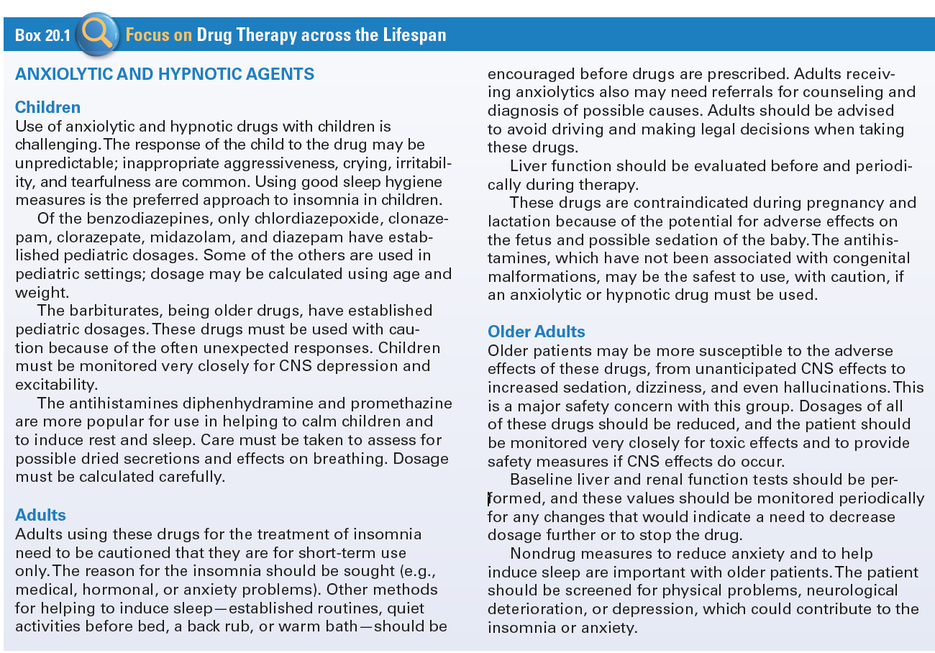
Use of Anxiolytic and Hypnotic Agents Across the Lifespan

Slide 4
Benzodiazepines: Actions & Indications
Actions:
  Act in the limbic system and the RAS
  Make GABA more effective
  Causes interference with neurons firing
  Lower doses assist with anxiety
  Higher doses cause sedation and hypnosis
Indications: anxiety disorders, alcohol withdrawal, hyperexcitability and agitation, preoperative relief of anxiety and tension to aid in balanced anesthesia

Slide 5
Benzodiazepines: Pharmacokinetics
  Well absorbed from GI tract
  Peak levels achieved in 30 minutes to 2 hours
  Lipid soluble and distributes well throughout the body
  Cross placenta
  Enter breast milk
  Metabolized in the liver
  Excretion is primarily in the urine

Slide 6
Benzodiazepines: Contraindications/Cautions
  Allergy to benzodiazepine
  Psychosis
  Acute narrow angle glaucoma
  Shock
  Coma
  Acute alcohol intoxication
  Pregnancy

Slide 7
Benzodiazepines: Adverse Effects
Sedation
Drowsiness
Depression
Lethargy
Blurred Vision
Confusion
Dry Mouth
Constipation
Nausea
Vomiting
Hypotension
Urinary Retention

Slide 8
Benzodiazepines: Drug-Drug Interactions
  Increase CNS depression when taken with alcohol
  Increase in effect when taken with cimetidine, oral contraceptives, or disulfiram
  Decrease in effect if given with theophylline or ranitidine

Slide 9
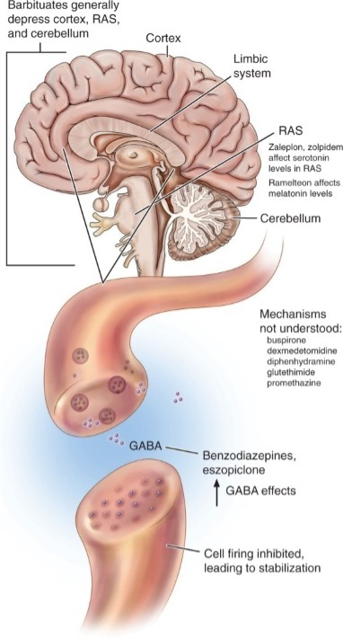
Sites of Action of Benzodiazepines and Barbiturates and Other Anxiolytics

Slide 10
Question #1
A client presents at the clinic with symptoms of hyperexcitability and agitation. Which medication would the nurse expect the physician to prescribe?
A. Hypnotic
  B. Benzodiazepine
  C. Barbiturate
  D. Other Anxiolytic and Hypnotic Drugs

Slide 11
Answer to Question #1
  B. Benzodiazepine
Rationale: Hyperexcitability and agitation are indications for the use of benzodiazepines.

Slide 12
Barbiturates: Action
CNS depressants
Inhibit neuroral impulse conduction in the ascending RAS
Depress cerebral cortex
Depress motor output
Cause: sedation, hypnosis, anesthesia, and coma

Slide 13
Barbiturates: Indication
Relief of the signs and symptoms of anxiety
Sedation
Insomnia
Preanesthesia
Seizures

Slide 14
Barbiturates: Pharmacokinetics
Well absorbed
Reaching peak in 20 – 60 minutes
Metabolized in the liver
Excreted in the urine

Slide 15
Barbiturates: Contraindications and Cautions
Allergy to any barbiturate
Previous history of addiction to sedative–hypnotic drugs
Latent or manifest porphyria
Marked hepatic impairment or nephritis
Respiratory distress or severe respiratory dysfunction
Pregnancy

Slide 16
Barbiturates: Adverse Effects
CNS Depression
Physical Dependency
Drowsiness
Somnolence
Lethargy
Ataxia
Vertigo
Nausea
Vomiting
Constipation

Slide 17
Barbiturates: Drug-Drug Interactions
Increase CNS depression when given with alcohol, antihistamines, and other tranquilizers
Altered response to phenytoin
MAO cause increase serum levels and effect
Decrease effectiveness of the following drugs: anticoagulants, digoxin, tricyclic antidepressants, corticosteroids and oral contraceptives

Slide 18
Question #2
Please answer the following statement as true or false.
Peak levels of barbiturates occur in 60 to 90 minutes.

Slide 19
Answer to Question #2
False
Rationale: The barbiturates are absorbed well, reaching peak levels in 20 to 60 minutes.

Slide 20
Other Anxiolytic and Hypnotic Drugs #1
Antihistamines (promethazine [Promethegan], diphenhydramine [generic]): Preoperative medications and postoperative to decrease the need for narcotics
Buspirone (generic): Reduces the signs and symptoms of anxiety without severe CNS and adverse effects
Dexmedetomidine (Precedex): Sedation of intubated and mechanically ventilated patients
Eszopiclone (Lunesta): Insomnia

Slide 21
Other Anxiolytic and Hypnotic Drugs #2
Meprobamate (generic): Acute anxiety, up to 4 months
Ramelton (Rozerem), tasimelteon (Hetiloz): Melatonin receptor agonists
Suvorexant (Belsomra): Orexin receptor antagonist
Zaleplon (Sonata) and zolpidem (Ambien): Short-term treatment of insomnia

Slide 22
Question #3
You are admitting a new patient to the clinic. A review of home medications indicates the patient is taking a barbiturate to help him sleep. The patient tells you that he is having problems with both his visual and auditory senses. The patient wants to know what is wrong. What would be the best response?
A. We will have to wait and see what the doctor says.
B. What you are describing could be adverse effects from the sleep medicine you are taking.
C. There is nothing wrong. You are just getting older.
D. Sometimes these things happen with our patients. We need to do a complete assessment before we know for sure.

Slide 23
Answer to Question #3
B. What you are describing could be adverse effects from the sleeping medication you are taking?
Rationale: Nursing diagnoses related to drug therapy might include: Disturbed thought processes and disturbed sensory perception (visual, auditory, kinesthetic, tactile) related to CNS effects

