Slide 1
Chapter 26:
Narcotics, Narcotic Antagonists, and Antimigraine Agents

Slide 2
Pain
Definition
  Sensory and emotional experience associated with actual or potential tissue damage
Acute or chronic
Drugs Used to Relieve Pain
  Narcotics: Opium derivatives used to treat many types of pain
  Antimigraine Drugs: Reserved for the treatment of migraine headaches

Slide 3
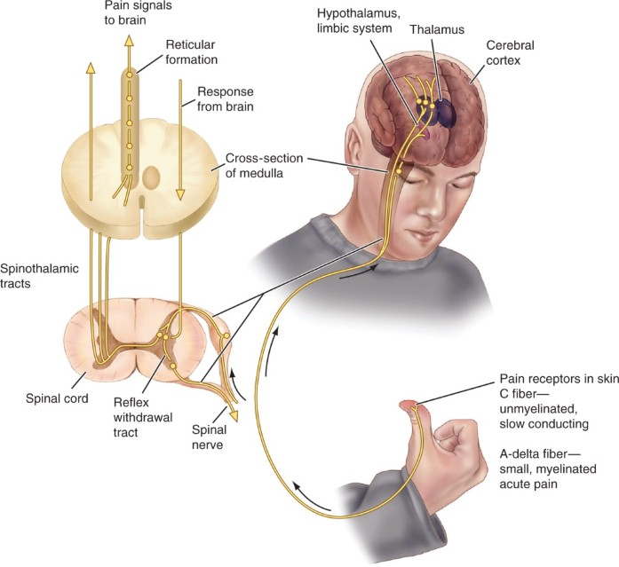
Neural Pathways of Pain

Slide 4
Gate-Control Theory of Pain
Sensory and emotional experience
Transmission of these impulses can be modulated or adjusted
Interneurons can act as “gates”
Several factors, including learned experiences, cultural expectations, individual tolerance, and the placebo effect, can activate the descending inhibitory nerves from the upper central nervous system

Slide 5
Pain Receptors
Opioid receptors
  CNS
  Nerves in the periphery
  Cells in the gastrointestinal (GI) tract

Slide 6
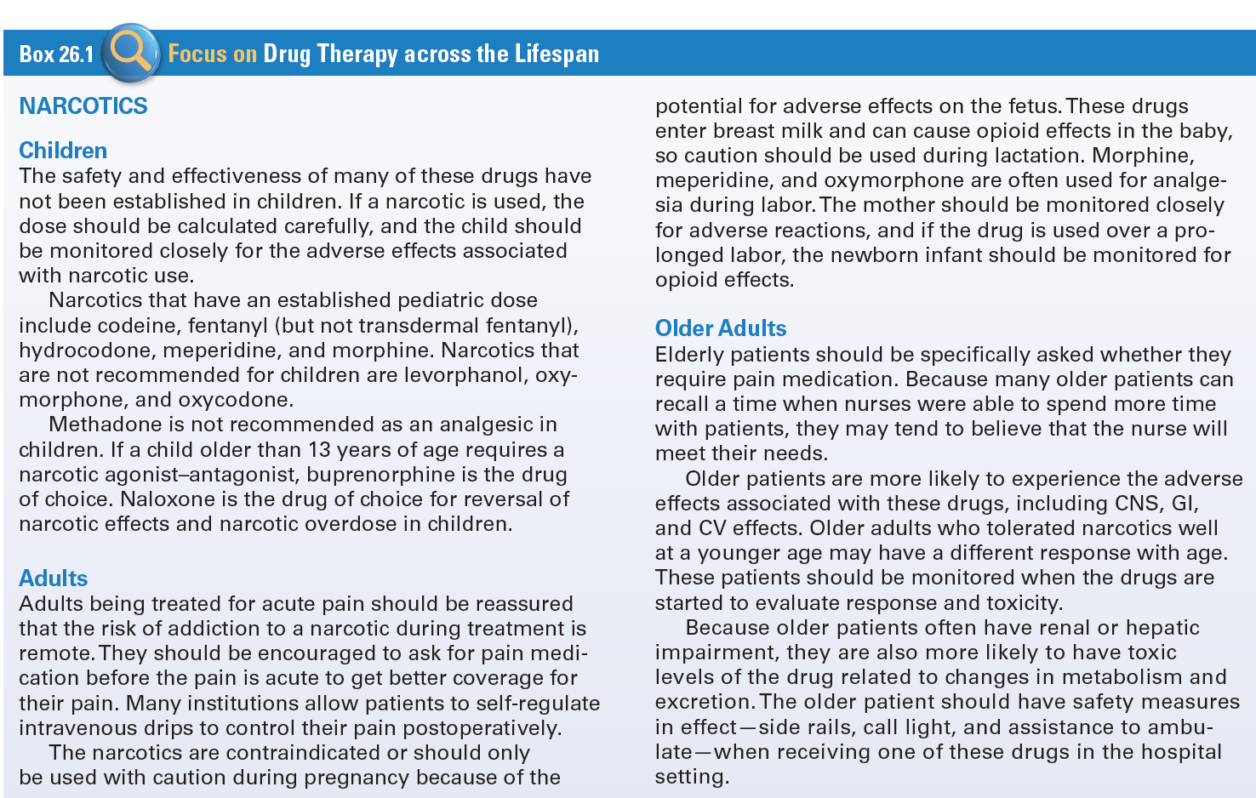
Use of Narcotics and Antimigraine Agents Across the Lifespan

Slide 7
Narcotic Agonists #1
Drugs that react with opioid receptors
Cause analgesia, sedation, or euphoria
Potential for physical dependence
Controlled substances
Rising problem of addiction

Slide 8
Narcotic Agonists #2
Actions
  Act at specific opioid receptor sites in the CNS
  Produce analgesia, sedation, and a sense of well-being
Indications
  Relief of severe acute or chronic pain
  Analgesia during anesthesia
  Cross placenta

Slide 9
Narcotic Agonists #3
Pharmacokinetics
  IV most reliable way to achieve therapeutic response
  IM and sub-q rate of absorption varies between sexes
  Hepatic metabolism and generally excreted in the urine and bile
Contraindications
  Known allergy
  Pregnancy, labor, lactation
  Diarrhea caused by poisons

Slide 10
Narcotic Agonists #4
Cautions
  Respiratory dysfunction
  GI or GU surgery
  Acute abdomen or ulcerative colitis

Slide 11
Narcotic Agonists #5
Adverse Effects
  Respiratory depression with apnea, cardiac arrest, shock, orthostatic hypotension, nausea, vomiting, constipation, biliary spasm, dizziness, psychoses, anxiety, fear, hallucinations
Drug-to-Drug Interactions
  Barbiturate general anesthetics, phenothiazines, and MAOIs

Slide 12
Question #1
Identify a reason a narcotic agonist may be prescribed?
A. Relief of minor pain
B. Analgesia during anesthesia
C. Analgesia during sleep
D. Relief of moderate acute pain

Slide 13
Answer to Question #1
b. Analgesia during anesthesia
Rationale: Indications:
  Relief of severe acute or chronic pain
  Analgesia during anesthesia
  Cross placenta

Slide 14
Narcotic Agonists–Antagonists #1
Buprenorphine (Buprenex)
  Treats mild to moderate pain
Butorphanol (generic)
  Preoperative medication, relieves moderate to severe pain
Nalbuphine (generic)
  Treats moderate to severe pain, adjunct for general anesthesia, relieves pain during labor and delivery
Pentazocine (Talwin)
  Preferred drug for patients switched from parenteral to oral forms after surgery or labor

Slide 15
Narcotic Agonists–Antagonists #2
Actions
  Act at a specific opioid receptor sites in the CNS to produce analgesia, sedation, euphoria, and hallucinations
Indications
  Moderate to severe pain
  Adjunct to general anesthesia
  Relief of pain during labor and delivery

Slide 16
Narcotic Agonists–Antagonists #3
Pharmacokinetics
  Readily absorbed IM and reach peak levels when given IV
  Metabolized in the liver excreted in urine or feces
  Cross placenta
Contraindications
  Known allergy
  Pregnancy and lactation

Slide 17
Narcotic Agonists–Antagonists #4
Cautions
  Physical dependence on a narcotic
  COPD and disease of the respiratory tract
  Acute MI or documented CAD

Slide 18
Narcotic Agonists–Antagonists #5
Adverse Effects
  Respiratory depression
  Nausea, vomiting, constipation, and biliary spasm actions
  Headache, dizziness, psychoses, anxiety, hallucinations
  Ureteral spasm, urinary retention
  Sweating and dependence
Drug-Drug Interactions
  Barbiturate general anesthetics

Slide 19
Narcotic Antagonists #1
Naloxone (Narcan, Evzio)
  Reverses adverse effects of narcotics; diagnoses suspected acute narcotic overdose
Naltrexone (ReVia)
  Used orally in the management of alcohol or narcotic dependence

Slide 20
Narcotic Antagonists #2
Actions
  Drugs that bind strongly to opioid receptors, but they do not activate the receptors
  Reverse effects of opioids
Indications
  Reversal of the adverse effects of narcotics
  Treat narcotic and/or alcoholic dependence

Slide 21
Narcotic Antagonists #3
Pharmacokinetics
  Well absorbed after injection and are widely distributed in the body
  Hepatic metabolism and excreted in the urine
  Enter breast milk
Contraindications
  Known allergy

Slide 22
Narcotic Antagonists #4
Adverse Effects
  Tachycardia
  Blood pressure changes
  Dysrhythmias

Slide 23
Narcotic Antagonists #5
Drug-Drug Interactions
  Lagers doses may be needed to reverse effects of:
    Buprenorphine
    Butorphanol
    Nalbuphine
    Pentazocine
    Propoxyphene

Slide 24
Question #2
Identify one indicator for a narcotic antagonist to be prescribed?
A. Treatment of alcohol independence
B. Reversal of bronchoconstriction
C. Treatment of narcotic dependence
D. Reversal of tachycardia

Slide 25
Answer to Question #2
C. Treatment of narcotic dependence
Rationale: Indications
  Reversal of the adverse effects of narcotics
  Treat narcotic and/or alcoholic dependence

Slide 26
Migraine Headaches
Migraine Headaches
  Severe, throbbing headaches on one side of the head
  Common
  Classic
Cluster Headaches
  Begin during sleep; involve sharp, steady eye pain, sweating, flushing, tearing, and nasal congestion
Tension Headaches
  Usually occur at times of stress; dull band of pain around the entire head

Slide 27
Ergot Derivatives #1
Cause constriction of cranial blood vessels and decrease the pulsation of cranial arteries. As a result, they reduce the hyper perfusion of the basilar artery vascular bed.
Dihydroergotamine (Migranal, D.H.E. 45)
Ergotamine (Ergomar)

Slide 28
Ergot Derivatives #2
Actions
  Block alpha-adrenergic and serotonin receptor sites in the brain to cause constriction of cranial vessels
Indications
  Prevention or abortion of migraine or vascular headaches

Slide 29
Ergot Derivatives #3
Pharmacokinetics
  Rapidly absorbed from many routes
  Onset of action range from 15-30 minutes
  Metabolized in the liver and primarily excreted in the bile
  Excreted in breast milk

Slide 30
Ergot Derivatives #4
Contraindications
  Known allergy
  Pregnancy or lactation
  CAD
  HTN
  PVD
Cautions
  Pruitus
  Malnutrition

Slide 31
Ergot Derivatives #5
Adverse Effects
  Numbness
  Tingling of extremities
  Muscle pain
  Pulselessness
  Weakness
  Chest pain
  Arrhythmias
  Nausea
  Vomiting
  Diarrhea

Slide 32
Ergot Derivatives #6
Drug-Drug Interactions
  Beta blockers

Slide 33
Question #3
What is an action of Ergotamine?
A. Decreases hyperfusion of basilar artery vascular bed
B. Increases hyperfusion of basilar artery vascular bed
C. Increases hypoperfusion of basilar artery vascular bed
D. Decreases hypoperfusion of basilar artery vascular bed

Slide 34
Answer to Question #3
A. Decreases hyper fusion of basilar artery vascular bed
Rationale: Actions: Constricts cranial blood vessels, decreases pulsation of cranial arteries, and decreases hyperfusion of basilar artery vascular bed; mechanism of action is not understood

Slide 35
Triptans #1
Cause cranial vascular constriction and relief of migraine headache pain in many patients
  Almotriptan (Axert)
  Eletriptan(Relpax)
  Frovatriptan (Frova)
  Naratriptan (Amerge)
  Rizatriptan (Maxalt, Maxalt-MLT)
  Sumatriptan (Imitrex),
  Zolmitriptan (Zomig, Zomig-ZMT).

Slide 36
Triptans #2
Actions
  Bind to selective serotonin receptors sites to cause vasoconstriction of cranial vessels
Indications
  Treatment of acute migraine and are not used for prevention of migraines

Slide 37
Triptans #3
Pharmacokinetics
  Rapidly absorbed from many sites
  Metabolized in the liver
  Primarily excreted in the urine
  Cross the placenta and enter breast milk
Contraindications
  Known allergy, pregnancy, CAD

Slide 38
Triptans #4
Cautions
  Elderly, risk factors for CAD, and lactation
Adverse Effects
  Numbness, tingling, burning sensation, feeling of coldness, weakness, dysphasia, blood pressure alterations
Drug-Drug Interactions
  Ergot-containing drugs
  MAOIs

Slide 39
Nursing Considerations for
Antimigraine headaches
Assess:
  History and Physical Exam
  Known allergies history of MI, CAD, or hypertension
  Hepatic or renal dysfunction
  Pregnancy or lactation patient’s neurological status, including level of orientation, affect, and reflexes
  VS and ECG as appropriate

