Slide 1
Chapter 29: Introduction to the Autonomic Nervous System

Slide 2
Autonomic Nervous System (ANS) #1
Referred to as the involuntary or visceral nervous system
Works closely with the endocrine system
Narrow range of normal on a minute-to-minute basis
Integrates parts of the central nervous system (CNS) and peripheral nervous system to automatically react to changes in the internal and external environments

Slide 3
Autonomic Nervous System (ANS) #2
Definition
Involuntary or visceral nervous system
Function
Mostly with little conscious awareness of its activity
Regulate and integrate the body’s internal functions
Integrate parts of the CNS and PNS to react to changes in the internal and external environment

Slide 4
Location of the Main Nerve Centers for the ANS
Hypothalamus
Medulla
Spinal Cord

Slide 5
Bodily Functions Regulated by the ANS
Blood Pressure
Heart Rate
Respiration
Body Temperature
Water Balance
Urinary Excretion
Digestive Functions

Slide 6
Divisions of the ANS
The ANS is divided into two branches:
Sympathetic
Parasympathetic
These branches differ in three basic ways:
(1) The location of the originating cells in the CNS
(2) The location of the nerve ganglia
(3) The preganglionic and postganglionic neurons

Slide 7
Activation of Sympathetic Nervous System: Fight or Flight
Blood pressure and heart rate increase
Respiratory efficiency also increases
Bronchi are dilated and respiratory rate increases
Pupils dilate
Piloerection
Blood to be diverted from GI tract
Blood also diverted away from internal organs

Slide 8
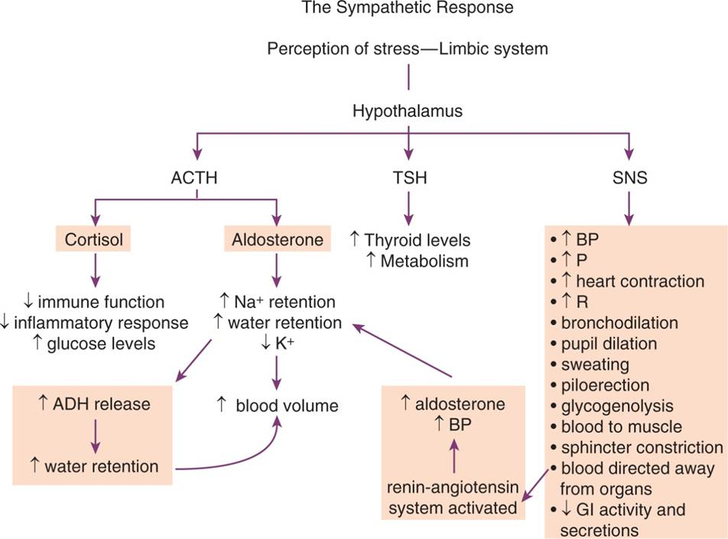
The “Fight or Flight” Response to Sympathetic Stress Reaction

Slide 9
Adrenergic Response
Norepinephrine synthesis and storage
Norepinephrine release
Adrenergic receptors
Alpha₁
Alpha₂
Beta₁
Beta₂
Termination of response

Slide 10
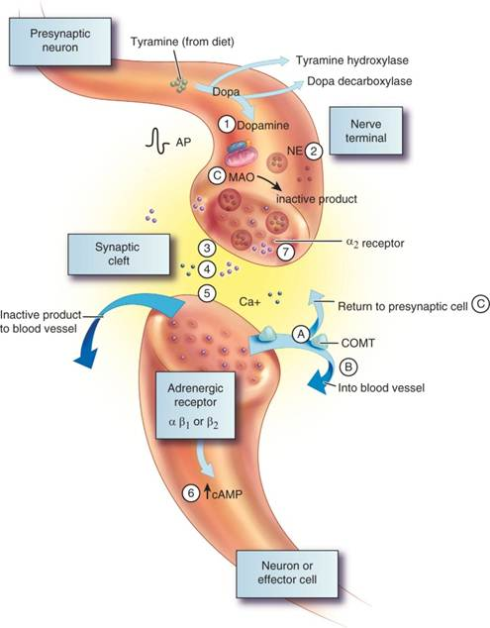
Sequence of Events of an Adrenergic Synapse

Slide 11
Location and Function of Alpha₁ Receptors
Blood Vessels
Cause vasoconstriction and increase peripheral resistance, raising blood pressure
Iris
Cause pupil dilation
Urinary Bladder
Cause the increased closure of the internal sphincter

Slide 12
Location and Function of Alpha₂ Receptors
Nerve Membranes
Act as modulators of norepinephrine release
Beta Cells in the Pancreas
Help to moderate the insulin release stimulated by SNS activation

Slide 13
Location and Function of Beta₁ Receptors
Cardiac Tissue
Can stimulate increased myocardial activity and increased heart rate
Responsible for increased lipolysis or breakdown of fat for energy in peripheral tissues

Slide 14
Question #1
Identify a difference between the sympathetic and the parasympathetic nervous system?
A. The presynaptic and postsynaptic neurons
B. The location of the nerve ganglia
C. The termination of the nerve fibers
D. The electrical determination of the synapse

Slide 15
Answer to Question #1
B. The location of the nerve ganglia
Rationale: These branches differ in three basic ways:
(1) The location of the originating cells in the CNS
(2) The location of the nerve ganglia
(3) The preganglionic and postganglionic neurons

Slide 16
Location and Function of Beta₂ Receptors
Smooth Muscle in Blood Vessels
Stimulation leads to vasodilatation
Bronchi
Can cause dilation
Periphery
Increased muscle and liver breakdown of glycogen and increased release of glucagon
Uterine Muscle
Results in relaxed uterine smooth muscle

Slide 17
Parasympathetic Nervous System (PNS)
Increased motility and secretions in the GI tract
Decreased heart rate and contractility
Constriction of the bronchi with increased secretion
Relaxation of the GI and urinary bladder sphincters
Pupillary constriction

Slide 18
Cholinergic Response #1
Cholinergic nerves:
All preganglionic nerves in the ANS, both sympathetic and parasympathetic
Postganglionic nerves of PSNS and a few SNS nerves
Motor nerves on skeletal muscles
Cholinergic nerves within the CNS
ACh synthesis and storage
ACh release

Slide 19
Cholinergic Response #2
Muscarinic Receptors
Receptors that are stimulated by muscarine (plant alkaloid from mushrooms)
Found in visceral effector organs
Found in sweat glands
Found in some vascular smooth muscle
Stimulation causes pupil constriction, increased GI motility, increase salivation, increased urinary bladder constriction, decreased heart rate

Slide 20
Cholinergic Response #3
Nicotinic Receptors
Located in the CNS, adrenal medulla, the autonomic ganglia, and the neuromuscular junction
Stimulation causes muscle contraction, autonomic response, release of norepinephrine and epinephrine from the adrenal medulla

Slide 21
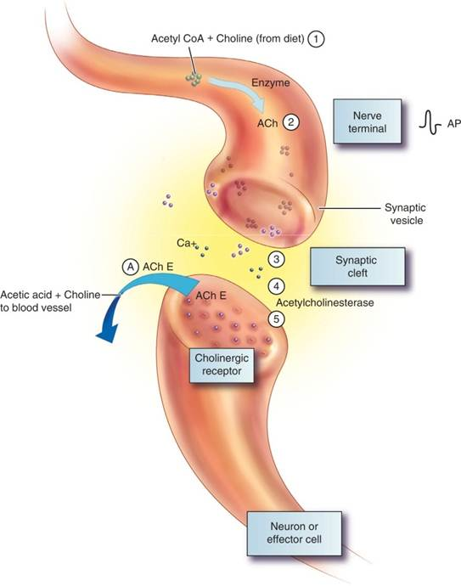
Sequence of Events at a Cholinergic Synapse

Slide 22
Question #2
The following are types of nerves: (1) Preganglionic; (2) Postganglionic; (3) Motor; (4) Sensory; and (5) Presynaptic. Which types of nerves are cholinergic nerves?
A. 3, 4, 5
B. 1, 3, 5
C. 1, 2, 3
D. 2, 3, 4

Slide 23
Answer to Question #2
C. 1, 2, 3
Rationale: All preganglionic nerves in the ANS, both sympathetic and parasympathetic; Postganglionic nerves of the PSNS and a few SNS nerves; Motor nerves on skeletal muscles; Cholinergic nerves within the CNS

