Slide 1
Chapter 31:
Adrenergic Antagonists

Slide 2
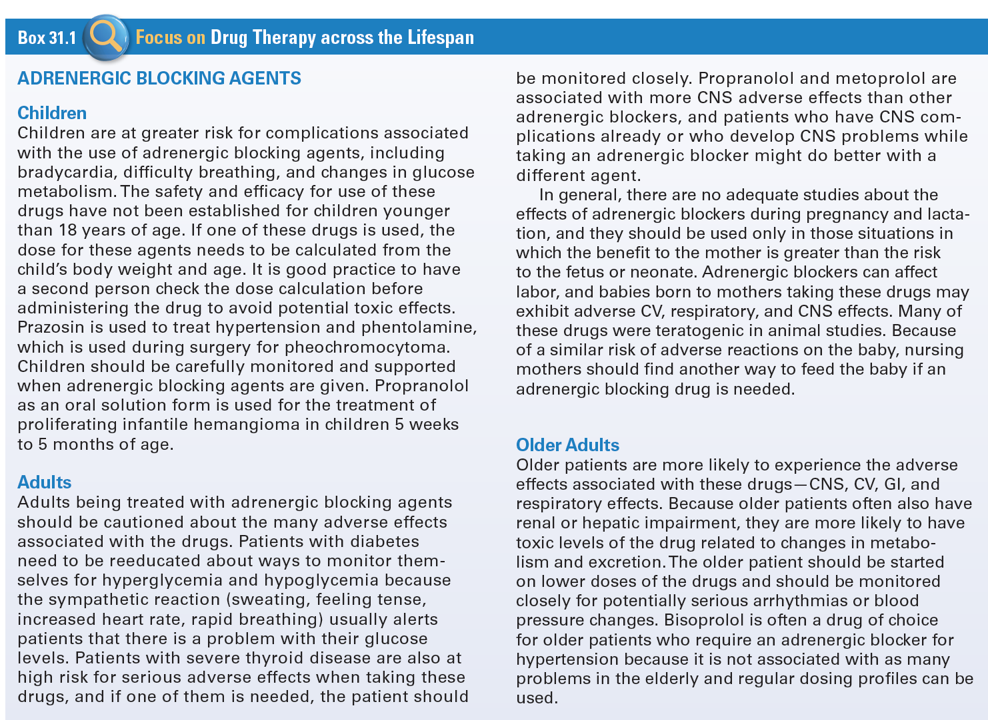
Use of Adrenergic Blocking Agents
Across the Lifespan

Slide 3
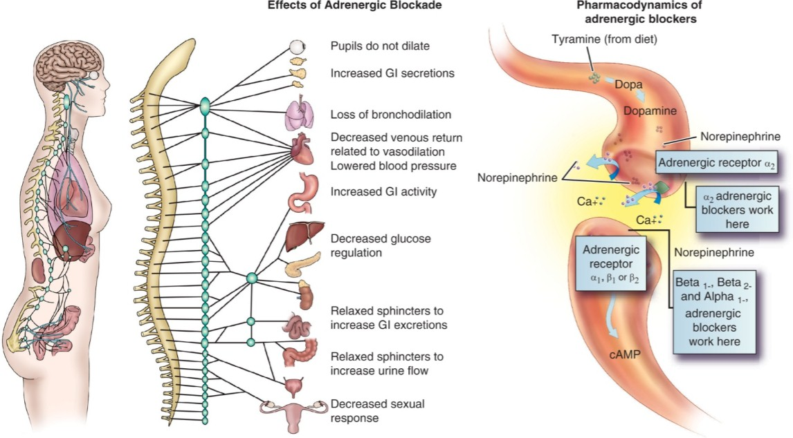
Site of Action of Adrenergic Blockers

Slide 4
Adrenergic Blocking Agents
Definition
  Called sympatholytic drugs because they lyse, or block, the effects of the SNS
Therapeutic and Adverse Effects
  Related to their ability to react with specific adrenergic receptor sites without activating them
Action
  Prevent norepinephrine from activating the receptor

Slide 5
Nonselective Adrenergic Blocking Agents #1
Amiodarone (Cordarone): Serious emergencies and only used as an antiarrhythmic
Carvedilol (Coreg): Hypertension, congestive heart failure (adult)
Labetalol (Trandate): Hypertension, pheochromocytoma, clonidine withdrawal

Slide 6
Nonselective Adrenergic Blocking Agents #2
Actions
  Competitively block the effects of norepinephrine at the alpha and beta receptors throughout the SNS
  Prevents the signs and symptoms associated with sympathetic stress reaction and results in lower blood pressure, slower pulse, and increased renal perfusion with decreased renin levels
Indications
  Essential hypertension

Slide 7
Nonselective Adrenergic Blocking Agents #3
Pharmacokinetics
  Well absorbed and distributed throughout the body
  Metabolized in the liver and excreted in feces and urine
Contraindications
  Known allergy or sensitivity
  Bradycardia or heart block
  Shock or CHF

Slide 8
Nonselective Adrenergic Blocking Agents #4
Caution- Bronchospasm, diabetes and pregnancy
Adverse Effects
  Dizziness, insomnia, fatigue, nausea, vomiting, arrhythmias, hypotension, CHF, pulmonary edema, bronchospasm
Drug-Drug Interactions
  Enflurane, halothane or isoflurane anesthetics
  Diabetic agents
  Calcium channel blockers

Slide 9
Nursing Considerations for Nonselective Adrenergic Blocking Agents
Assess:
  History and Physical Exam
  Known allergies or hypersensitivity
  Bradycardia or heart blocks, VS, LS and level of orientation
  Asthma or bronchospasm
  Shock or HF, ECG as appropriate, lab values
  Pregnancy
  Diabetes

Slide 10
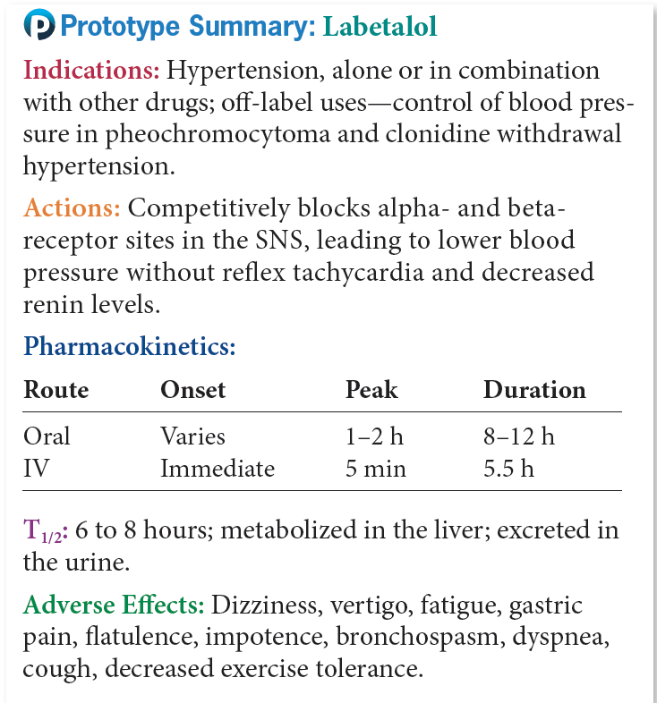
Prototype Nonselective Adrenergic Blocking Agents

Slide 11
Question #1
What is an indication for use non-selective adrenergic blocking agents?
A. Essential hypertension
B. Malignant hypertension
C. Secondary hypertension
D. Malignant hyperthermia

Slide 12
Answer to Question #1
Essential hypertension
Rationale: The alpha- and beta-adrenergic blocking agents block all of the receptor sites within the SNS, which results in lower blood pressure, slower pulse, and increased renal perfusion with decreased renin levels. These drugs are indicated for the treatment of essential hypertension.

Slide 13
Nonselective Alpha-Adrenergic Blocking Agents #1
Phentolamine (Regitine)
  Prevention of cell death and tissue sloughing after extravasation of IV norepinephrine or dopamine, and severe hypertension reactions caused by manipulation of the pheochromocytoma before and during surgery; diagnosis of pheochromocytoma

Slide 14
Nonselective Alpha-Adrenergic Blocking Agents #2
Actions
  Blocks postsynaptic alpha₁ receptors, decreasing sympathetic tone in the vasculature and causing vasodilatation
Pharmacokinetics
  Absorbed after injection and is excreted in the urine

Slide 15
Nonselective Alpha-Adrenergic Blocking Agents #3
Contraindications
  Allergy
  CAD or MI
Caution
  Pregnancy and lactation
  Adverse Effects
  Hypotension, orthostatic hypotension, angina, MI, CVA
  Arrhythmia, weakness, and dizziness

Slide 16
Nonselective Alpha-Adrenergic Blocking Agents #4
Drug-Drug Interactions
  Ephedrine and epinephrine
  Alcohol

Slide 17
Nursing Considerations for Nonselective
Alpha-Adrenergic Blocking Agents
Assess:
  History and Physical Exam
  Known allergies
  Presence of any CV diseases
  Pregnancy and lactation
  Orientation, affect, and reflexes
  VS, peripheral perfusion and cardiac output

Slide 18
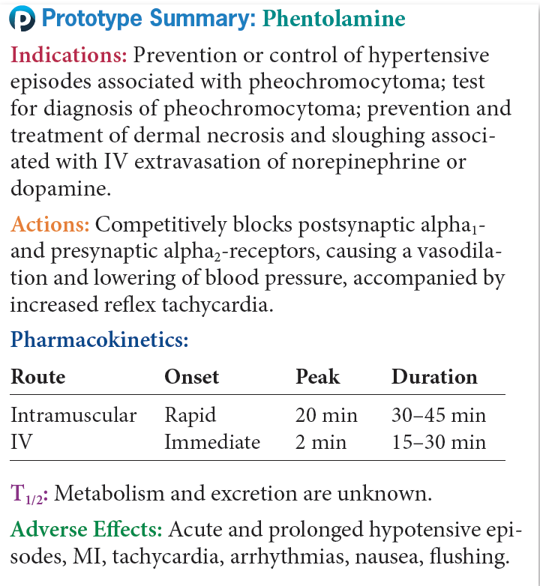
Prototype Nonselective Alpha-Adrenergic
Blocking Agent

Slide 19
Alpha₁-Selective Adrenergic Blocking Agents #1
Alfuzosin (Uroxatral): BPH
Doxazosin (Cardura): HTN, BPH
Prazosin (Minipress): HTN, alone or in combination with other drugs
Silodosin (Rapaflo): BPH
Terazosin (generic): HTN, BPH
Tamsulosin (Flomax): BPH

Slide 20
Alpha₁-Selective Adrenergic
Blocking Agents #2
Actions
  Block the postsynaptic alpha 1- receptor sites
  This causes a decrease in vascular tone and vasodilatation
Indications
  BPH and hypertension
Pharmacokinetics
  Well absorbed, undergo extensive hepatic metabolism, excreted in the urine

Slide 21
Alpha₁-Selective Adrenergic
Blocking Agents #3
Contraindications
  Allergy, lactation
Caution
  CHF or renal failure
Adverse Effects
  Dizziness, weakness, fatigue
  Nausea, vomiting, abdominal pain, diarrhea
  Arrhythmias, hypotension, edema, CHF, and angina

Slide 22
Alpha₁-Selective Adrenergic
Blocking Agents #4
Drug-Drug Interactions
  Vasodilators or antihypertensive drugs

Slide 23
Nursing Considerations for Alpha₁-Selective Adrenergic Blocking Agents
Assess:
  History and Physical Exam
  Known allergy
  Level of orientation, affect, and reflexes
  VS, CV status, renal function, including urinary output
  Renal and hepatic function tests

Slide 24
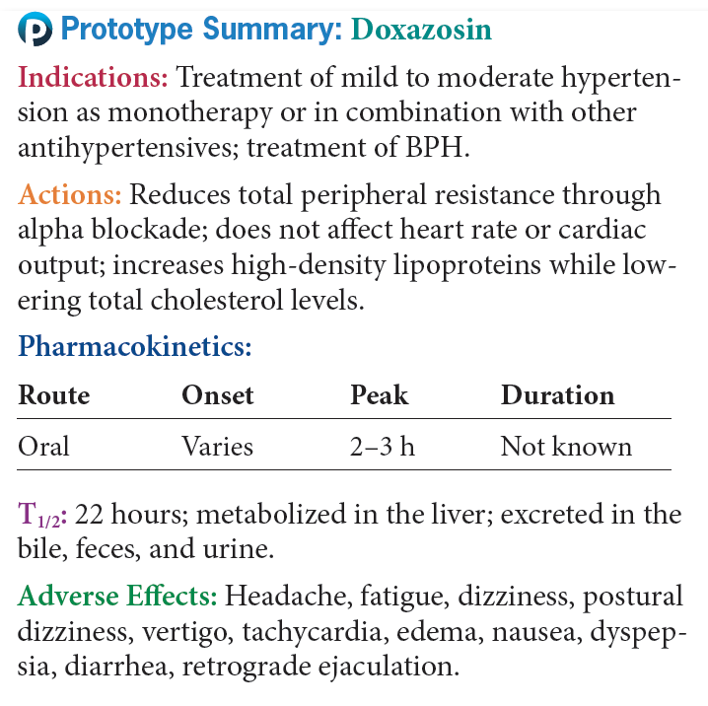
Prototype Alpha₁-Selective
Adrenergic Blocking Agents #1

Slide 25
Question #2
Alpha₁- selective adrenergic blocking agents are to be used with caution in what population of patients?
A. Those with hepatic disease
B. Those with hypotension
C. Those with congestive heart failure
D. Those with respiratory distress

Slide 26
Answer to Question #2
C. Those with congestive heart failure
  Rationale: Alpha₁-selective adrenergic blocking agents are used with caution in patients who have CHF or renal failure.

Slide 27
Nonselective Beta-Adrenergic Blocking Agents #1
Carteolol (generic)- Open angle glaucoma
Metipranolol (OptiPranolol)- Open angle glaucoma
Nadolol (Corgard)- Hypertension, angina
Nebivolol (Bystolic)- Hypertension
Propranolol (Inderal)- Hypertension, angina, migraines
Sotalol (Betapace, Betapace AF)- Ventricular arrythimias
Timolol (Timoptic)- Hypertension

Slide 28
Nonselective Beta-Adrenergic Blocking Agents #2
Actions
  Competitive blocking of the beta-receptors in the SNS
  Blocking of beta receptors in the heart and in the juxtaglomerular apparatus of the nephron
Indications
  Treating cardiovascular problems, Hypertension, Angina and Migraine headaches
  Preventing reinfarction after MI

Slide 29
Nonselective Beta-Adrenergic Blocking Agents #3
Pharmacokinetics
  Absorbed from GI tract and undergo hepatic metabolism
Contraindications
  Known Allergy, diabetes
  Bradycardia, heart block, shock, or CHF
  COPD, asthma, pregnancy and lactation
Caution
  Diabetes, hepatic dysfunction

Slide 30
Nonselective Beta-Adrenergic Blocking Agents #4
Adverse Effects
  Fatigue, dizziness, depression, sleep disturbances
  Bradycardia, heart block, hypotension
  Bronchospasm
  Nausea, vomiting, diarrhea
  Decrease libido

Slide 31
Nonselective Beta-Adrenergic Blocking Agents #5
Drug-Drug Interactions
  Clonidine
  NSAIDs
  Insulin or anti-diabetic medications

Slide 32
Nursing Considerations for Nonselective
Beta-Adrenergic Blocking Agents
Assess:
  History and Physical Exam
  Known allergy, bradycardia or heart blocks, shock, or heart failure bronchospasm, chronic obstructive pulmonary disease, or acute asthma
  Diabetes, thyrotoxicosis, pregnancy and lactation
  Renal or hepatic dysfunction
  VS, cardiac status and appropriate labs

Slide 33
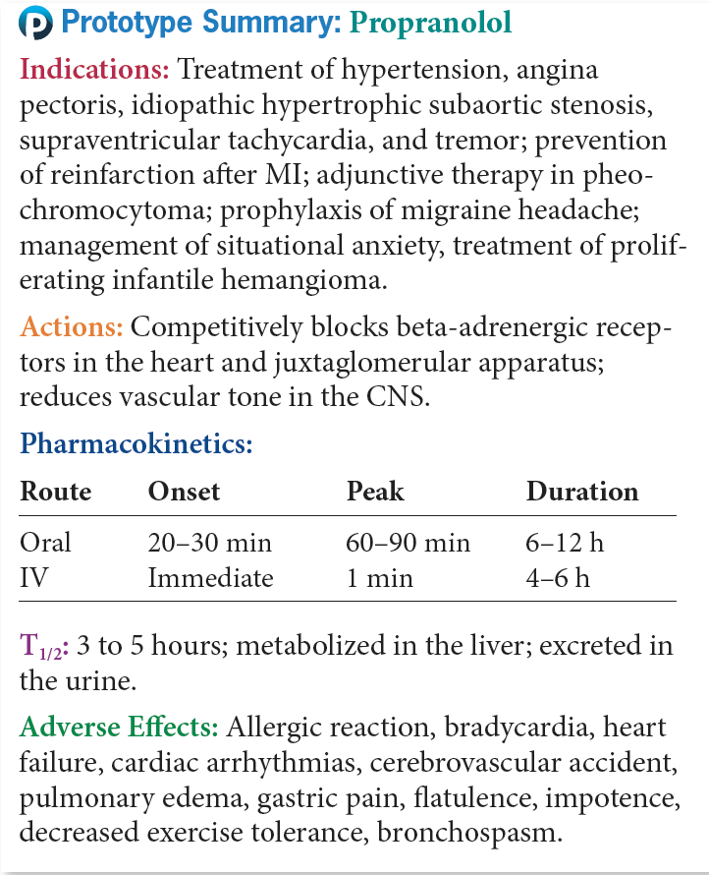
Prototype Nonselective Beta-Adrenergic
Blocking Agents

Slide 34
Beta₁-Selective Adrenergic
Blocking Agents #1
Acebutolol (Sectral)
Atenolol (Tenormin)
Betaxolol (Betoptic)
Bisoprolol (Zebeta)
Esmolol (Brevibloc)
Metoprolol (Lopressor, Toprol XL).

Slide 35
Beta₁-Selective Adrenergic
Blocking Agents #2
Advantage
  Do not usually block beta₂-receptor sites, including the sympathetic bronchodilation
    Preferred for patients who smoke or have asthma, obstructive pulmonary disease, or seasonal or allergic rhinitis
Uses
  Hypertension, angina, some cardiac arrhythmias

Slide 36
Beta₁-Selective Adrenergic
Blocking Agents #3
Actions
  Selectively block beta 1 receptors in the SNS
Pharmacokinetics
  Absorbed from GI tract
  Metabolized in liver and excreted in urine
Contraindications
  Allergy, sinus bradycardia, heart block, cardiogenic shock, CHF, and hypotension
Caution- COPD, diabetes, thyroid disease

Slide 37
Beta₁-Selective Adrenergic
Blocking Agents #4
Adverse Effects
  Fatigue, dizziness, sleep disturbances
  Bradycardia, heart block, CHF, hypotension
  Symptoms in respiratory tract range from rhinitis to bronchospasm
  Nausea, vomiting, diarrhea
  Decreased libido and impotence
Drug-Drug Interactions
  Clonidine, NSAIDs, rifampin, barbiturates, epinephrine, prazosin, verapamil, cimetidine, methimazole, propylthiouracil

Slide 38
Nursing Considerations for Beta₁-Selective Adrenergic Blocking Agents
Assess:
  History and Physical Exam
  Known allergy bradycardia or heart blocks, shock, or heart failure
  Neurological and cardiac status, VS, LS, ECG as appropriate
  Appropriate lab tests

Slide 39
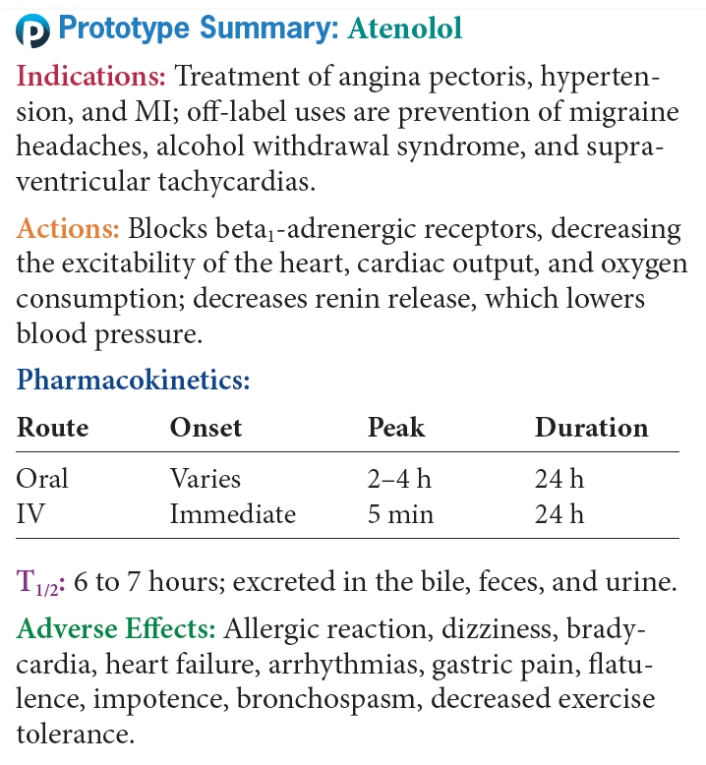
Prototype Beta₁-Selective
Adrenergic Blocking Agents #1

Slide 40
Question #3
You are caring for a child who has been diagnosed with a heart problem. Propanolol has been ordered for this patient. What would be considered in calculating a child’s dose?
A. Child’s body weight and age
B. Child’s body mass
C. Child’s age in months and height
D. Child’s age and body mass index

Slide 41
Answer to Question #3
Child’s body weight and age
Rationale: Children are at greater risk for complications associated with the use of adrenergic blocking agents, including bradycardia, difficulty breathing, and changes in glucose metabolism. The safety and efficacy for use of these drugs has not been established for children younger than 18 years of age. If one of these drugs is used, the dosage for these agents needs to be calculated from the child’s body weight and age.

