Slide 1
Chapter 32:
Cholinergic Agonists

Slide 2
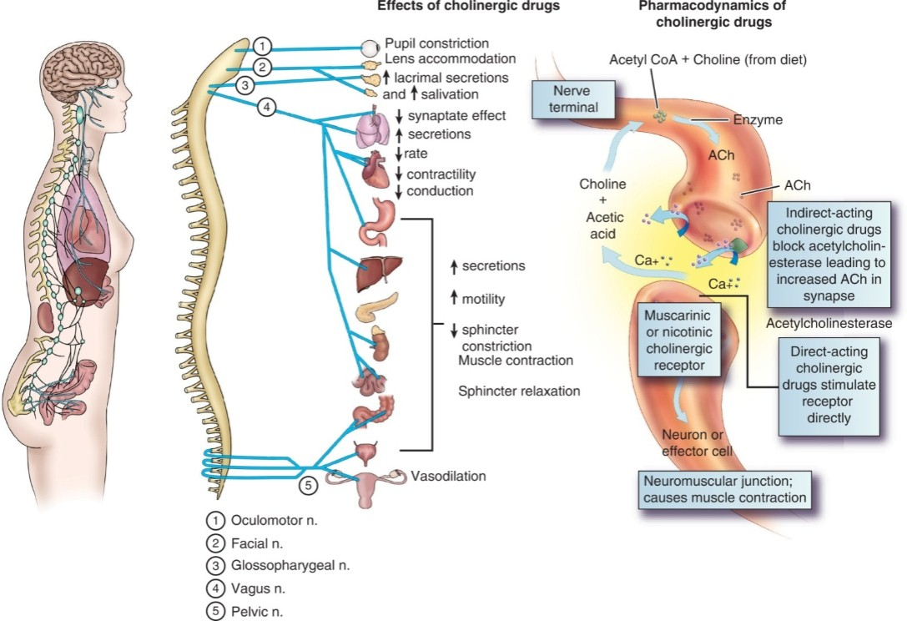
Pharmacodynamics of Cholinergic Drugs

Slide 3
Cholinergic Drugs
Definition
  Chemicals that act at the same site as the neurotransmitter acetylcholine (ACh)
Action
  Often called parasympathomimetic drugs because their action mimics the action of the parasympathetic nervous system
  Not limited to a specific site; therefore associated with many undesirable systemic effects

Slide 4
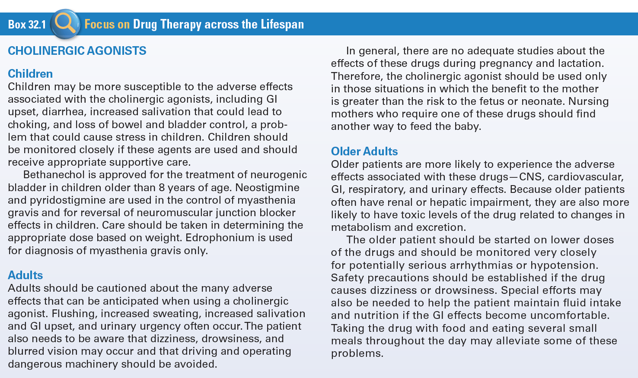
Use of Cholinergic Agonists Agents
Across the Lifespan

Slide 5
Types of Cholinergic Agonists #1
Direct-Acting Cholinergic Agonists
  Occupy receptor sites for ACh on the membranes of the effector cells of the postganglionic cholinergic nerves
  Cause increased stimulation of the cholinergic receptor

Slide 6
Types of Cholinergic Agonists #2
Indirect-Acting Cholinergic Agonists
  React with the enzyme acetylcholinesterase and prevent it from breaking down the ACh that was released from the nerve
  Cause increased stimulation of the ACh receptor sites

Slide 7
Direct-Acting Cholinergic Agonists #1
Bethanechol (Duvoid, Urecholine)
Carbachol (Miostat)
Cevimeline (Evoxac)
Pilocarpine (Salagen)

Slide 8
Direct-Acting Cholinergic Agonists #2
Actions
  Act at cholinergic receptors in the peripheral nervous system to mimic the effects of ACh and parasympathetic stimulation
Indications
  Increase the tone of the detrusor muscle of the bladder and relax the bladder sphincter

Slide 9
Direct-Acting Cholinergic Agonists #3
Pharmacokinetics
  Well absorbed and have relatively short half-life
  (1-6 hours)
  Metabolized and excretion of these drugs is not known

Slide 10
Direct-Acting Cholinergic Agonists #4
Contraindications
  Any condition that would be exacerbated by parasympathetic effects—bradycardia, hypotension
  Known allergy, peptic ulcer disease
  Intestinal obstruction or recent GI surgery
  Asthma
  Bladder obstruction
  Epilepsy and parkinsonism
Caution
  Pregnancy and lactation

Slide 11
Direct-Acting Cholinergic Agonists #5
Adverse Effects
  Nausea, vomiting, cramps, diarrhea, increase salivation, and involuntary defecation
  Bradycardia, heart block, hypotension
  Urinary urgency
  Flushing or increased sweating
Drug-Drug Interactions
  Acetylcholinesterase

Slide 12
Nursing Considerations for Direct-Acting Cholinergic Agonists
Assess:
  History and Physical Exam
  Known allergy, bradycardia, vasomotor instability, peptic ulcer, and obstructive urinary or GI diseases;
  Recent GI or genitourinary (GU) surgery; asthma; parkinsonism or epilepsy
  VS, LS, cardiac status and I&O

Slide 13
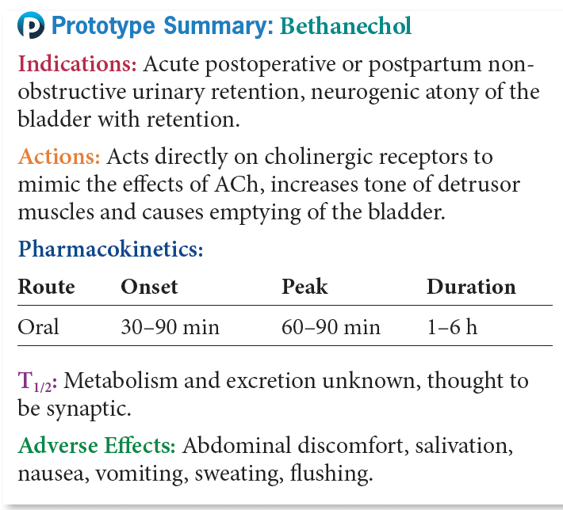
Prototype Direct-Acting
Cholinergic Agonists

Slide 14
Question #1
Tell whether the following statement is true or false.
An indication for the use of Duvoid is to diagnose and treat esophageal varices.

Slide 15
Answer to Question #1
  False
Rationale: Bethanechol (Duvoid, Urecholine)
  Treat urinary retention; neurogenic bladder atony
  Diagnose and treat reflux esophagitis

Slide 16
Myasthenia Gravis
Definition
  Chronic muscular disease caused by a defect in neuromuscular transmission
  Autoimmune disease; patients make antibodies to ACh receptors, causing gradual destruction of them
Symptoms
  Progressive weakness and lack of muscle control with periodic acute episodes

Slide 17
Acetylcholinesterase Inhibitors Used to Treat Myasthenia Gravis
Neostigmine (Bioxiverz): Has a strong influence at the neuromuscular junction
Pyridostigmine (Mestinon): Has a longer duration of action than neostigmine
Edrophonium (Enlon): Diagnostic agent for myasthenia gravis

Slide 18
Alzheimer’s Disease
A progressive disorder involving neural degeneration in the cortex
Leads to a marked loss of memory and the ability to carry on activities of daily living
Cause of the disease is not yet known
  There is a progressive loss of ACh-producing neurons and their target neurons

Slide 19
Drugs Used to Treat Alzheimer’s Disease
Galantamine (Razadyne)
  Used to stop progression of Alzheimer’s dementia
Rivastigmine (Exelon)
  Available in solution for swallowing ease
Donepezil (Aricept)
  Has once-a-day dosing

Slide 20
Indirect-Acting Cholinergic Agonists #1
Actions
  Blocks ACh at the synaptic cleft, which allows the accumulation of ACh released from the nerve endings and leads to increased and prolonged stimulation of ACh
Indications
  Myasthenia gravis and Alzheimer’s disease
Pharmacokinetics
  Well absorbed and distributed throughout the body
  Metabolized in the liver and excreted in the urine

Slide 21
Indirect-Acting Cholinergic Agonists #2
Contraindications
  Allergy
  Bradycardia
  Intestinal or urinary tract obstruction
  Pregnancy and lactation
Caution
  Any condition that could be exacerbated by cholinergic stimulation
  Asthma, coronary disease, peptic ulcer, arrhythmias, epilepsy, or parkinsonism

Slide 22
Indirect-Acting Cholinergic Agonists #3
Adverse Effects
  Bradycardia
  Hypotension
  Increased GI secretions and activity
  Increased bladder tone
  Relaxation of GI and genitourinary sphincters
  Bronchoconstriction
  Pupil constriction
Drug-Drug Interactions
  NSAIDs, cholinergic drugs

Slide 23
Nursing Considerations for
Indirect-Acting Cholinergic Agonists
Assess:
  History and Physical Exam
  Known allergy, arrhythmias, coronary artery disease, hypotension, urogenital or GI obstruction, or peptic ulcer, GI or GU surgery
  Orientation, affect, reflexes, ability to carry on activities of daily living
  VS, ECG as appropriate, urinary output and renal/ liver function tests

Slide 24
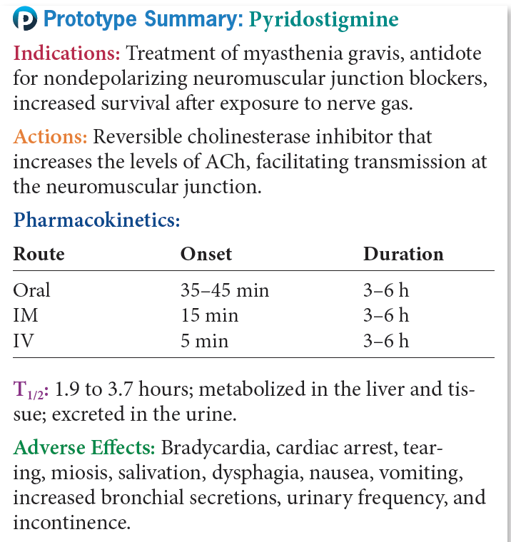
Prototype Indirect-Acting Cholinergic Agonists–Myasthenia Gravis

Slide 25
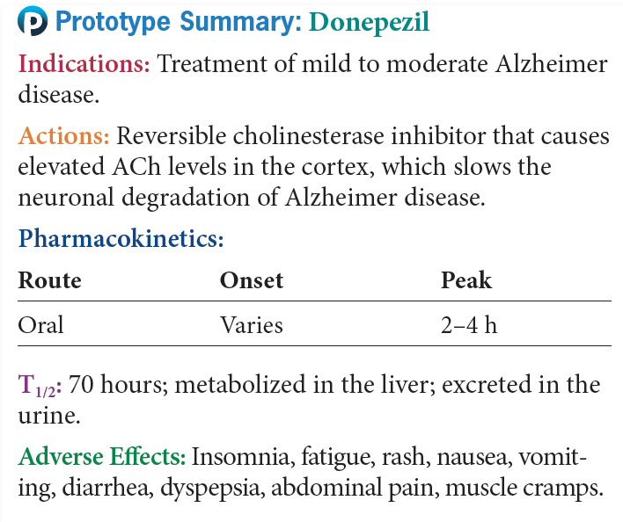
Prototype Indirect-Acting Cholinergic Agonists-Alzheimer’s Disease

Slide 26
Question #2
Which of the drugs used to treat Alzheimer’s disease is available in solution for swallowing ease?
A. Cognex
B. Reminyl
C. Aricept
D. Exelon

Slide 27
Answer to Question #2
D. Exelon
Rationale: Rivastigmine (Exelon): Available in solution for swallowing ease

Slide 28
Question #3
The nurse is providing patient education to a patient taking an indirect-acting cholinergic agonist. What drug-to-drug interaction would the nurse include in the patient education?
A. NSAIDs
B. Direct-acting cholinergic agonist
C. Acetylcholinesterase inhibitors
D. Direct-acting cholinergic antagonist

Slide 29
Answer to Question #3
A. NSAIDs
Rationale: Indirect-acting cholinergic agonists have a drug-to-drug interaction with NSAIDs.

