Slide 1
Chapter 37:
Thyroid and Parathyroid Agents

Slide 2
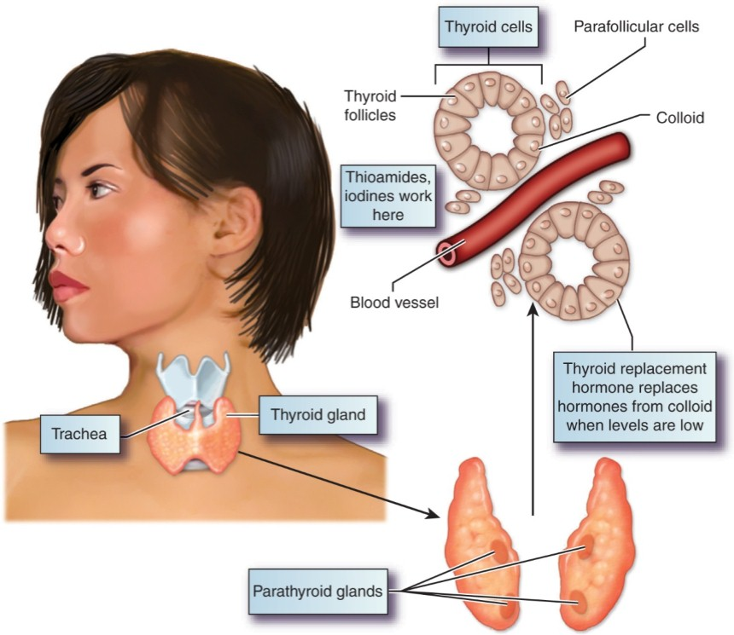
The Thyroid and Parathyroid Glands

Slide 3
Actions of the Thyroid Gland
Produces two thyroid hormones using iodine found in the diet:
  Tetraiodothyronine or levothyroxine (T₄)
  Triiodothyronine or liothyronine (T₃)
Removes iodine from the blood, concentrates it, and prepares it for attachment to tyrosine, an amino acid

Slide 4
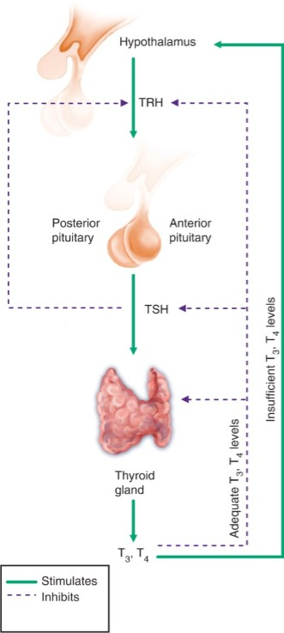
Thyroid Control of Hormone Levels

Slide 5
Functions of Thyroid Hormones
Regulate the rate of metabolism
Affect heat production and body temperature
Affect oxygen consumption, cardiac output, and blood volume
Affect enzyme system activity
Affect metabolism of carbohydrates, fats, and proteins
Regulate growth and development

Slide 6
Types of Thyroid Dysfunction
Hypothyroidism
  Underactivity
Hyperthyroidism
  Overactivity

Slide 7
Causes of Hypothyroidism
Absence of the thyroid gland
Lack of sufficient iodine in the diet to produce the needed level of thyroid hormone
Lack of sufficient functioning thyroid tissue due to tumor or autoimmune disorders
Lack of TRH related to a tumor or disorder of the hypothalamus
Most common issue with thyroid function

Slide 8
Hyperthyroidism
Definition
  Excessive amounts of thyroid hormones are produced and released into the circulation
Cause
  Graves’ disease
Signs and Symptoms
  Increased body temperature, tachycardia, thin skin, palpitations, hypertension, flushing, intolerance to heat, amenorrhea, weight loss, and goiter

Slide 9
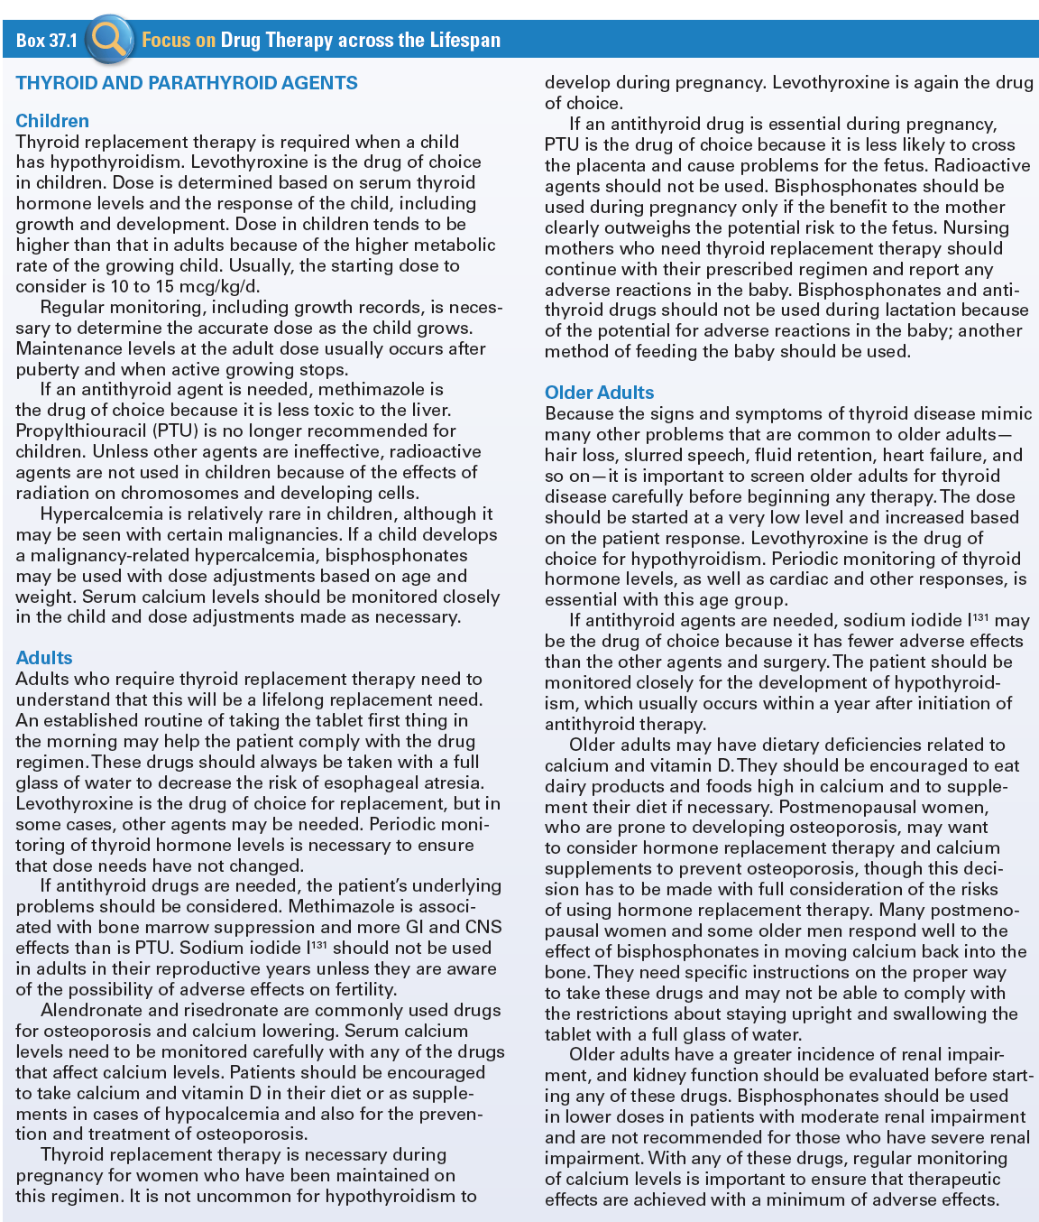
Use of Thyroid and Parathyroid
Agents Across the Lifespan

Slide 10
Replacement Hormone Products for Treating Hypothyroidism
Levothyroxine (Synthroid, Levoxyl, Levothroid): Synthetic salt of T₄
Thyroid Desiccated (Armour Thyroid and others): Prepared from dried animal thyroid glands and contains both T₃ and T₄
Liothyronine (Cytomel, Triostat): Synthetic salt of T₃
Liotrix (Thyrolar): Synthetic preparation of T₄ and T₃ in a standard 4:1 ratio

Slide 11
Thyroid Hormones #1
Actions
  Increases the metabolic rate of body tissues, increasing oxygen consumption, respiration, and heart rate; the rate of fat, protein, and carbohydrate metabolism; and growth and maturation
Indications
  Replacement therapy in hypothyroidism; pituitary TSH suppression in the treatment of euthyroid goiters, management of thyroid cancer; thyrotoxicosis in conjunction with other therapy; myxedema coma
Pharmacokinetics
  Absorbed in GI tract and binds to serum proteins
  Eliminated in bile
  Does not cross the placenta

Slide 12
Thyroid Hormones #2
Contraindications
  Known allergy
  Thyrotoxicosis
  Acute MI
Caution
  Lactation
  Hypoadrenal conditions such as Addison’s

Slide 13
Thyroid Hormones #3
Adverse Effects
  Skin reactions
  Symptoms of hyperthyroidism
  Cardiac stimulation
  CNS effects
Drug-Drug Interactions
  Cholestyramine
  Oral anticoagulants
  Digitalis
  Theophylline

Slide 14
Nursing Considerations for
Thyroid Hormones
Assess:
  History and Physical Exam
  Known allergy
  Lactation, Addison disease, acute myocardial infarction not complicated by hypothyroidism, and thyrotoxicosis, skin lesions
  Orientation and affect; baseline pulse, blood pressure, and electrocardiogram; respiration and adventitious sounds; and thyroid function tests

Slide 15
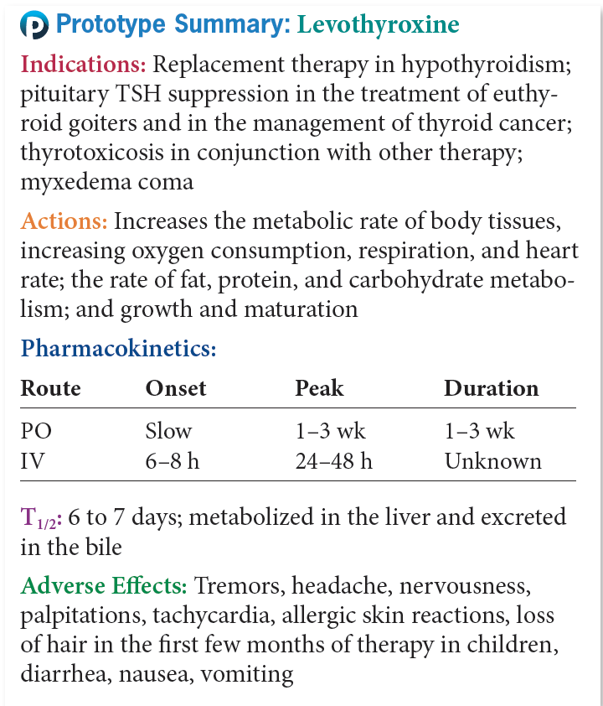
Prototype Thyroid Hormone

Slide 16
Question #1
Please answer the following statement as true or false.
The hormones PTH and calcitonin work together to maintain a delicate balance of serum calcium levels in the body and also to keep serum calcium levels within normal limits.

Slide 17
Answer to Question #1
True
Rationale: Renal tubular phosphate reabsorption is balanced by calcium secretion into the urine, which causes a drop in serum calcium, stimulating PTH secretion. The hormones PTH and calcitonin work together to maintain the delicate balance of serum calcium levels in the body and to keep serum calcium levels within the normal range.

Slide 18
Antithyroid Agents #1
Actions
  Thioamides: prevent formation of thyroid hormone within the thyroid cells, lowering the serum level, partially inhibit conversion of T₄ to T₃
  Iodine Solutions: high doses block thyroid function
Indications
  Hyperthyroidism
Pharmacokinetics
  Thioamides: Well absorbed from GI tract, concentrated in thyroid gland, some excretion detected in urine
  Iodine Solutions: Rapidly absorbed from GI tract, widely distributed throughout body fluids, excretion through urine

Slide 19
Antithyroid Agents #2
Contraindications
  Known allergy
  Pregnancy
Caution
  Lactation

Slide 20
Antithyroid Agents #3
Adverse Effects
  Thioamides: Thyroid suppression
  Iodine Solutions: Hypothyroidism
Drug-Drug Interactions
  Thioamides: Oral anticoagulants, theophylline, metoptolol, propranolol, digitalis
  Iodine Solutions: Anticoagulants, theophylline, digoxin, metoprolol, propranolol

Slide 21
Nursing Considerations for
Antithyroid Agents
Assess:
  History and Physical Exam
  Known allergy, pregnancy and lactation status, liver dysfunction; and pulmonary edema or pulmonary tuberculosis
  Skin lesions; orientation and affect; baseline, pulse, blood pressure, and electrocardiogram; respiration, and adventitious sounds; and thyroid function tests

Slide 22
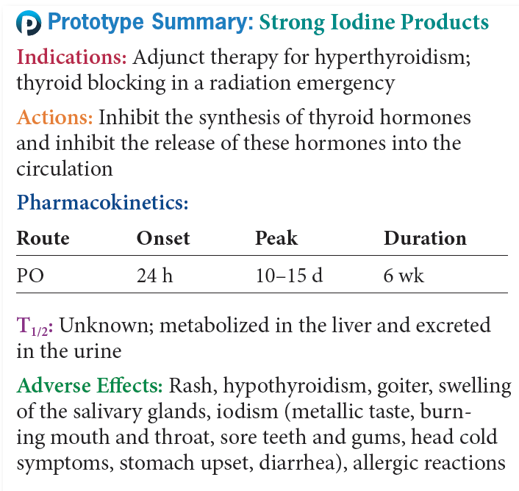
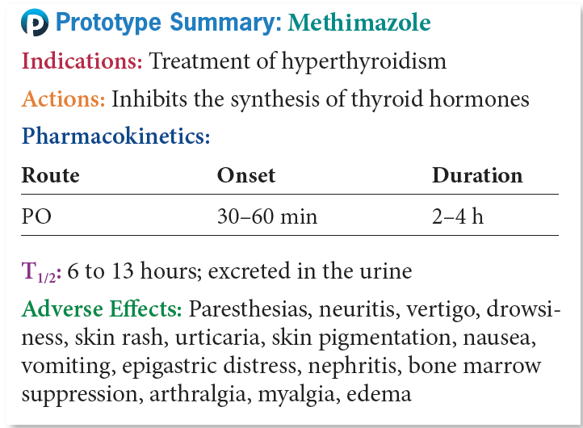
Prototype Antithyroid Agents

Slide 23
Question #2
In which of the following ways does the thyroid gland use iodine?
A. To stimulate the production of TSH
B. To produce the thyroid hormones
C. To regulate parathyroid production
D. To destroy part of the thyroid gland

Slide 24
Answer to Question #2
B. To produce the thyroid hormones
Rationale: The thyroid gland uses iodine to produce the thyroid hormones that regulate body metabolism. Control of the thyroid gland involves an intricate balance among TRH, TSH, and circulating levels of thyroid hormone.

Slide 25
Parathyroid Dysfunction
Hypoparathyroidism
  The absence of parathormone
  Most likely to occur with the accidental removal of the parathyroid glands during thyroid surgery
Hyperparathyroidism
  The excessive production of parathormone
  Can occur as a result of parathyroid tumor or certain genetic disorders

Slide 26
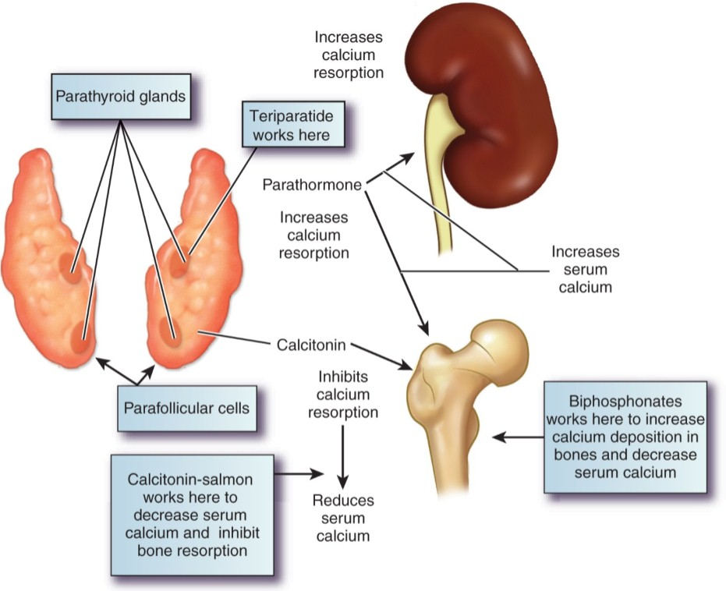
Calcium Controlled in the Body

Slide 27
Paget’s Disease
Genetically-linked disorder
Overactive osteoclasts that are eventually replaced by enlarged and softened bony structures.
Patients complain of deep bone pain, headaches, and hearing loss

Slide 28
Antihypocalcemic Agents #1
Teriparatide (Forteo)
Parathyroid hormone (Natapara)

Slide 29
Antihypocalcemic Agents #2
Actions
  Stimulation of osteoclasts or bone cells to release calcium from the bone
  Increased intestinal absorption of calcium
  Increased calcium resorption from the kidneys
  Stimulation of cells in the kidney to produce calcitriol
Indications
  Management of hypocalcemia in patients undergoing chronic renal dialysis
  Treatment of hypoparathyroidism

Slide 30
Antihypocalcemic Agents #3
Pharmacokinetics
  Absorbed from GI tract and widely distributed throughout the body
  Stored in liver, fat, muscle, skin, and bones
  Metabolized in the liver, excreted in the urine

Slide 31
Antihypocalcemic Agents #4
Contraindications
  Allergy to vitamin D, hypercalcemia, vitamin D toxicity, and pregnancy
Caution
  History of renal stones
Adverse Effects
  GI effects
  CNS effects
Drug-Drug Interactions
  Magnesium containing antacids
  Cholestyramine or mineral oil

Slide 32
Nursing Considerations for Patients Receiving Antihypocalcemic Agents
Assess:
  History and Examination
  Known allergy
  Hypercalcemia, vitamin toxicity, renal stone, and pregnancy or lactation
  Skin lesions; orientation and affect; liver evaluation; serum calcium, magnesium, and alkaline phosphate levels; and radiographs of bones as ppropriate,

Slide 33
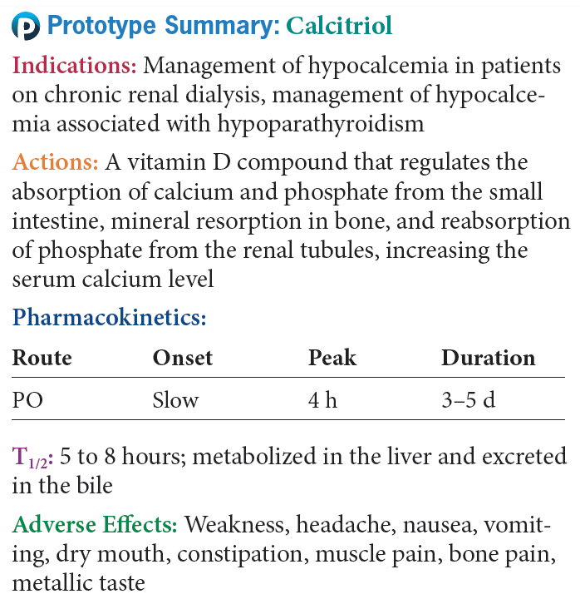
Prototype Antihypocalcemic Agents

Slide 34
Antihypercalcemic Agents #1
Bisphosphonates
  These drugs act on the serum levels of calcium and not directly on the parathyroid gland or PTH
  Slow normal and abnormal bone resorption
  Side effects: headache, nausea, and diarrhea
Calcitonins
  Hormones secreted by the thyroid gland to balance the effects of PTH
  Inhibit bone resorption
  Side effects: flushing of face and hands

Slide 35
Antihypercalcemic Agents #2
Slow or block bone resorption
Etidronate (Didronel)
Ibandronate (Boniva)
Pamidronate (Aredia)
Risedronate (Actonel)
Alendronate (Fosamax)
Zoledronic acid (Zometa)

Slide 36
Antihypercalcemic Agents #3
Actions-
  Bisphosphonates- Slow or block bone resorption; by doing this, they help to lower serum calcium levels, but they do not inhibit normal bone formation and mineralization
  Calcitonin's- Inhibits bone resorption, lowers serum calcium levels in children and in patients with Paget’s disease, and increases the excretion of phosphate, calcium, and sodium from the kidney

Slide 37
Antihypercalcemic Agents #4
Contraindications
  Bisphosphonates- Hypocalcemia, pregnancy and lactation, renal dysfunction, GI disease
  Calcitonins- Pregnancy, renal dysfunction or pernicious anemia

Slide 38
Antihypercalcemic Agents #5
Adverse effects
  Bisphosphates- Most common, headache, nausea, and diarrhea, bone pain with Paget’s disease
  Calcitonins- Flushing of the face and hands, skin rash, nausea and vomiting, urinary frequency, and local inflammation at the site of injection.

Slide 39
Antihypercalcemic Agents #6
Drug-Drug Interactions
  Bisphosphonates- antacids, calcium products,iron, or multiple vitamins and aspirin
  Calcitonins- None known

Slide 40
Nursing Considerations for Patients Receiving Antihypercalcemic Agents
Assess:
  History and Examination
  Known allergy, pregnancy and lactation
  hypocalcemia; and renal dysfunction
  skin lesions; orientation and affect; abdominal examination; serum electrolytes; and renal function tests

Slide 41
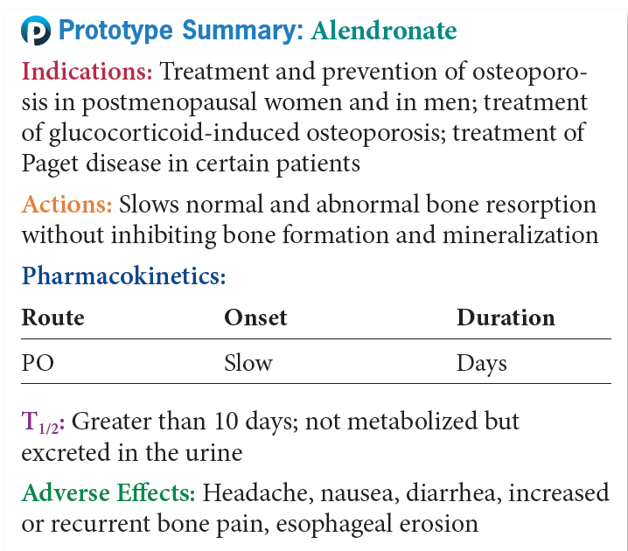
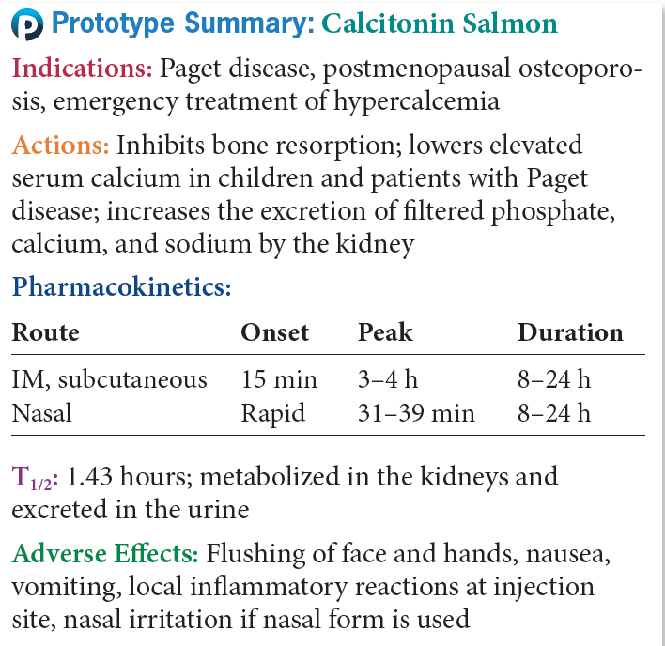
Prototype Antihypercalcemic Agents

Slide 42
Question #3
Paget’s disease is a genetically-linked disorder. It is a condition involving overactive osteoclasts that are eventually replaced by enlarged and softened bony structures. What are the clinical manifestations of Paget’s disease?
A. Deep bone pain
B. Increased hearing acuity
C. Increased visual acuity
D. Cardiac arrhythmias

Slide 43
Answer to Question #3
A. Deep bone pain
Rationale: The genetically-linked disorder Paget’s disease is a condition of overactive osteoclasts that are eventually replaced by enlarged and softened bony structures. Patients with this disease complain of deep bone pain, headaches, and hearing loss and usually have cardiac failure and bone malformation.

