Slide 1
Chapter 39: Introduction to the Reproductive System

Slide 2
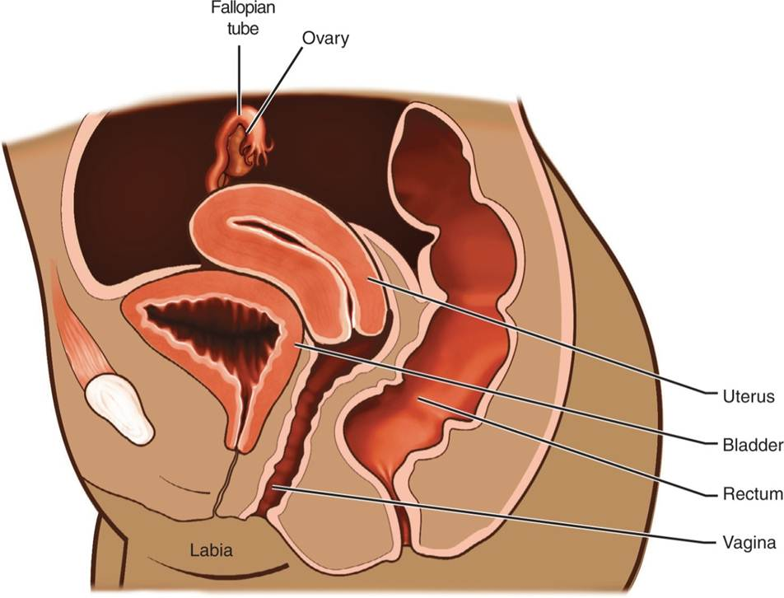
Female Reproductive System

Slide 3
Role of the Female Ovary
Store ova
Produces the sex hormones estrogen and progesterone

Slide 4
Hormones Produced in the Ovaries
Estrogen
Estradiol, estrone, and estriol
Enter cells and bind to receptors within the cytoplasm
Promote messenger RNA activity
Progesterone
Released into circulation after ovulation

Slide 5
Function of the Hypothalamus
Releases GnRH at puberty
Stimulates the anterior pituitary release of FSH and LH
Stimulates the production and release of the sex hormones
Controls levels by a series of negative feedback systems

Slide 6
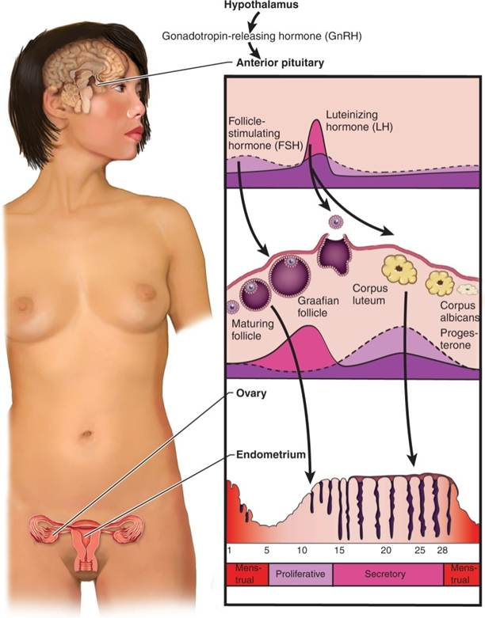
Pituitary and Ovarian Hormone Levels

Slide 7
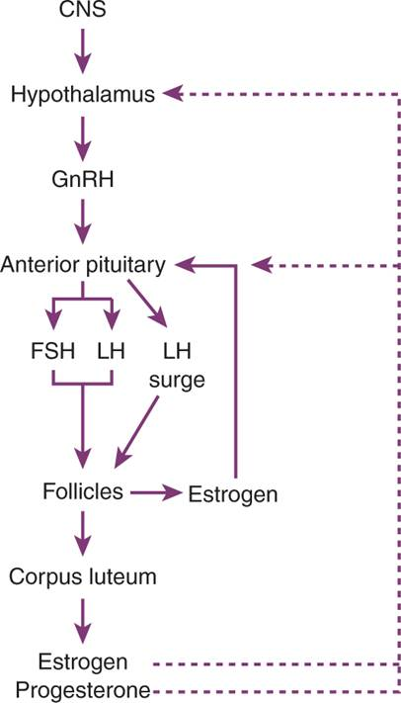
Interaction of Hormones on the Menstrual Cycle

Slide 8
The Menstrual Cycle
Each cycle begins with release of FSH and LH and stimulation of ovarian follicles
For about 14 days, developing follicles release estrogen
At about day 14, estrogen levels have caused LH surge, and ovulation occurs
Progesterone is released when follicle ruptures
After about 14 days, if pregnancy does not occur, the corpus luteum involutes and levels of estrogen and progesterone decline, triggering the release of GnRH, followed by FSH and LH

Slide 9
Pregnancy
The ovum is fertilized by the sperm.
A new cell is produced that divides to produce the embryo.
The embryo implants on the wall of the uterus.
The interface between the fetal cells and the uterus produce the placenta.

Slide 10
Pregnancy Changes
Estrogen and progesterone are responsible for many of the changes in the female body during pregnancy. They include:
Elevated body temperature
Development of the cervical plug
Further growth of female accessories structures and breast tissue, softening of the ligaments to allow easier delivery, elevated blood glucose levels, elevated cholesterol levels, surface blood vessels to release heat, and impaired immune and inflammatory responses

Slide 11
Question #1
Please answer the following statement as true or false?
The placenta is created at the interface between the fetal cells and the uterus.

Slide 12
Answer to Question #1
True
Rationale: The interface between the fetal cells and the uterus produce the placenta.

Slide 13
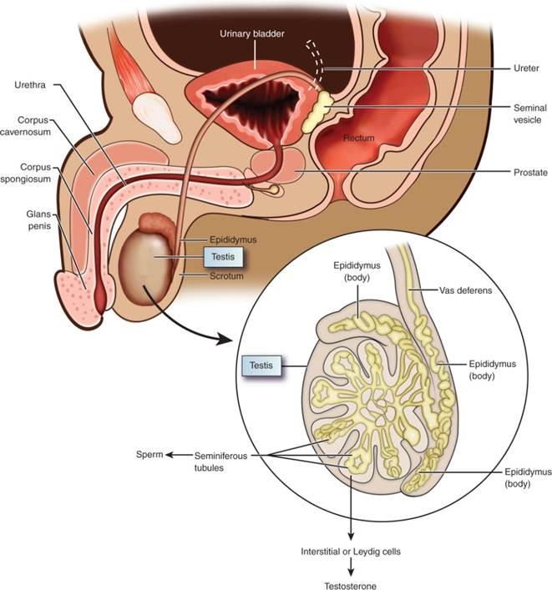
Male Reproductive System

Slide 14
Components of the Testes
Seminiferous Tubules
Produce the sperm
Interstitial (Leydig) Cells
Produce the hormone testosterone

Slide 15
Production of Sperm in the Seminiferous Tubules
In response to FSH stimulation, and testosterone in the interstitial cells
In response to LH stimulation

Slide 16
Effects of Testosterone on the Body
Growth of male and sexual accessory organs
Growth of testes and scrotal sac
Thickening of vocal cords
Hair growth
Increased protein anabolism and decreased protein catabolism
Thickening of cartilage and skin
Vascular thickening
Increased hematocrit

Slide 17
Four Phases of the Human Sexual Response
Period of stimulation with mild increases in sensitivity and beginning stimulation of the SNS
Plateau stage when stimulation levels off
Climax resulting from massive sympathetic stimulation of the body
Period of recovery or resolution

Slide 18
Menopause and Andropause
Occur when the body can no longer produce sex hormones
The hypothalamus and anterior pituitary respond by releasing increasing levels of GnRH, FSH, and LH in an attempt to achieve higher levels of sex hormones

Slide 19
Question #2
Both estrogen and testosterone play a large part in the human reproductive cycle. What role does testosterone play in the human body?
A. Decreased hemoglobin
B. Increased hematocrit
C. Decreased release of skin emollients
D. Increased time to mount an inflammatory response

Slide 20
Answer to Question #2
B. Increased hematocrit
Rationale: Results of testosterone on the body include: thickening of cartilage and skin; vascular thickening; increased hematocrit

