Slide 1
Chapter 43:
Drugs Affecting Blood Pressure

Slide 2
Blood Pressure Control
BP determined by
  Heart Rate
  Stroke Volume: Amount of blood pumped out of the ventricle with each heartbeat
  Total Peripheral Resistance: Resistance of the muscular arteries to the blood being pumped through
Baroreceptors
Renin-angiotensin-aldosterone system

Slide 3
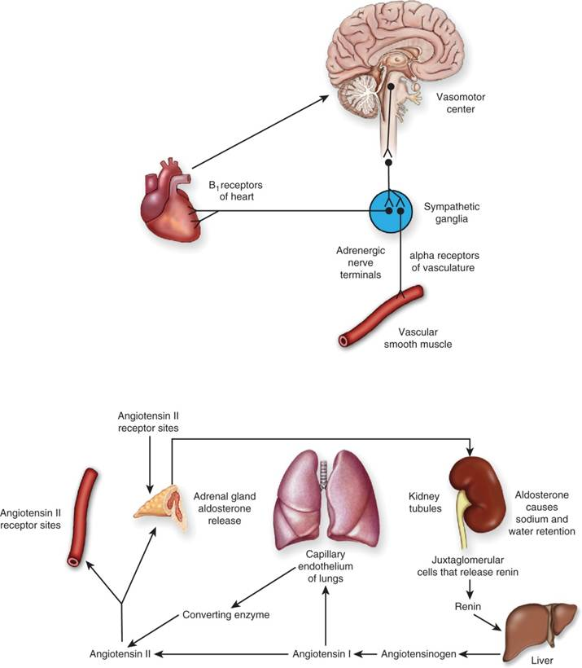
Control of Blood Pressure

Slide 4
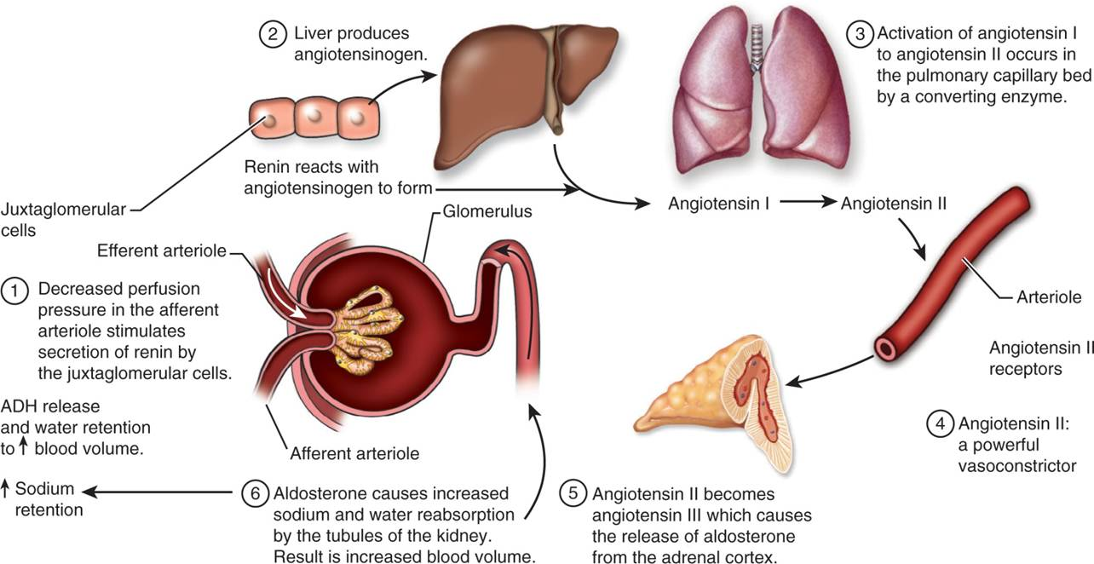
The Renin–Angiotensin System

Slide 5
Risks for Coronary Artery Disease Related to Hypertension
Thickening of the heart muscle
Increased pressure generated by the muscle on contraction
Increased workload on the heart

Slide 6
Conditions Related to Untreated Hypertension
CAD and Cardiac Death
Stroke
Renal Failure
Loss of Vision

Slide 7
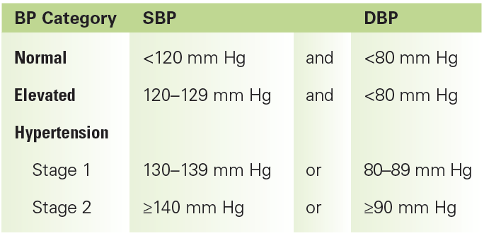
Categories Rating the Severity of Hypertension

Slide 8
Factors Known to Increase Blood Pressure
High levels of psychological stress
Exposure to high-frequency noise
High-salt diet
Lack of rest
Genetic predisposition

Slide 9
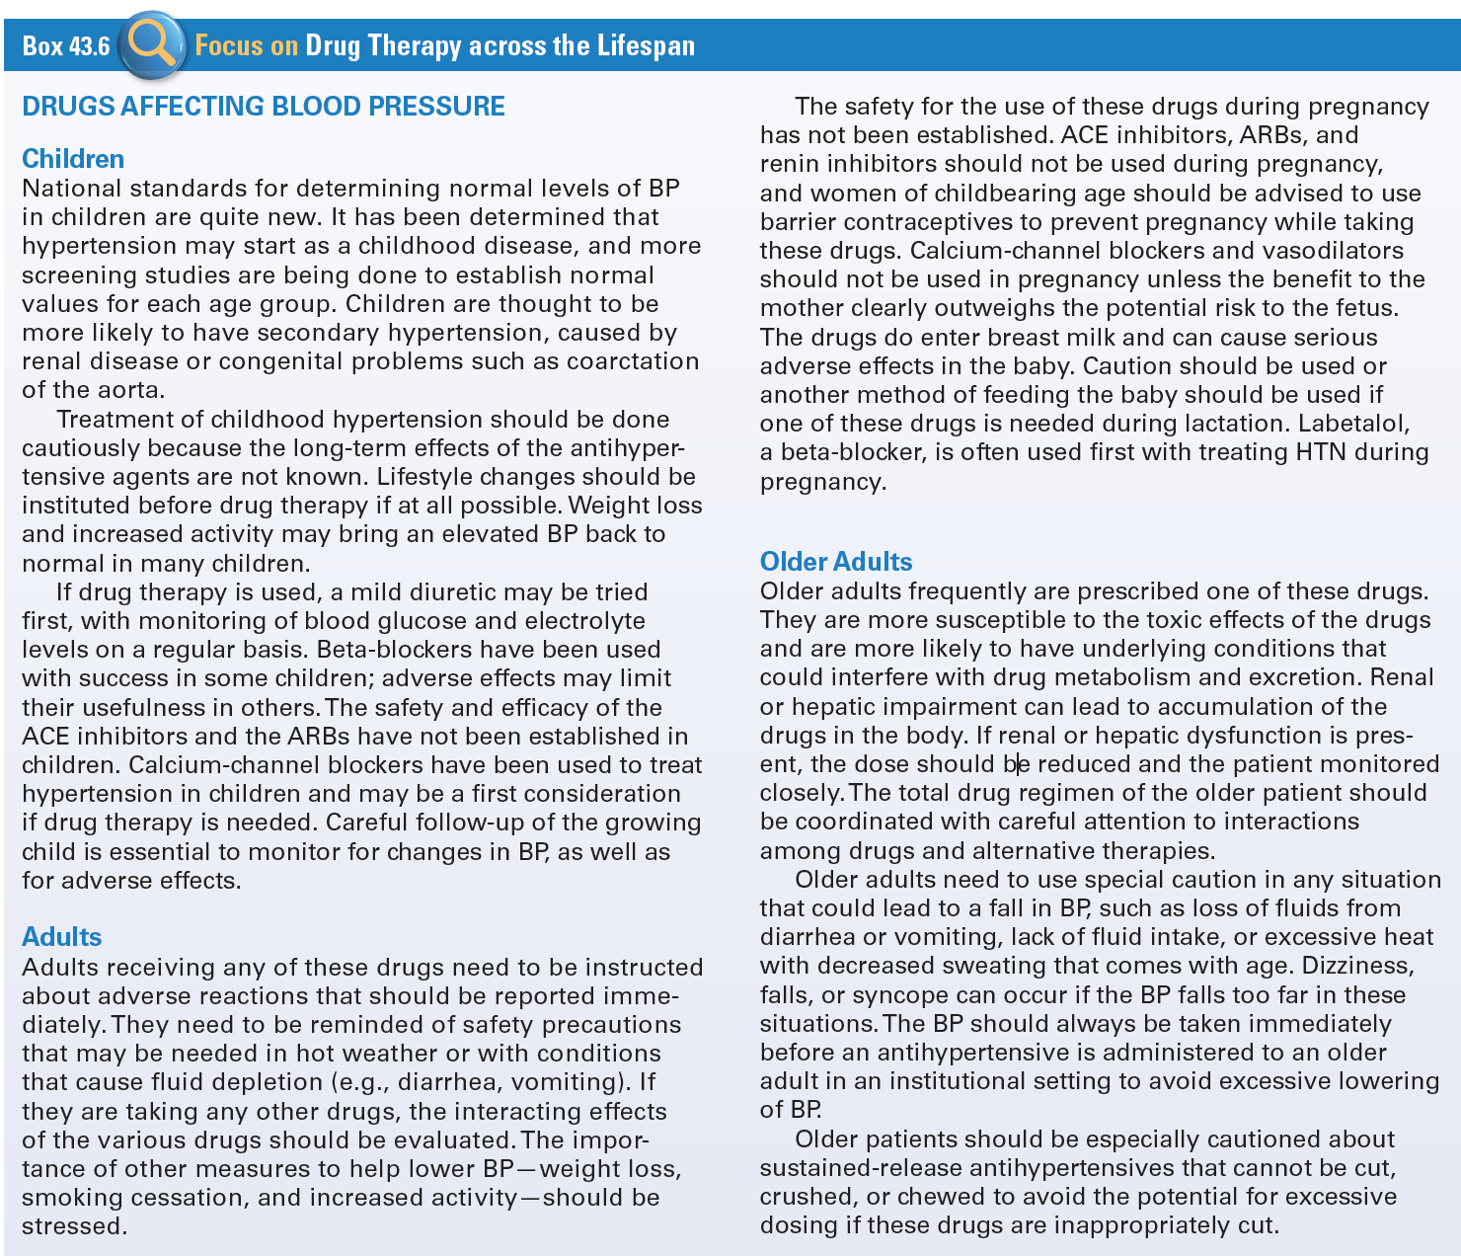
Use Of Drugs Affecting Blood Pressure Across The Lifespan

Slide 10
Hypotension
BP becomes too low
  When the heart muscle is damaged and unable to pump effectively
  With severe blood or fluid loss, when volume drops dramatically
  When there is extreme stress and the body’s levels of norepinephrine are depleted, leaving the body unable to respond to stimuli to raise BP

Slide 11
Antihypertensive Agents
ACE Inhibitors
Angiotensin II Receptor Blockers
Renin Inhibitors
Calcium Channel Blockers
  Vasodilators
  Diuretics
  Sympathetic Nervous System Blockers

Slide 12
Stepped Care Management of Hypertension
Step 1: Lifestyle modifications are instituted
  Weight reduction, smoking cessation, moderation of alcohol intake, reduction of dietary salt, increase in aerobic physical activity
Step 2: Inadequate response
  Drug therapy added
Step 3: Inadequate response
  Consider change in drug dose or class, or addition of another drug for combined effect
Step 4: Inadequate response
  Second or third agent or diuretic is added if not already prescribed

Slide 13
ACE Inhibitors #1
Benazepril (Lotensin)
Captopril (Capoten)
Enalapril (Vasotec)
Enalaprilat (generic)
Fosinopril (generic)
Lisinopril (Prinivil, Zestril)
Moexipril (Univasc)
Perindopril (Aceon)
Quinapril (Accupril)
Ramipril (Altace)
Trandolapril (Mavik)

Slide 14
ACE Inhibitors #2
Actions
  Blocks ACE from converting angiotensin I to angiotensin II, leading to a decrease in blood pressure, a decrease in aldosterone production, and a small increase in serum potassium levels along with sodium and fluid loss
Indications
  Treatment of hypertension, congestive heart failure (CHF), diabetic nephropathy, left ventricular dysfunction following an MI
Pharmacokinetics
  Well absorbed, widely distributed, metabolized in the liver, and excreted in the urine and feces

Slide 15
ACE Inhibitors #3
Contraindications
  Allergies
  Impaired renal function
  Pregnancy and lactation
Caution
  CHF

Slide 16
ACE Inhibitors #4
Adverse Effects
  Related to the effects of vasodilatation and alterations in blood flow
  GI irritation
  Renal insufficiency
  Cough
Drug-Drug Interactions
  Allopurinol

Slide 17
Nursing Considerations for ACE Inhibitors
Assess:
  History and Physical Exam
  Known allergy
  Impaired kidney function, pregnancy and lactation
  Salt/volume depletion and heart failure
  Baseline status before beginning therapy, including
  VS, LS, BS, weight, skin, ECG, CBC with differential and electrolytes

Slide 18
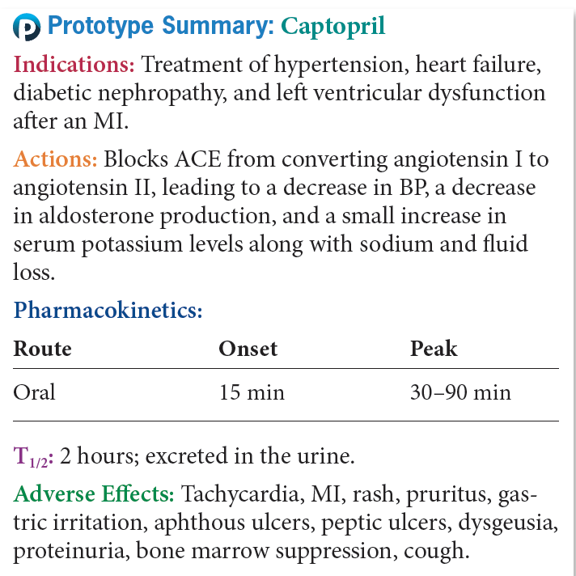
Prototype ACE Inhibitors

Slide 19
Question #1
Please answer the following questions as true or false.
The use of a loop diuretic is the first drug used in the Step Care Management program to treat hypertension.

Slide 20
Answer to Question #1
False
Rationale: A somewhat controversial study, the ALLHAT study, reported in 2002 that patients taking the less expensive, less toxic diuretics did better and had better blood pressure control than patients using other antihypertensive agents. Replications of this study have supported its findings and the use of a thiazide diuretic is currently considered the first drug used in the Step Care Management of Hypertension.

Slide 21
Angiotensin II Receptor Blockers #1
Azilsartan (Edarbi)
Candesartan (Atacand)
Eprosartan (Teveten)
Irbesartan (Avapro)
Losartan (Cozaar)
Olmesartan (Benicar)
Telmisartan (Micardis)
Valsartan (Diovan)

Slide 22
Angiotensin II Receptor Blockers #2
Actions
  Selectively bind with the angiotensin II receptors in vascular smooth muscle and in the adrenal cortex to block vasoconstriction and the release of aldosterone
Pharmacokinetics
  Well absorbed and undergo metabolism in the liver by the cytochrome P450 system. They are excreted in the feces and urine

Slide 23
Angiotensin II Receptor Blockers #3
Contraindications
  Allergy, pregnancy, and lactation
Caution
  Hepatic or renal dysfunction, and hypovolemia
Adverse Effects
  Headache, dizziness, syncope, weakness
  GI complaints
  Skin rash or dry skin
Drug-Drug Interactions
  Phenobarbital

Slide 24
Nursing Considerations for Angiotensin II Receptor Blockers
Assess:
  History and Physical Exam
  Known allergy
  Impaired renal and hepatic function, pregnancy and lactation
  Hypovolemia, assess baseline status before beginning therapy including, skin, VS, LS, baseline ECG and renal and function tests

Slide 25
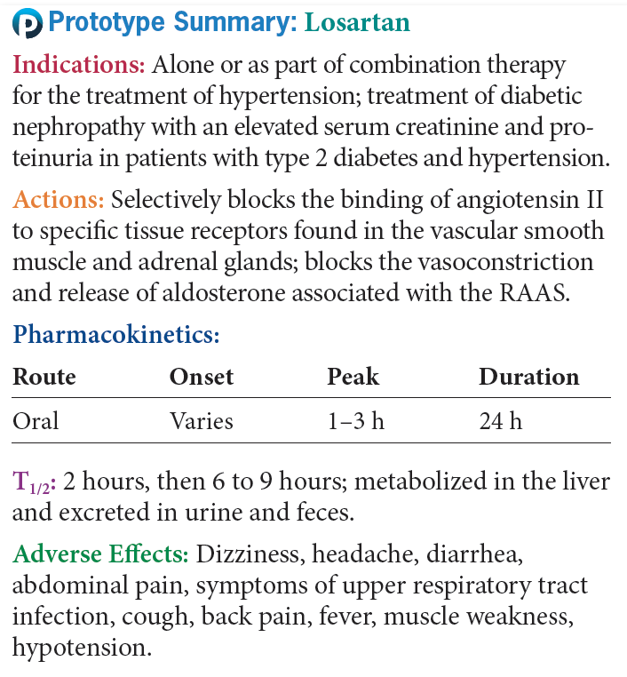
Prototype Angiotensin II Receptor Blockers

Slide 26
Renin Inhibitor
New class of drugs for treating hypertension which directly inhibits renin, leading to decreased plasma renin activity and inhibiting the conversion of angiotensinogen to angiotensin I
  aliskiren (Tekturna)
Pharmacokinetics- slowly absorbed from the GI tract, with peak levels in 3 hours. It is metabolized in the liver, with a half-life of 24 hours, and is excreted in the urine
Contraindications- Pregnancy and lactation
Adverse effects- Risk of hyperkalemia
Drug-Drug Interactions- Furosemide and ACE Inhibitors

Slide 27
Calcium Channel Blockers #1
Decrease BP, cardiac work load, and myocardial oxygen consumption
  Amlodipine (Norvasc)
  Felodipine (Plendil)
  Isradipine(generic)
  Nicardipine (Cardene)
  Diltiazem (Cardizem CD)
  Nifedipine (Procardia XL)
  Nisoldipine (Sular)
  Verapamil (Calan SR)

Slide 28
Calcium Channel Blockers #2
Actions
  Inhibits the movement of calcium ions across the membranes of cardiac and arterial muscle cells, depressing the impulse and leading to slowed conduction, decreased myocardial contractility, and dilation of arterioles, which lowers blood pressure and decreases myocardial oxygen consumption
Indications
  Treatment of essential hypertension in the extended release form
Pharmacokinetics
  Well absorbed, metabolized in the liver, and excreted in the urine

Slide 29
Calcium Channel Blockers #3
Contraindications
  Allergy, heart block or sick sinus syndrome, renal or hepatic dysfunction, pregnancy, and lactation
Adverse Effects
  Related to effects on cardiac output
  GI symptoms
  Cardiovascular symptoms
Drug-Drug Interactions
  Cyclosporine
Drug-Food Interactions
  Grapefruit juice

Slide 30
Nursing Considerations for Calcium Channel Blocker
Assess:
  History and Physical Exam
  Known allergy
  The main use of calcium-channel blockers is for the treatment of angina. See Chapter 46 for the nursing considerations of calcium channel blockers

Slide 31
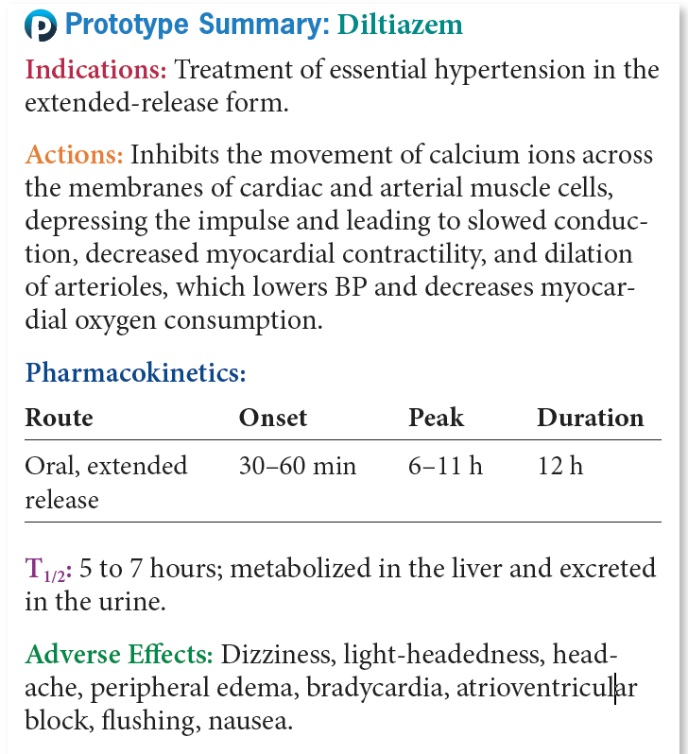
Prototype Calcium Channel Blockers

Slide 32
Question #2
The mechanism of action of an ACE inhibitor is the blocking of ACE from converting angiotensin I to angiotensin II. What does this cause?
A. Decrease in serum potassium levels
B. Decrease in aldosterone production
  C. Sodium and fluid loss
D. Increase in blood pressure

Slide 33
Answer to Question #2
B. Decrease in aldosterone production
  Rationale: Blocks ACE from converting angiotensin I to angiotensin II, leading to a decrease in blood pressure, a decrease in aldosterone production, and a small increase in serum potassium levels along with sodium and fluid loss

Slide 34
Vasodilators #1
Most of the vasodilators are reserved for use in severe hypertension, malignant hypertension, or hypertensive emergencies
  Hydralazine (generic): Maintains increased renal blood flow
  Minoxidil (generic): Used only for severe and unresponsive hypertension
  Nitroprusside (Nitropress): Used for hypertensive crisis; maintain hypertension during surgery

Slide 35
Vasodilators #2
Actions
  Acts directly on vascular smooth muscle to cause muscle relaxation, leading to vasodilatation, and drop in blood pressure
Indications
  Severe hypertension
Pharmacokinetics
  Rapidly absorbed and widely distributed, metabolized in the liver, and primarily excreted in the urine
Contraindications
  Allergy, pregnancy, lactation, cerebral insufficiency

Slide 36
Vasodilators #3
Caution
  Peripheral vascular disease, CAD, CHF, or tachycardia
Adverse Effects
  Related to changes in the blood pressure
  GI upset
  Cyanide Toxicity
Drug-Drug Interactions
  Based on individual drug

Slide 37
Nursing Considerations for Vasodilators
Assess:
  History and Physical Exam
  Known allergy
  Impaired kidney or liver function, pregnancy or lactation
  Baseline status to include, VS, LS, BS, skin, ECG, and appropriate lab values

Slide 38
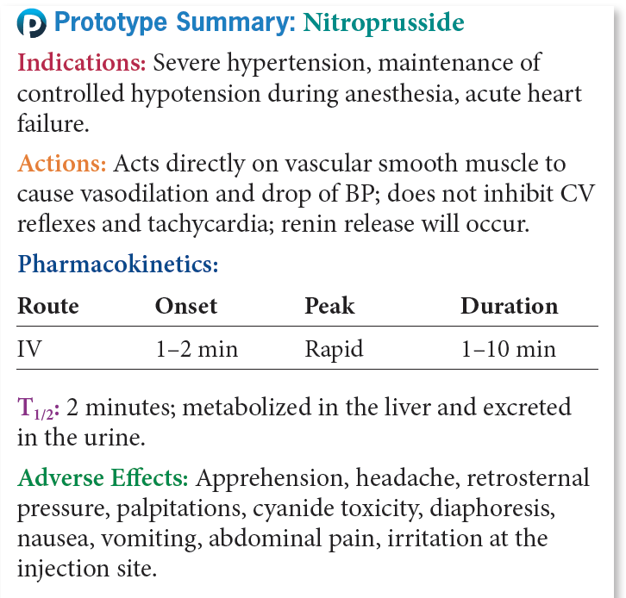
Prototype Vasodilators

Slide 39
Diuretics
Increase the excretion of sodium and water from the kidney to lower blood pressure (Figure 43.3). See Chapter 51 for a detailed discussion of these agents.
  Thiazide and thiazide-like diuretics: chlorothiazide (Diuril), hydrochlorothiazide (HydroDIURIL), methyclothiazide (generic), chlorthalidone (generic), indapamide (generic), and metolazone (Zaroxolyn)
  Potassium-sparing diuretics: amiloride (Midamor), spironolactone (Aldactone), and triamterene (Dyrenium)

Slide 40
Sympathetic Nervous System Blockers #1
Beta-blockers
  Acebutolol (Sectral)
  Atenolol (Tenormin)
  Betaxolol (generic)
  Bisoprolol (Zebeta)
  Metoprolol (Lopressor)
  Nadolol (Corgard)
  Nebivolol (Bystolic)
  Pindolol (generic)
  Propranolol (Inderal),
  Timolol (generic)

Slide 41
Sympathetic Nervous System Blockers #2
Alpha- and beta-blockers
  Carvedilol (Coreg)
  Labetalol (Trandate)

Slide 42
Sympathetic Nervous System Blockers #3
Alpha-adrenergic blockers
  Phenoxybenzamine (Dibenzyline)
  Phentolamine (Regitine)

Slide 43
Sympathetic Nervous System Blockers #4
Alpha₁-blockers
  Doxazosin (Cardura)
  Prazosin (Minipress)
  Terazosin (generic)

Slide 44
Sympathetic Nervous System Blockers #5
Alpha₂-agonists
  Clonidine (Catapres)
  Guanfacine (Tenex)
  Methyldopa (generic)

Slide 45
Antihypotensive Agents
Blood Pressure-Raising Agents
  Midodrine (generic)
Droxidopa (Northera)
Sympathetic adrenergic agonists or vasopressors
  Dobutamine (generic)
  Dopamine (generic)
  Ephedrine (generic)
  Epinephrine (Adrenalin, Adrenaclick)
  Isoproterenol (Isuprel)
  Norepinephrine (Levophed)
  Phenylephrine (generic)

Slide 46
Nursing Considerations for Patients Receiving Antihypotensive Drugs
Assess:
  History and Physical Exam
  Known allergy
  Impaired kidney or liver function, pregnancy and lactation
  CV dysfunction; visual problems; urinary retention; and pheochromocytoma
  Baseline to include, VS, skin, weight, respirations and LS, appropriate lab values

Slide 47
Question #3
The nurse is caring for a 27-year-old African American woman who was just prescribed an ACE inhibitor for management of her hypertension. What should be advised related to contraception?
  A. The use of spermicidal jellies is recommended.
  B. The mini pill is the contraception method of choice.
  C. Use barrier contraceptives to prevent pregnancy while taking these drugs.
  D. No special precautions need to be taken.

Slide 48
Answer to Question #3
  C. Use barrier contraceptives to prevent pregnancy while taking these drugs.
Rationale: The safety for the use of these drugs during pregnancy has not been established. ACE inhibitors, ARBs, and renin inhibitors should not be used during pregnancy, and women of child-bearing age should be advised to use barrier contraceptives to prevent pregnancy while taking these drugs.

