Slide 1
Chapter 49:
Drugs Used to Treat Anemias

Slide 2
Blood Components
Plasma
  The liquid part of blood; contains proteins essential for the immune response and blood clotting
Formed Elements of the Blood
  Leukocytes (WBCs): Part of the immune system
  Erythrocytes (RBCs): Carry oxygen to the tissues and remove carbon dioxide

Slide 3
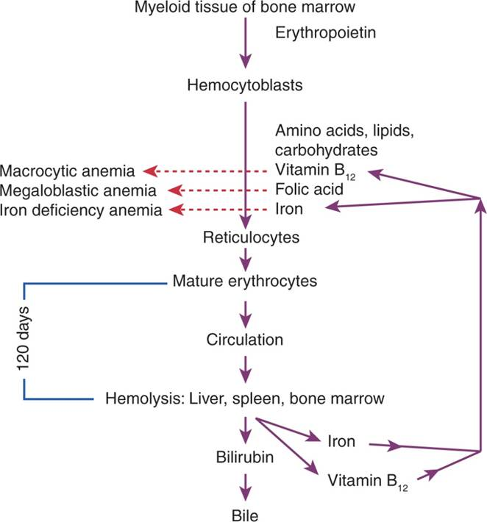
Erythropoiesis

Slide 4
Factors Essential to Producing Healthy RBCs
Adequate Amounts of Iron
  To form hemoglobin rings to carry the oxygen
Minute Amounts of Vitamin B₁₂ and Folic Acid
  To form a supporting structure that can survive being battered through blood vessels for 120 days
Essential Amino Acids and Carbohydrates
  To complete the hemoglobin rings, cell membrane, and basic structure

Slide 5
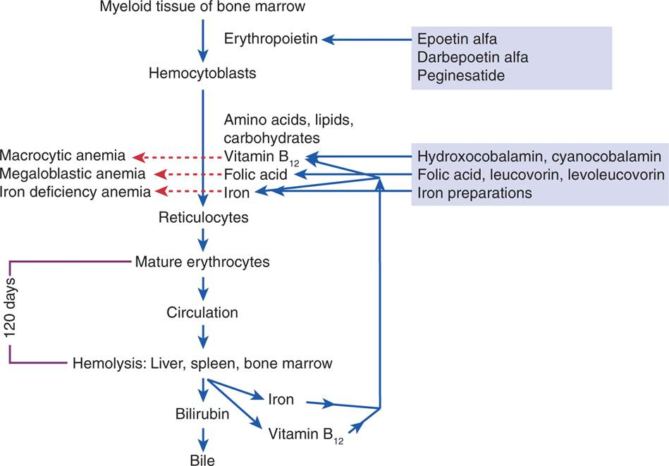
Sites of Action of Drugs Used to Treat Anemias

Slide 6
Types of Anemia
Iron Deficiency Anemia
  A negative iron balance occurs
Megaloblastic Anemia
  Folic acid deficiency
  Vitamin B12 deficiency
    Pernicious Anemia
Sick Cell Anemia
  Chronic hemolytic anemia that occurs almost exclusively in African Americans

Slide 7
Persons at Risk for Iron Deficiency Anemia
Menstruating women who lose RBCs monthly
Pregnant and nursing women who have increased demands for iron
Rapidly growing adolescents, especially those who do not have a nutritious diet
Persons with GI bleeding

Slide 8
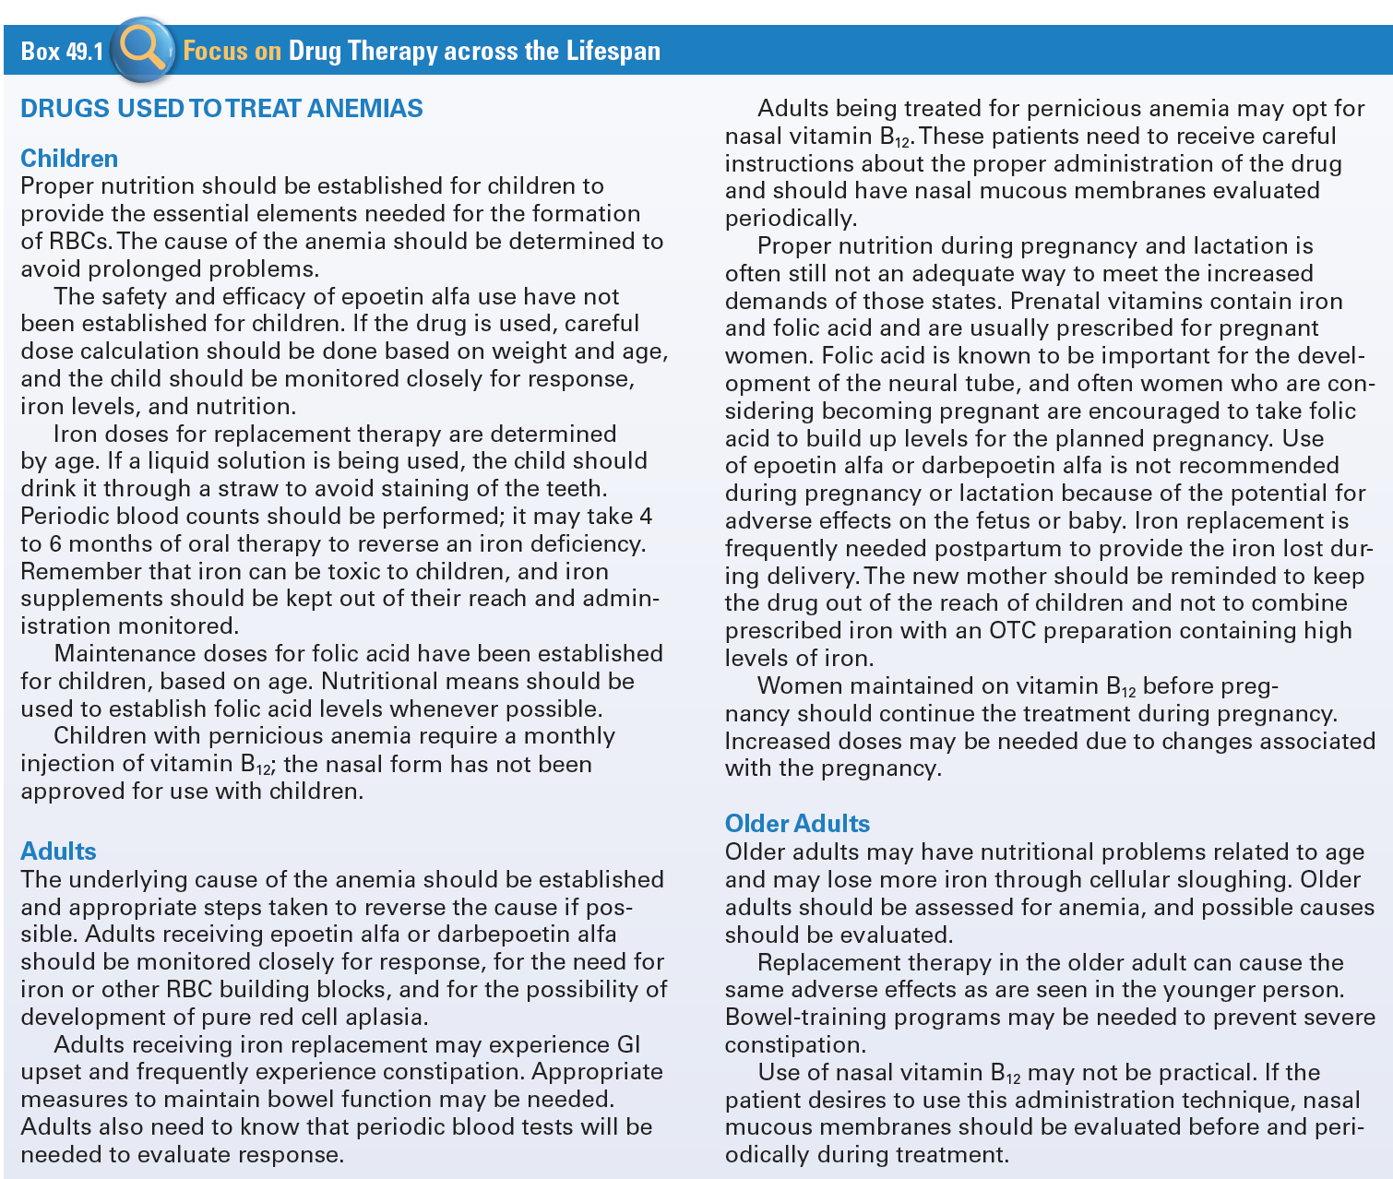
Use of Drugs Used to Treat Anemias Across the Lifespan

Slide 9
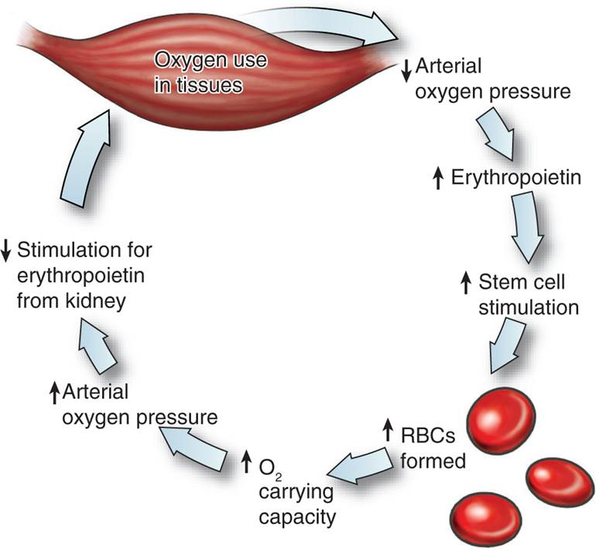
Erythropoiesis Controls the Rate of Blood Cell Production

Slide 10
Erythropoiesis-Stimulating Agents #1
Stimulate the bone marrow to make more RBC’s
  Epoetin Alfa (Epogen, Procrit)
    Treats anemia associated with renal failure and AIDS, decreases need for blood transfusions in patients undergoing surgery
  Darbopoetin Alfa (Aranesp)
    Treats anemia associated with chronic renal failure, including patients on dialysis
  Methoxy Polyethylene Glycol-Epoetin Beta (Mircera)
    Treats anemias associated with chronic renal failure, including patients receiving dialysis

Slide 11
Erythropoiesis-Stimulating Agents #2
Actions
  Acts like the natural glycoprotein erythropoietin to stimulate the production of RBC’s in the bone marrow
Indications
  Treats anemia associated with chronic renal failure to reduce the need for allogenic blood transfusions in surgical patients

Slide 12
Erythropoiesis-Stimulating Agents #3
Pharmacokinetics
  Metabolized through the normal kinetic process
Contraindications
  Uncontrolled hypertension
  Allergy to mammalian cell-derived
  Allergy to human albumin
  Lactation

Slide 13
Erythropoiesis-Stimulating Agents #4
Adverse Effects
  CNS – Headache, fatigue, asthenia, dizziness, and seizure
  Nausea, vomiting, and diarrhea
  CV – Hypertension, edema, possible chest pain
Drug-Drug Interactions
  Should not be mixed in solution with other drugs

Slide 14
Nursing Considerations for Erythropoiesis-Stimulating Agents
Assess:
  History and Physical Exam and known allergies
  Severe hypertension, pregnancy, anemia and abnormal renal function
  Patients with cancer receiving the drugs to increase hematocrit after antineoplastic chemotherapy
  Neurological and CV status, respirations
  Appropriate lab values

Slide 15
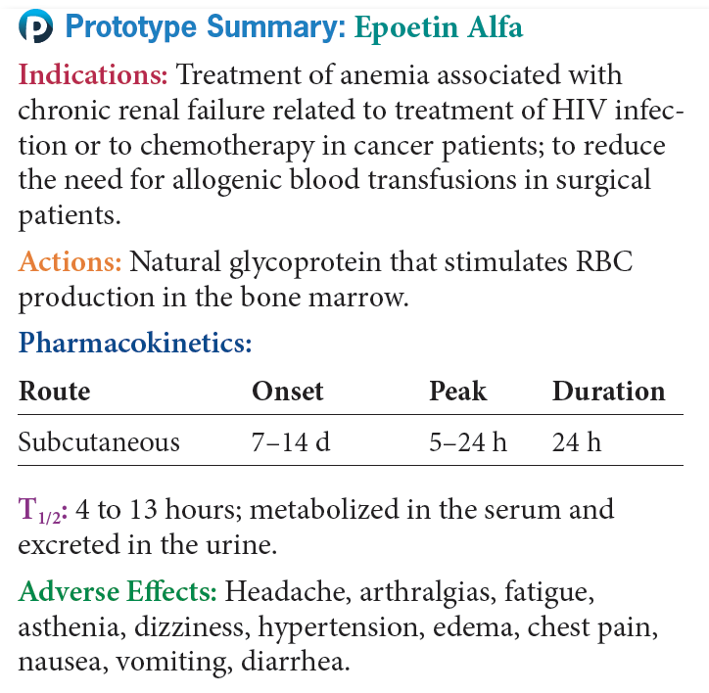
Prototype Erythropoietins

Slide 16
Agents Used for Iron Deficiency Anemia #1
Ferrous Asparate (FE Aspartate)
Ferrous Fumarate (Feostat)
Ferrous Gluconate (Fergon)
Ferrous Sulfate (Feosol)
Ferrous Sulfate Exsiccated (Feratab, Slow FE)
Ferumoxytol (Feraheme)
Iron Dextran (InFeD)
Iron Sucrose (Venofer)
Sodium Ferric Gluconate Complex (Ferrlecit)

Slide 17
Agents Used for Iron Deficiency Anemia #2
Actions- Elevate the serum iron concentration
Indications-
  Treatment of iron deficiency anemias and may also be used as adjunctive therapy in patients receiving Epoetin Alfa
Pharmacokinetics
  Absorbed in the small intestines
  Transported in the blood bound to transferrin
  Small amounts are lost daily in the sweat, urine, sloughing of skin and mucosal cell, and sloughing of intestinal cells

Slide 18
Agents Used for Iron Deficiency Anemia #3
Contraindications
  Allergy
  Hemochromatosis
  Hemolytic anemia
  Normal iron balance
  Peptic ulcer, colitis, or regional enteritis

Slide 19
Agents Used for Iron Deficiency Anemia #4
Adverse Effects
  Oral - GI irritation and CNS toxicity
  Parental iron is associated with severe anaphylactic reactions, local irritation, staining of the tissues, and phlebitis
Drug-Drug Interactions
  Antacids, tetracycline, cimetidine
  Ciprofloxacin, norfloxacin, or ofloxacin
  Chloramphenicol

Slide 20
Agents Used for Iron Deficiency Anemia #5
Food Interactions
  Eggs
  Milk
  Coffee
  Tea
  Acidic liquids

Slide 21
Nursing Considerations for Iron Preparations
Assess:
  History and Physical Exam and known allergy
  Colitis, enteritis, or peptic ulcer, hemolytic anemias
  Skin, neurological status, VS and CV function and BS
  Appropriate lab values

Slide 22
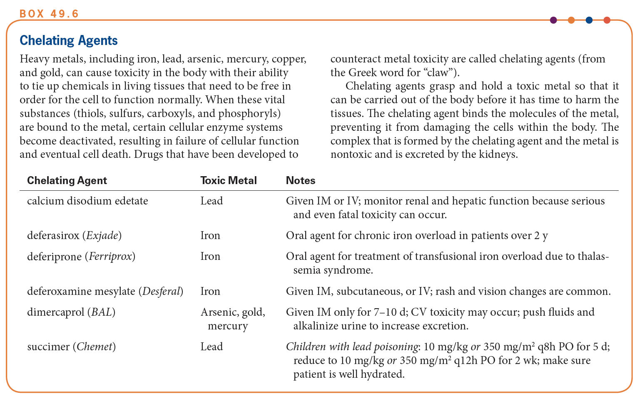
Chelating Agents #1

Slide 23
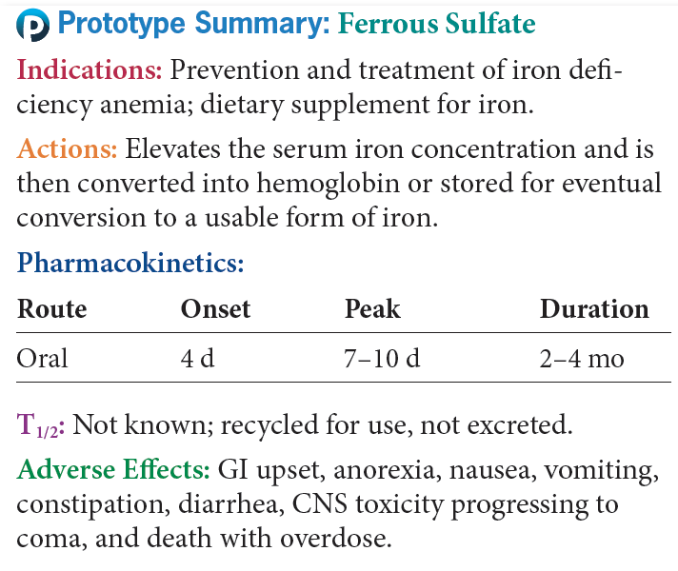
Prototype Iron Preparations

Slide 24
Question #1
Please answer the following statement as true or false.
Megaloblastic anemia occurs when there is insufficient folic acid or vitamin B₁₂ to support the stromal structure of the RBC.

Slide 25
Answer to Question #1
True
Rationale: Megaloblastic anemia equals insufficient folic acid or vitamin B₁₂ to create the stromal structure needed in a healthy RBC.

Slide 26
Question #2
A 4-year-old is brought to the emergency room. The child is in shock. The mother states she found the child eating her iron-fortified vitamin pills about 2½ hours ago. The mother estimates the child ate close to 200 tablets. What medication would you expect the physician to order for the treatment iron toxicity?
A. Deferoxamine mesylate
B. Methoxy polyethylene glycol-epoetin beta
C. Sodium ferric gluconate complex
D. Levoleucovorin

Slide 27
Answer to Question #2
a. Deferoxamine mesylate
Rationale: Supportive measures to deal with shock, dehydration, and gastrointestinal damage will be necessary. In addition, an iron-chelating agent such as deferoxamine mesylate may be tried.

Slide 28
Causes of Folate and Vitamin B₁₂ Deficiencies
Folate Deficiencies
  Secondary to increased demand
  Absorption problems in the small intestine
  Drugs that cause folate deficiencies
  Secondary to the malnutrition of alcoholism
Vitamin B₁₂ Deficiencies
  Poor diet or increased demand
  Lack of intrinsic factor in the stomach

Slide 29
Agents for
Megaloblastic Anemias #1
Folic Acid
  Folic acid (generic)
  Leucovorin (generic)
  Levoleucovorin (Fusilev), IV
B12
  Hydroxocobalamin (generic), injectable drug
  Cyanocobalamin (Nascobal), nasal spray

Slide 30
Agents for
Megaloblastic Anemias #2
Actions
  Essential for cell growth and division for the production of a strong stroma in RBCs
  B₁₂ is also necessary for the maintenance of the myeline sheath in nerve tissues
Indications
  Replacement therapy for dietary deficiencies, pregnancy
  Folic acid is used as a rescue drug for cells exposed to some toxic chemotherapeutic agent

Slide 31
Agents for
Megaloblastic Anemias #3
Pharmacokinetics
  Well absorbed after injection, metabolized in the liver, and excreted in the urine
Contraindications
  Allergy
Caution
  Pregnancy or lactation
  Patients with other anemias

Slide 32
Agents for
Megaloblastic Anemias #4
Adverse Effects
  Pain and discomfort at the injection site
Nasal irritation with intranasal spray
Drug-drug interactions
  Relatively few since they are essential

Slide 33
Nursing Considerations for Agents for
Megaloblastic Anemias
Assess:
  History and Physical Exam and known allergy
  Pregnancy, lactation, and nasal erosion
  Affect, orientation, and reflexes; pulse, blood pressure, and perfusion; respirations and adventitious sounds; and complete blood count, hematocrit, and iron levels

Slide 34
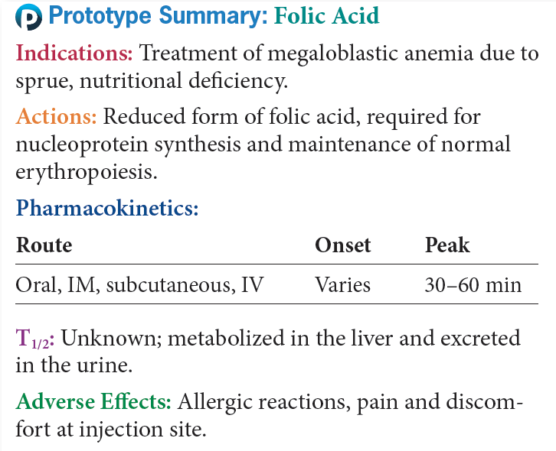
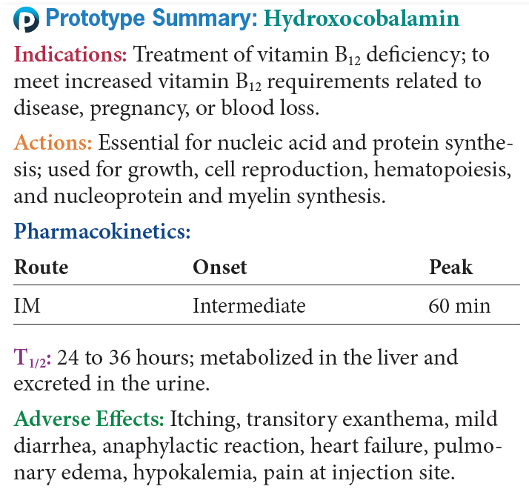
Prototype Agents for
Megaloblastic Anemias

Slide 35
Question #3
Please answer the following statement as true or false.
The only iron preparation designated for only parenteral use is ferrous sulfate exsiccated.

Slide 36
Answer to Question #3
False
Rationale: Ferrous fumarate, ferrous gluconate, ferrous sulfate, and ferrous sulfate exsiccated are available for oral administration. Iron dextran is a parenteral form of iron given by Z-track method that may be used if an oral form cannot be given or cannot be tolerated.

Slide 37
Agents for Sickle Cell Anemia #1
Hydroxyurea (Droxia)
Actions and Indications
  Increases amount of fetal hemoglobin produced in bone marrow
  Dilutes formation of the abnormal hemoglobin S

Slide 38
Agents for Sickle Cell Anemia #2
Pharmacokinetics
  Well absorbed from GI tract
  Metabolized in liver
  Excreted in urine
  Known to cross placenta and enter into breast milk

Slide 39
Agents for Sickle Cell Anemia #3
Contraindications
  Known allergy
  Severe anemia or leukopenia
Caution
  Impaired liver or renal function
  Pregnancy and lactation

Slide 40
Agents for Sickle Cell Anemia #4
Adverse Effects
  GI, headache, dizziness, disorientation, fever, chills, and malaise, increased cancer risk
Drug-Drug Interactions
  Uricosuric agents

Slide 41
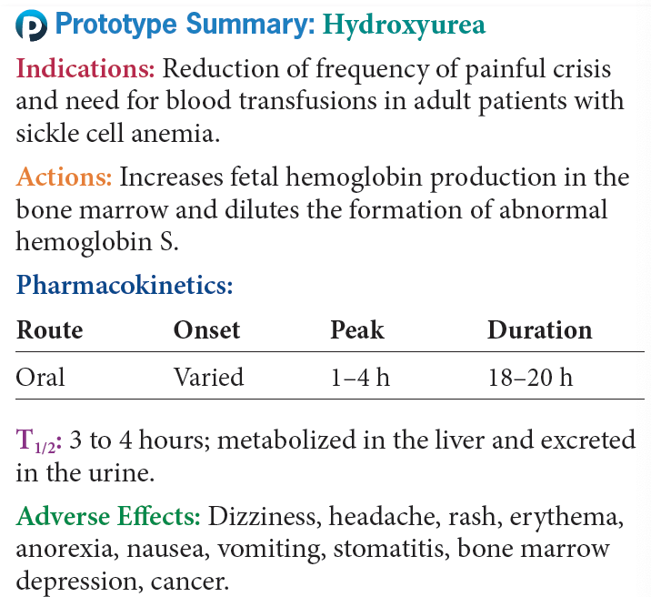
Prototype Agents for Sickle Cell Anemia

