Slide 1
Chapter 55:
Drugs Acting on the Lower Respiratory Tract

Slide 2
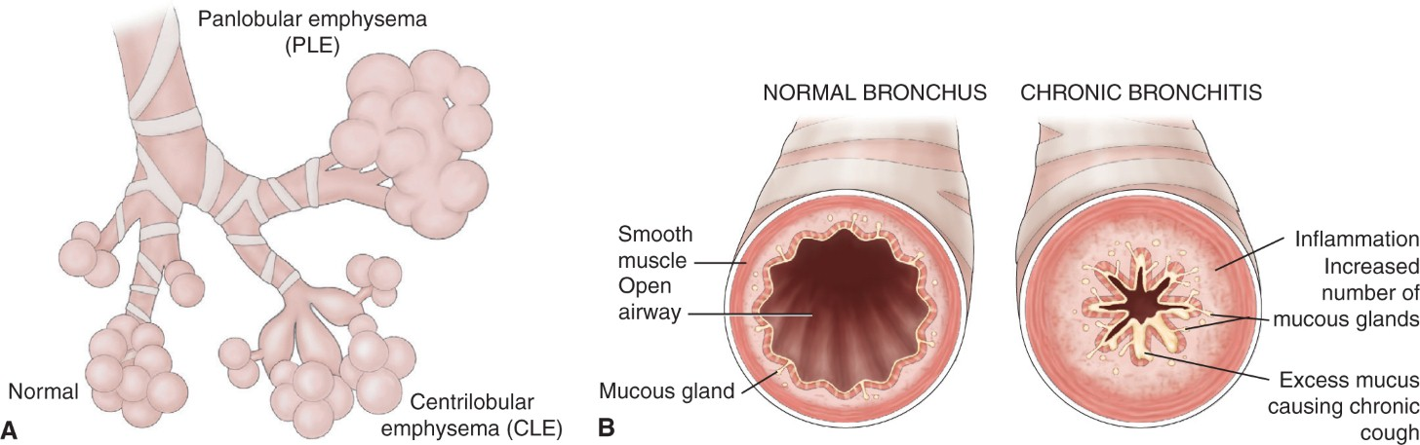
Changes in the Airway With COPD

Slide 3
Manifestations of COPD
Air is trapped in the lower respiratory tract
The alveoli degenerate and fuse together
The exchange of gases is greatly impaired

Slide 4
Prevention and Treatment for COPD
Reduce environmental exposure to irritants
Smoking cessation
Filter allergens from the air
Avoid exposure to known irritants and allergens
Open the conducting airways through muscular bronchodilation
Decrease the effects of inflammation on the airway lining

Slide 5
Adult Respiratory Distress Syndrome (ARDS)
Characteristics
  Progressive loss of lung compliance and increasing hypoxia
Causes
  Cardiovascular collapse; major burns; severe trauma; rapid depressurization
Treatment
  Reversal of the underlying cause combined with ventilatory support

Slide 6
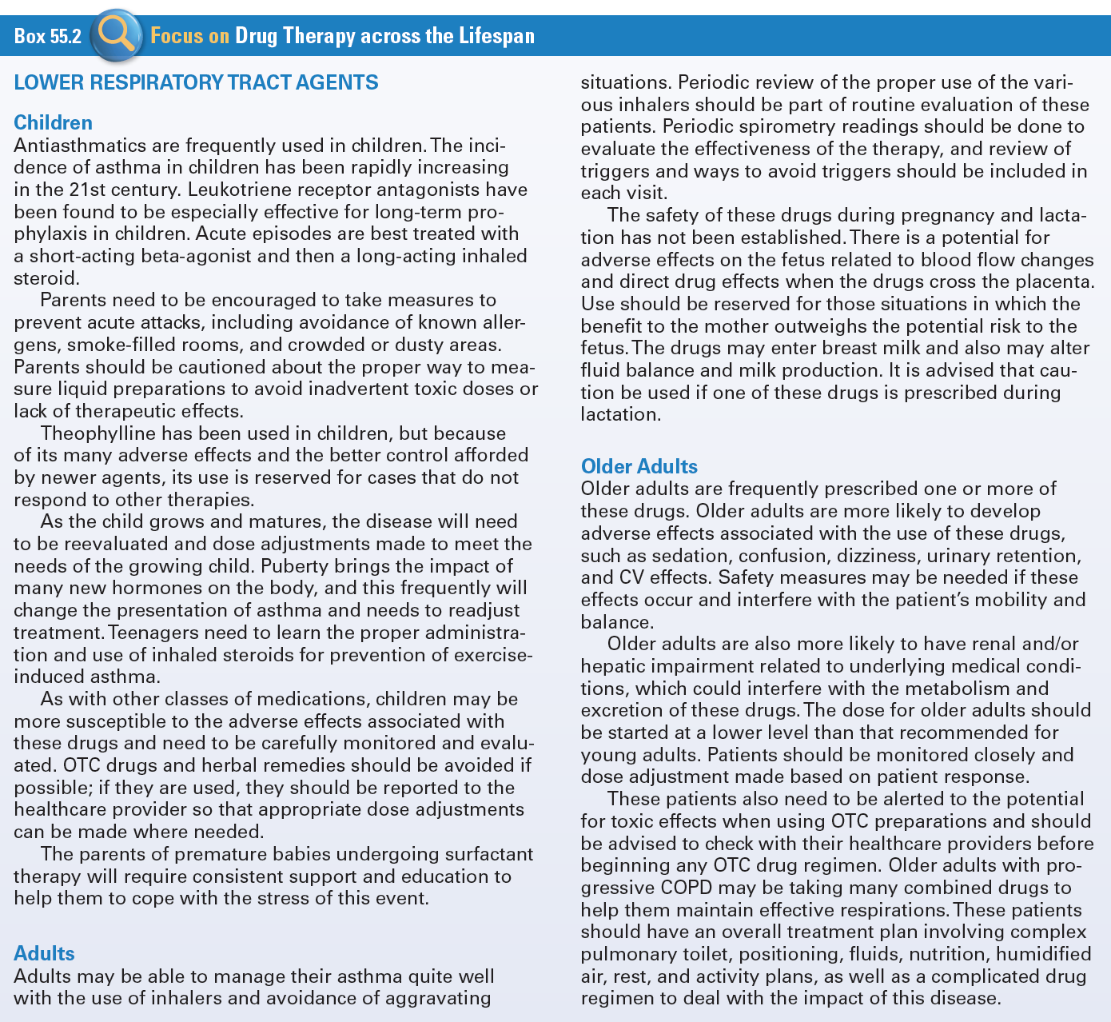
Use of Lower Respiratory Tract Agents Across the Lifespan

Slide 7
Bronchodilators/Antiasthmatics
Used to facilitate respiration by dilating the airways
Xanthines
Sympathomimetics
Anticholinergics

Slide 8
Xanthines #1
Caffeine (Caffedrine, and others)
Theophylline (generic)

Slide 9
Xanthines #2
Actions
  Direct effect on the smooth muscles of the respiratory tract, both in the bronchi and in the blood vessels
Indications
  Symptomatic relief or prevention of bronchial asthma and for reversal of bronchospasm associated with COPD
Pharmacokinetics
  Narrow therapeutic margin
  Rapidly absorbed for the GI tract
  Metabolized in the liver and excreted in the urine

Slide 10
Xanthines #3
Contraindications
  GI problems, coronary disease, respiratory dysfunction, renal or hepatic disease, alcoholism, or hyperthyroidism
Adverse Effects
  Related to theophylline levels in the blood
  GI upset, nausea, irritability, and tachycardia to seizure, brain damage, and even death
Drug-Drug Interactions
  Many drugs interact with xanthines
  Substances in cigarettes

Slide 11
Nursing Considerations for Xanthines
Assess:
  History and Physical Exam and known allergy
  Peptic ulcer, gastritis, renal or hepatic dysfunction, and coronary disease
  Monitor blood pressure, pulse, cardiac auscultation, peripheral perfusion, and baseline electrocardiogram
  Skin, BS, liver and renal function, appropriate lab values, as well as theophylline levels

Slide 12
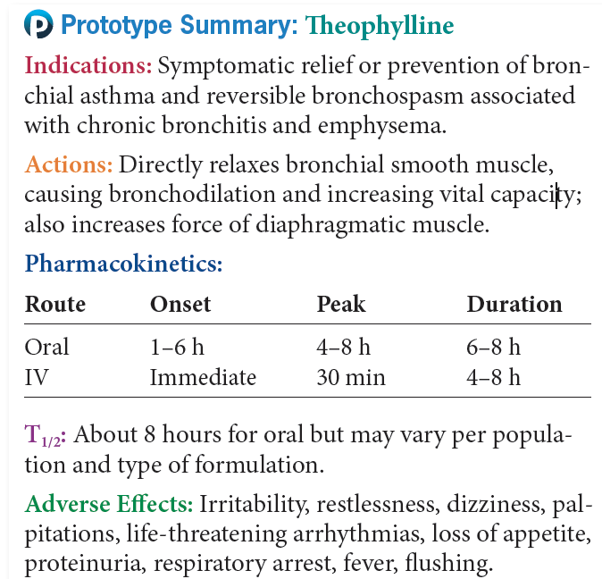
Prototype Xanthines

Slide 13
Sympathomimetics #1
Mimic effects of the sympathetic nervous system: dilation of bronchi with increased rate and depth of respiration
  Albuterol (Proventil HFA, and others)
  Arformoterol (Brovana)
  Ephedrine (generic)
  Epinephrine (EpiPen)
  Formoterol (Foradil)
  Indacaterol (Arcapta)
  Isoproterenol (Isuprel and others)
  Levalbuterol (Xopenex HFA)
  Metaproterenol (generic)
  Olodaterol (Striverdi)
  Salmeterol (Serevent)
  Terbutaline (generic)

Slide 14
Sympathomimetics #2
Actions
  Beta₂ selective adrenergic agonists
Indications
  Acute asthma attach
  Bronchospasm in acute or chronic asthma
  Prevention of exercise-induced asthma
Pharmacokinetics
  Rapidly distributed after injection, transformed in the liver to metabolites that are excreted in the urine
Contraindications
  Depends on the severity of the underlying condition

Slide 15
Sympathomimetics #3
Adverse Effects
  Sympathomimetic stimulation
  CNS stimulation
  GI upset, cardiac arrhythmias, hypertension, bronchospasm, sweating, pallor, and flushing
Drug-Drug Interactions
  General anesthetics

Slide 16
Nursing Considerations for Sympathomimetics
Assess:
  History and Physical Exam and known allergy
  Cigarette use, pregnancy and lactation
  Cardiac disease, vascular disease, arrhythmias, diabetes, and hyperthyroidism
  Reflexes and orientation, VS, reflexes and orientation and appropriate lab values

Slide 17
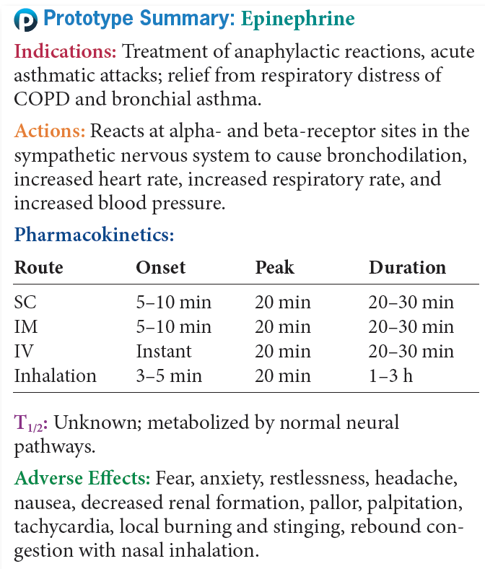
Prototype Sympathomimetics

Slide 18
Question #1
Please answer the following question as true or false.
The adverse effects of the Xanthines are related to theophylline levels in the blood and include brain damage.

Slide 19
Answer to Question #1
True
Rationale: Adverse Effects: Related to theophylline levels in the blood; GI upset, nausea, irritability, and tachycardia to seizure, brain damage, and even death.

Slide 20
Anticholinergics #1
Patients who cannot tolerate the sympathetic effects of the sympathomimetic might respond to the anticholinergic drugs
  Ipratropium (Atrovent)
  Tiotropium (Spiriva)
  Aclidinium (Tudorza Pressair)
  Umeclidinium (Incruse Ellipta)

Slide 21
Anticholinergics #2
Actions
  Anticholinergic that blocks vagally mediated reflexes by antagonizing the action of acetylcholine
Indications
  Maintenance treatment of bronchospasm associated with COPD
Pharmacokinetics
  Onset of action is 15 minutes when inhaled
  Peaks in 1-2 hours, duration of action is 3-4 hours

Slide 22
Anticholinergics #3
Caution
  Any condition that would be aggravated by the anticholinergic effects of the drug
Adverse Effects
  Related to the anticholinergic effects of the drug
  Dizziness, headache, fatigue, nervousness, dry mouth, sore throat, palpitations, and urinary retention
Drug-Drug Interactions
  Other anticholinergics

Slide 23
Nursing Considerations for Anticholinergics
Assess:
  History and Physical Exam and known allergy
  Acute bronchospasm, bladder neck obstruction or prostatic hypertrophy, orientation, affect, and reflexes
  Pulse and B/P, respirations and adventitious sounds and urinary output

Slide 24
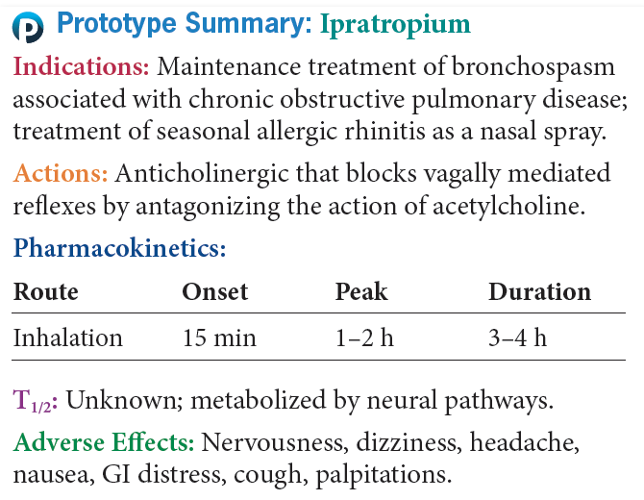
Prototype Anticholinergics

Slide 25
Inhaled Steroids #1
Very effective treatment for bronchospasm
  Beclomethasone (Beconase AQ)
  Budesonide (Pulmicort Respules, Pulmicort Flexhaler)
  Ciclesonide (Alvesco)
  Fluticasone (FloventDiscus, Flovent HFA)
  Triamcinolone (generic)

Slide 26
Inhaled Steroids #2
Actions
  Decrease the inflammatory response in the airway
  Indications
  Prevention and treatment of asthma
  Treat chronic steroid-dependent bronchial asthma
Pharmacokinetics
  Well absorbed from the respiratory tract
  Metabolized by natural systems, mostly within the liver, excreted in the urine

Slide 27
Inhaled Steroids #3
Contraindications
  Not used for emergency during an acute attack or status asthmaticus
  Pregnancy or lactation
Adverse Effects
  Sore throat
  Hoarseness
  Coughing
  Dry mouth
  Pharyngeal and laryngeal fungal infections

Slide 28
Nursing Considerations for Inhaled Steroids
Assess:
  History and Physical Exam and known allergy
  Systemic infections, pregnancy and lactation
  VS, respirations, adventitious sounds, nares

Slide 29
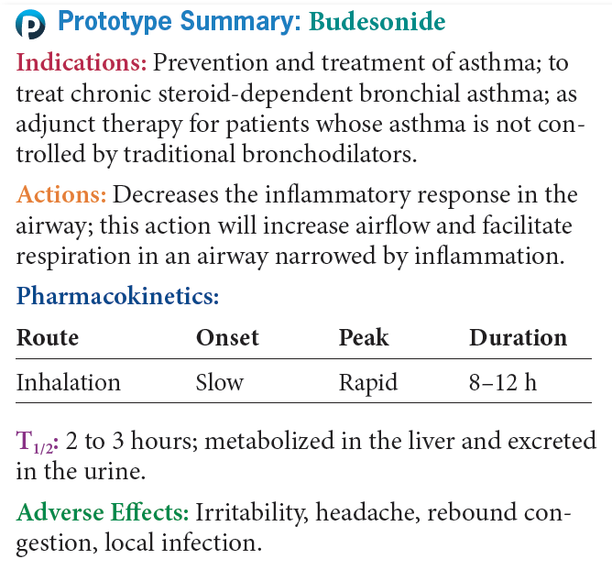
Prototype Inhaled Steroids

Slide 30
Leukotriene Receptor Antagonists #1
Act more specifically at the site of the problem associated with asthma
  Zafirlukast (Accolate)
  Montelukast (Singulair)
  Zileuton (Zyflo)

Slide 31
Leukotriene Receptor Antagonists #2
Actions
  Selectively and competitively block or antagonize receptors for the production of leukotrienes
Indications
  Prophylaxis and chronic treatment of bronchial asthma in adults and in patients younger than 12 years of age
Pharmacokinetics
  Rapidly absorbed from GI tract, extensively metabolized in the liver and primarily excreted in feces
Caution
  Hepatic or renal impairment
  Pregnancy and lactation

Slide 32
Leukotriene Receptor Antagonists #3
Adverse Effects
  Headache, dizziness, myalgia, nausea, diarrhea and abdominal pain, elevated liver enzyme concentrations, vomiting, and generalized pain
Drug-Drug Interactions
  Propranolol, theophylline, terfenadine, or warfarin
  Calcium channel blockers, cyclosporine, or aspirin

Slide 33
Nursing Considerations for Leukotriene Receptor Antagonists
Assess:
  History and Physical Exam and known allergy
  Acute bronchospasm or asthmatic attack
  Impaired renal or hepatic function
  Temperature, orientation and affect

Slide 34
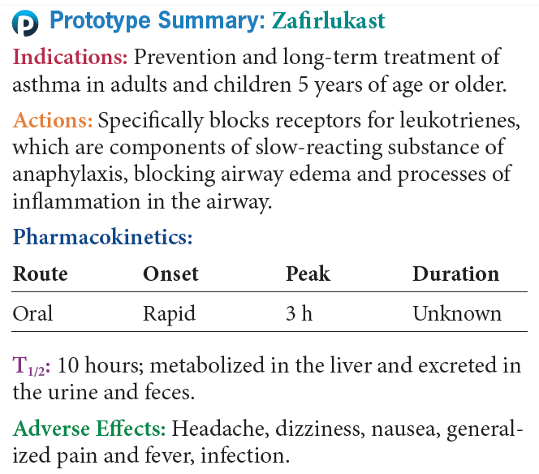
Prototype Leukotriene Receptor Antagonists

Slide 35
Mast Cell Stabilizers
Actions-
  Works at the cellular level to inhibit the release of histamine and inhibits the release of SRSA
Indications-Treatment of chronic bronchial asthma
  Exercise induced asthma
  Allergic rhinitis
  It is no longer considered part of the treatment standards because of the availability of more specific and safe
  Cromolyn (NasalCrom)

Slide 36
Lung Surfactants #1
Naturally occurring compounds or lipoproteins containing lipids and apoproteins that reduce the surface tension within the alveoli, allowing expansion of the alveoli for gas exchange
  Beractant (Survanta)
  Calfactant (Infasurf)
  Lucinactant (Surfaxin)
  Poractant (Curosurf)

Slide 37
Lung Surfactants #2
Actions
  Replace the surfactant that is missing in the lungs of neonates with RDS
Indications
  Rescue treatment of infants who have developed RDS
Pharmacokinetics
  Begin to act immediately on instillation into the trachea
  Metabolized in the lungs

Slide 38
Lung Surfactants #3
Contraindications -Emergency drug; no contraindication
Adverse Effects
  Patent ductus arteriosus
  Hypotension
  Intraventricular hemorrhage
  Pneumothorax
  Pulmonary air leak
  Hyperbilrubinemia
  Sepsis

Slide 39
Nursing Considerations for Lung Surfactants
Assess:
  History and Physical Exam and known allergy
  Time of birth and exact weight
  Temperature, Respirations, adventitious sounds, endotracheal tube placement and patency, and chest movements
  Blood pressure, pulse, and arterial pressure
  Blood gases and oxygen saturation

Slide 40
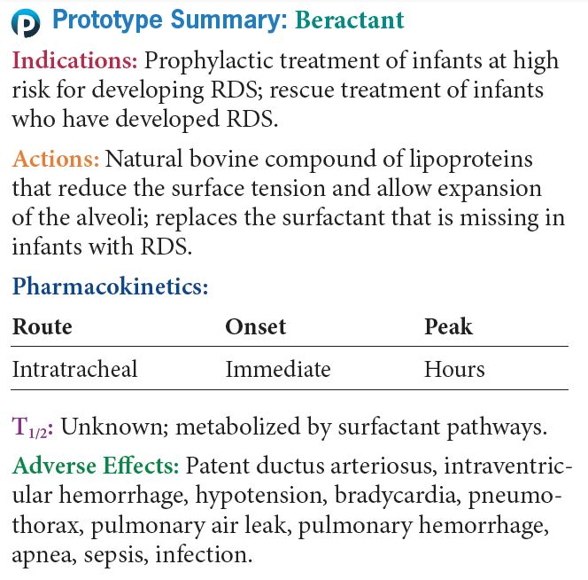
Prototype Lung Surfactants

Slide 41
Question #2
Which of the following is a contraindication to using lung surfactants?
A. Prematurity
B. Older adult
C. No contraindications
D. COPD

Slide 42
Answer to Question #2
C. No contraindications
Rationale: Because lung surfactants are used as emergency drugs in the newborn, there are no contraindications.

Slide 43
Question #3
The nurse is caring for a patient taking Budesonide. What would be an appropriate nursing diagnosis for this patient?
A. Risk for injury related to immunosuppression
B. Risk for injury related to CNS effects
C. Risk for injury related to CVS effects
D. Risk for injury related to age and risk of infection

Slide 44
Answer to Question #3
A. Risk for injury related to immunosuppression
Rationale: Nursing diagnoses related to drug therapy might include: risk for injury related to immunosuppression; acute pain related to local effects of the drug; deficient knowledge regarding drug therapy.

