Slide 1
Chapter 5 Therapeutic Relationships

Slide 2
Therapeutic Relationship
One of the most important skills a nurse can develop
Crucial to success of interventions with clients requiring psychiatric care

Slide 3
Components of Therapeutic Relationship #1
Trust
Behaviors such as caring, interest, understanding, consistency, honesty, keeping promises, and listening (see Box 5.1)
Congruence
Genuine interest
Self-comfort, self-awareness of strengths and limitations, clear focus
Client can detect dishonest behavior.

Slide 4
Components of Therapeutic Relationship #2
Empathy
Ability to perceive client’s meanings and feelings, to communicate that understanding
Client and nurse giving “gift of self”
Different from sympathy (feelings of concern or compassion; may project nurse’s personal feelings)
Acceptance (no judgments; set boundaries)
Positive regard (unconditional, nonjudgmental attitude)

Slide 5
Self-Awareness
Know self
Values (sense of right and wrong, code of conduct for living)
Values clarification process
Choosing
Prizing
Acting
Beliefs
Attitudes
Cultural awareness (see Box 5.2)

Slide 6
Question #1
Is the following statement true or false?
A nurse displays empathy by showing feelings of concern and compassion.

Slide 7
Answer to Question #1
False
Rationale: Empathy is perceiving the client’s meanings and feelings and communicating that understanding to the client.
Sympathy is showing feelings of concern and compassion.

Slide 8
Therapeutic Use of Self #1
Use of aspects of personality, experience, values, feelings, intelligence, needs, coping skills, perceptions to establish relationships with clients
Concept developed by H. Peplau
Personal actions arise from conscious and unconscious responses

Slide 9
Therapeutic Use of Self #2
Johari window: tool to learn about oneself
Four quadrants: open/public self; blind/unaware self; hidden/private self; unknown
Goal: move qualities from quadrants 2, 3, and 4 into quadrant 1

Slide 10
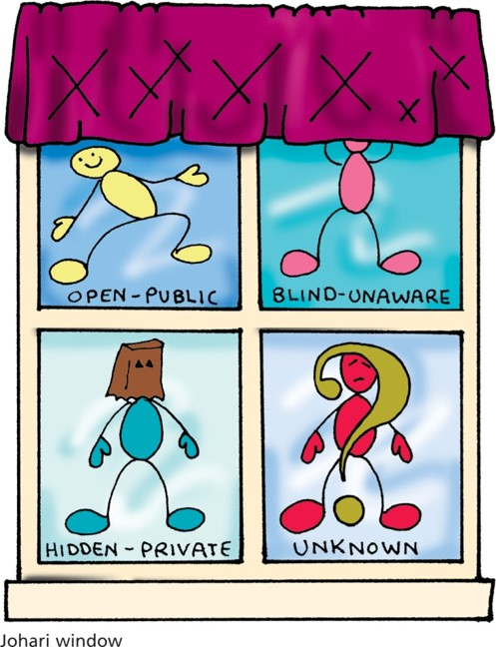
Therapeutic Use of Self #3

Slide 11
Patterns of Knowing
Preconceptions
Ways of observing, understanding client interactions
Four patterns of knowing (Carper, 1978; see Table 5.1)
Empirical (derived from nursing science)
Personal (from life experiences)
Ethical (from moral nursing knowledge)
Aesthetic (from art of nursing)
Fifth pattern: unknowing (Munhall, 1993)
Nurse admits lack of knowledge of client or client’s subjective world.

Slide 12
Types of Relationships #1
Social
Purpose: friendship, socialization, companionship, or task accomplishment
Sharing ideas; shifting roles; outcomes rarely assessed
Intimate
Emotional commitment of two persons
Individual needs met; assistance with helping each other meet needs.

Slide 13
Types of Relationships #2
Therapeutic
Focus on needs, experiences, feelings, ideas of client only
Nurse’s use of communication skills, personal strengths, understanding of human behavior
Joint agreement on areas to work on; outcome evaluation
Nurse’s level of self-awareness can benefit or hinder the relationship.

Slide 14
Question #2
Is the following statement true or false?
A social relationship usually involves communication for the purposes of friendship or task accomplishment.

Slide 15
Answer to Question #2
True
Rationale: A social relationship occurs for friendship, socialization, companionship, or task achievement. It involves communication that may be superficial and shifting roles.

Slide 16
Establishing a Therapeutic Relationship
Peplau’s model of three phases (see Table 5.2)
Orientation
Working
Identification
Exploitation
Termination
Overlapping, interlocking of phases

Slide 17
Establishing a Therapeutic Relationship: Orientation Phase
Meeting nurse, client
Establishment of roles
Discussion of purposes, parameters of future meetings
Identification of client’s problems
Clarification of expectations
Nurse–client contracts, confidentiality, self-disclosure

Slide 18
Establishing a Therapeutic Relationship: Working Phase
Problem identification
Client identifies issues or concerns.
Exploitation
Examination of feelings and responses
Development of better coping skills, more positive self-image, behavioral change, independence
Possible transference/countertransference

Slide 19
Establishing a Therapeutic Relationship: Termination Phase
Begins when client’s problems are resolved
Ends when relationship is ended
Client may feel termination as impending loss.
Clients often try to avoid termination.

Slide 20
Avoiding Behaviors That Diminish Therapeutic Relationships
Inappropriate boundaries (relationship becomes social or intimate)
One of the biggest risks is nurse’s belief they will not do anything nontherapeutic.
Feelings of sympathy, encouraging client dependency
Nonacceptance and avoidance
Warning signs of abuse of the nurse–client relationship (see Box 5.3)

Slide 21
Question #3
During the working phase of a nurse–client relationship, which action would occur?
A. Expectations are clarified.
B. Nurse–client contracts are established.
C. Feelings of loss are addressed.
D. Client’s feelings are examined.

Slide 22
Answer to Question #3
D. Client’s feelings are examined.
Rationale: During the working phase, the client identifies issues or concerns and examines feelings and responses.
Expectations are clarified and contracts are established during the orientation phase. Feelings of loss are addressed during the termination phase.

Slide 23
Therapeutic Roles of the Nurse in a Relationship
Teacher (coping, problem-solving, medication regimen, community resources)
Caregiver (therapeutic relationship, physical care)
Advocate (ensuring privacy and dignity, informed consent, access to services, safety from abuse and exploitation)
Parent surrogate
Must ensure relationship remains therapeutic (see Box 5.4)

Slide 24
Self-Awareness Issues
Nurse’s self-awareness: crucial to developing therapeutic relationships
Compassion fatigue
Helpful activities: values clarification, journaling, group discussions, reading

